Slide 1
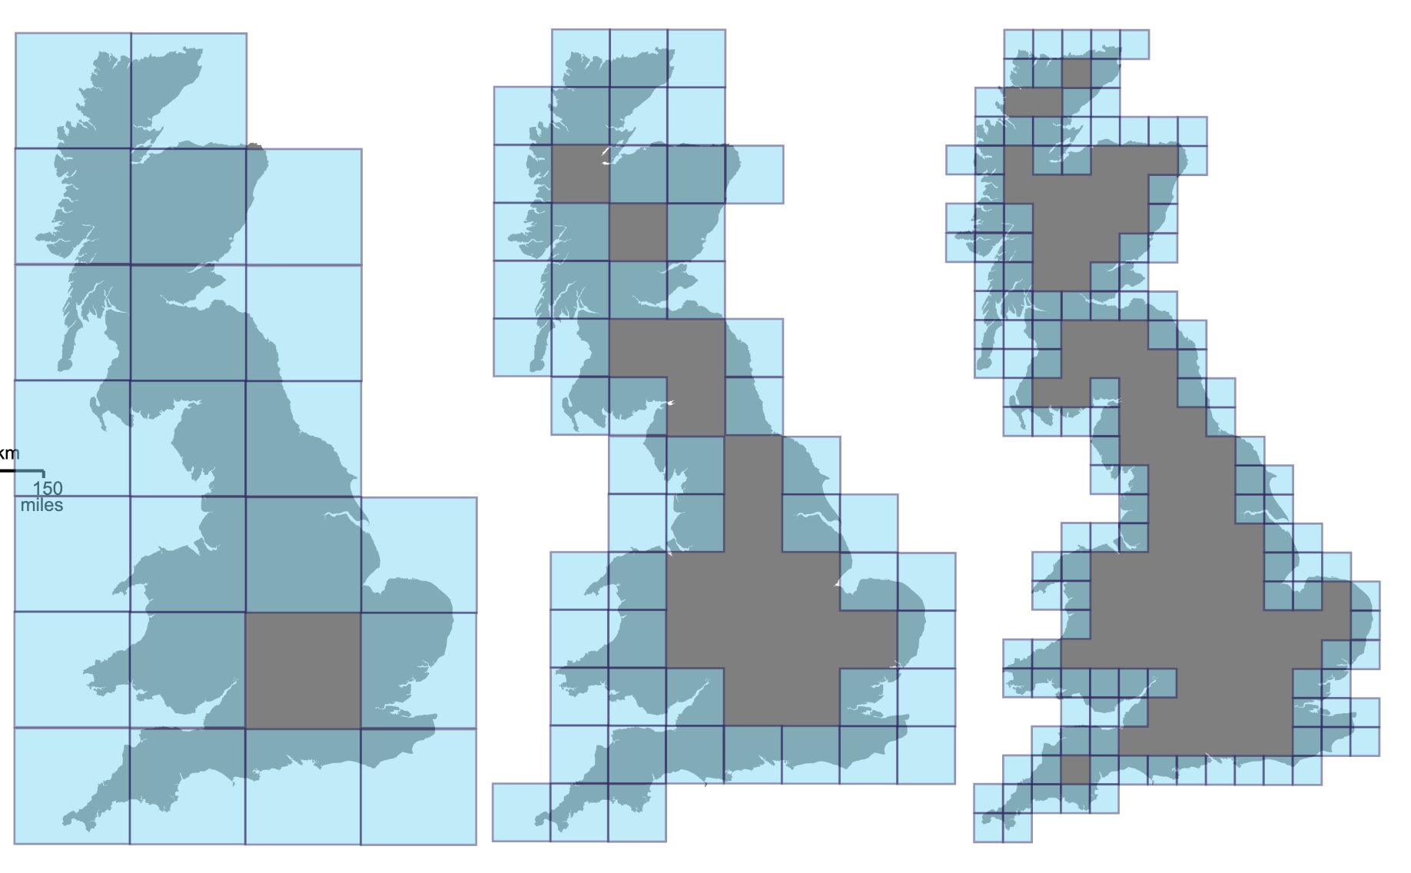
Measuring a Coastline
The Minkowski–Bouligand dimension
aka the Box Dimension
Isabella Star

Slide 2
Box Dimension of a Coastline
What and why am I measuring?
Coastlines are random geometry fractals
There’s no real math to it -> approximation!
What makes a coastline complex?
log(N) = Dlog(S) + log(C)
N = number of boxes
D = fractal dimension
S = scale factor
C = proportionality constant
How am I measuring?
Each iteration gives me N
S is the scales, i.e the boxes getting smaller
2^{i} as i approaches ∞
Scale of 0 -> 2 -> 4 -> 8 and so on
Notes:
fractal dimensions. These numbers attempt to quantify how densely the fractal occupies the space in which it lies.
the fractal dimension of a coastline is constant
The fractal dimension is used to quantify this roughness and complexity - the higher the dimension, the higher the roughness, the higher the complexity

Slide 3
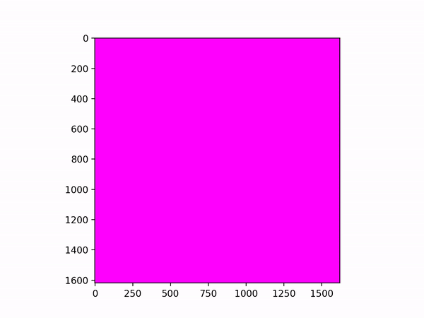
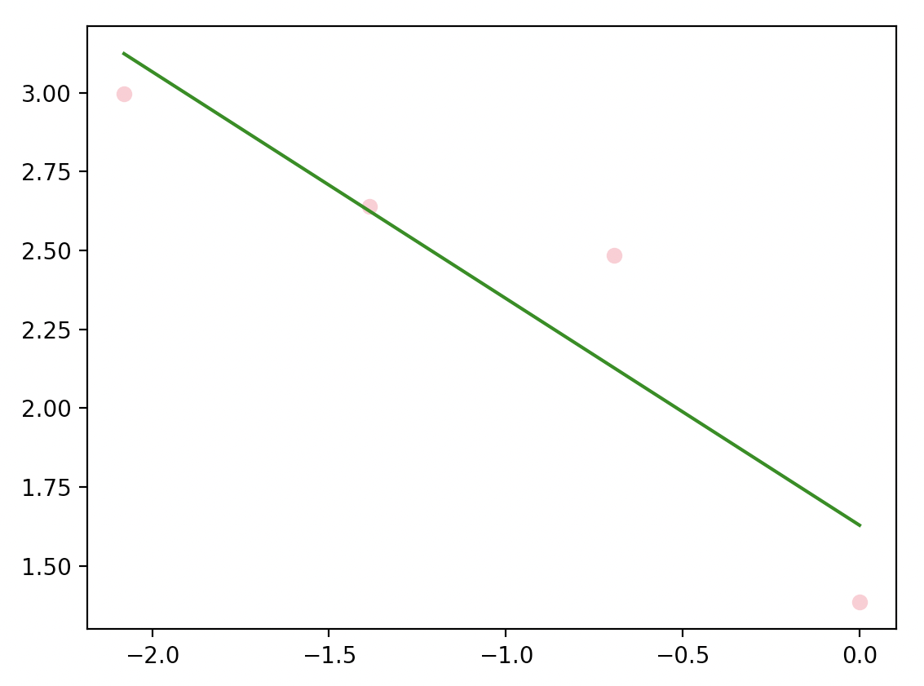
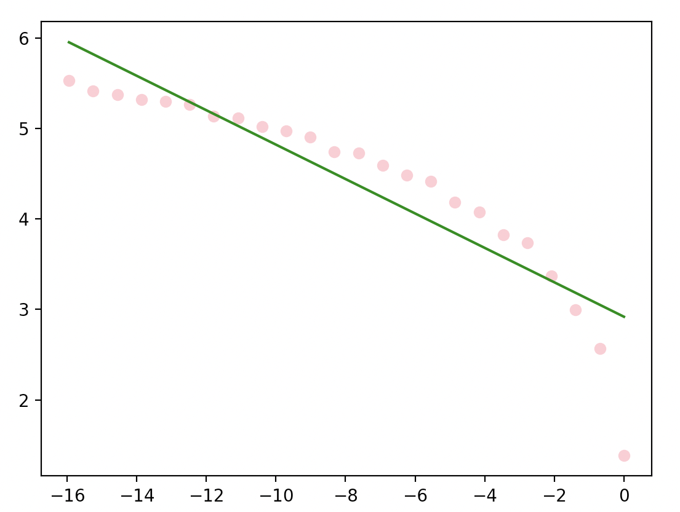
Animation + Figure
Circle
Ireland
log(S) v. log(N)
log(N) = Dlog(1/S) + log(C)
N = number of boxes
D = fractal dimension
S = scale factor
C = proportionality constant
D: 1.2727922061357855
D: 1.7086837039077771

