Slide 1
Flowing Particles
Nicole Ni

Slide 2
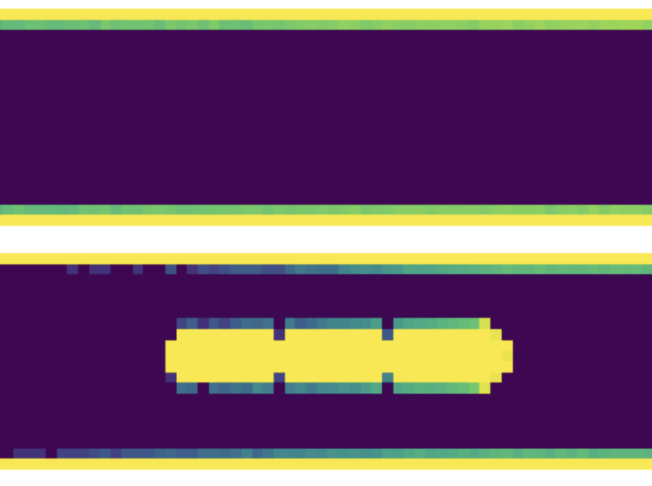
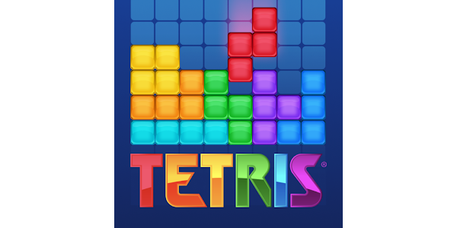
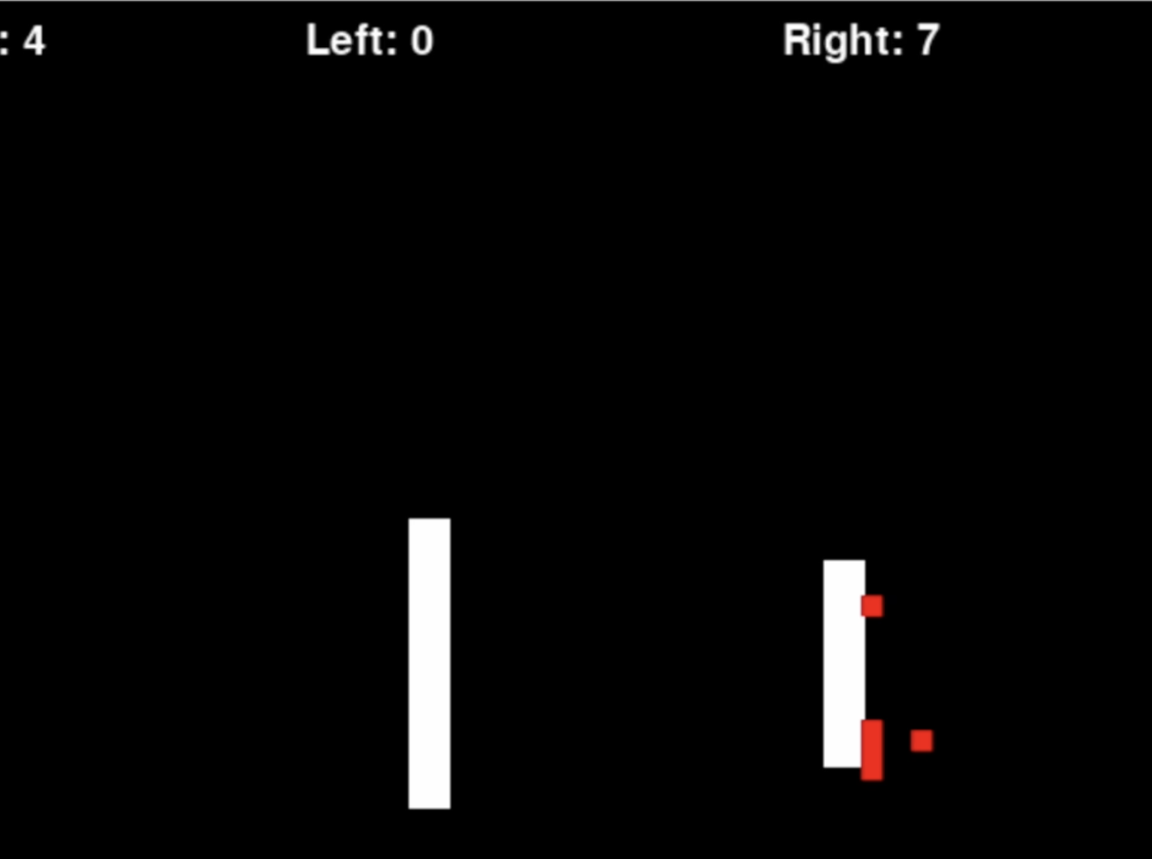
Overview
Inspired by homework 6: flow & Tetris game
In the homework we simulated flow of particles through pipe with various obstacles. This project uses similar ideas to simulate the flow of a particle, using random walks to determine which direction the particle flows, as well as randomly generating rectangles with different colors.
In the homework we uses matrix to represent the pipe and we cannot see the movement of the particle; In this simulation, pygame is used to create a clear animation of how the particle moves, as well as to add a “Heads Up Display” showing in real time how many particles passed through and how many got stuck
Challenges:
Preserve the update based on the old screen: previous move goes away once the while loop re-initiates
Accumulate the rectangles: will have to update the shape of left bar, right bar and left boundary
Rotations of the particles/rectangles
Color change of the rectangles: resolved by creating a “colorList” to store all the colors

Slide 3
Animation

