Slide 1
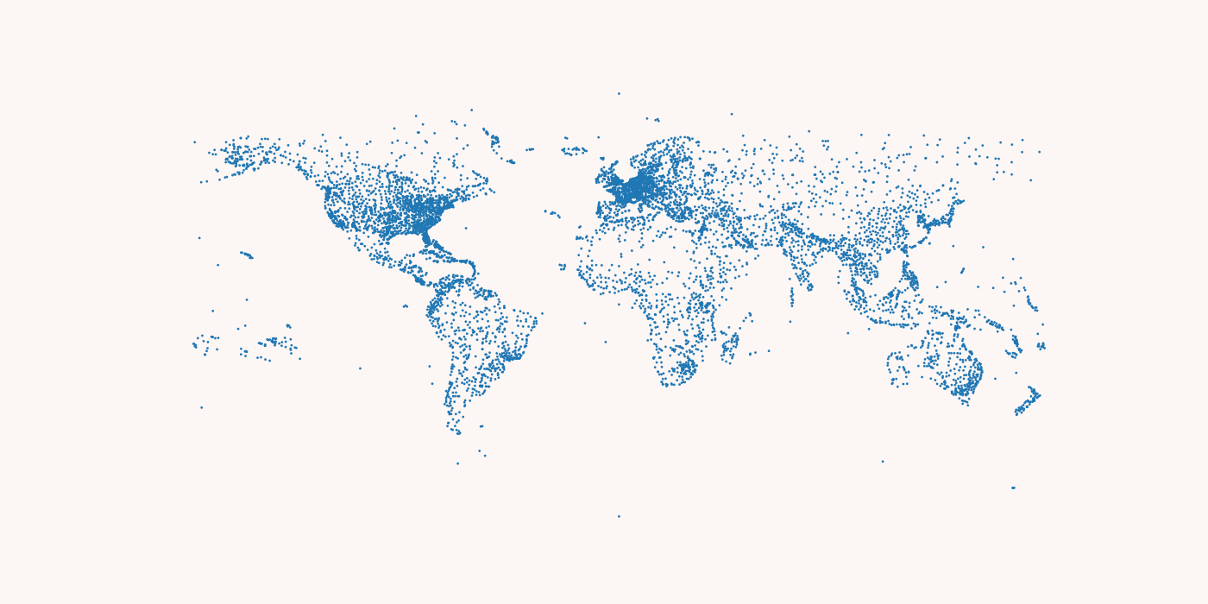
Mapping Airports and Flight Routes Around the World
Eugenie Lee

Slide 2
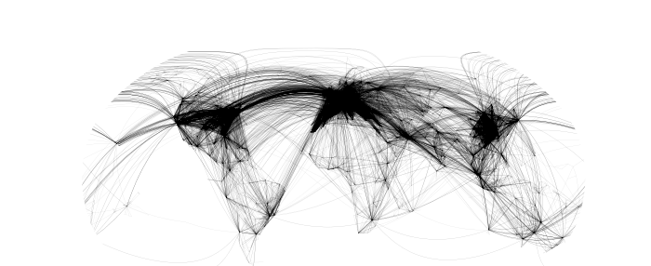
Top: Airports by Countries Bottom: Flight Routes
Topic: Animated 7698 airports in the world by different countries
Methods Used:
GeoPandas: Extends the datatypes used by pandas to allow spatial operations on geometric types. Adding the background map.
Cartopy: Also used for geospatial data and adding curved routes in the map.
Flight routes does not look like straight lines due to curvature of the earth
Source: https://openflights.org/data.html

Slide 3
Plotting by Each Countries

Slide 4
Plotting from a random point

