Slide 1
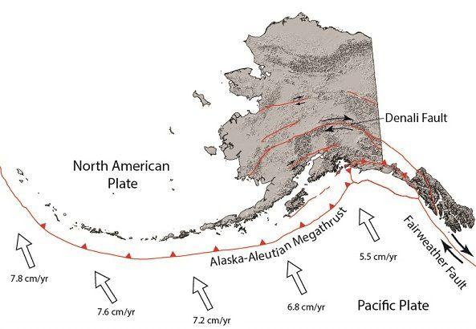
Earthquake Analysis in Alaska
Angela Beatty

Slide 2
Project Goal: Analyze earthquake events that occurred in Alaska over the past 30 years and identify fault lines.
Methods:
Created a catalog of earthquakes greater than 2.0 magnitude that occurred between 1972-2022
Extracted the longitude, latitude, magnitude, depth, and year for each earthquake and determined which year had the most earthquake activity (2018 was the most active)
Plotted earthquakes that occurred in 2018 and compared results to map of fault lines in Alaska
Simulated earthquakes greater than 5.0 magnitude that occurred between 1972-2022, color-coded by magnitude and sized by depth
Packages used: Cartopy, Ospy, Matplotlib, Datetime

Slide 3
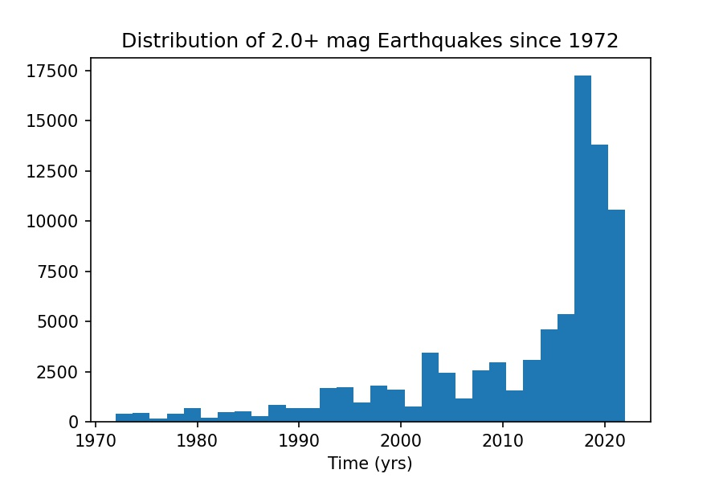
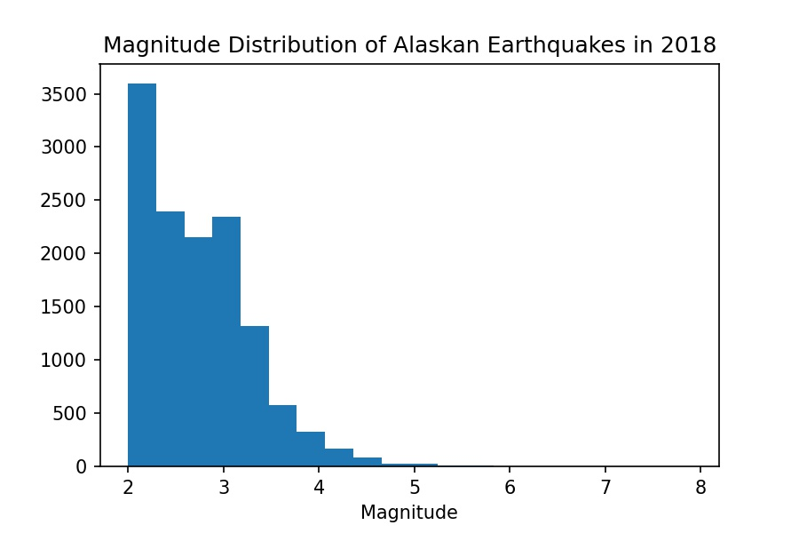
Analysis: Frequency of events and distribution of magnitudes
Histogram plots show a peak in earthquake events in 2018. In 2018, the majority of events had a magnitude of 2.0-2.5

Slide 4
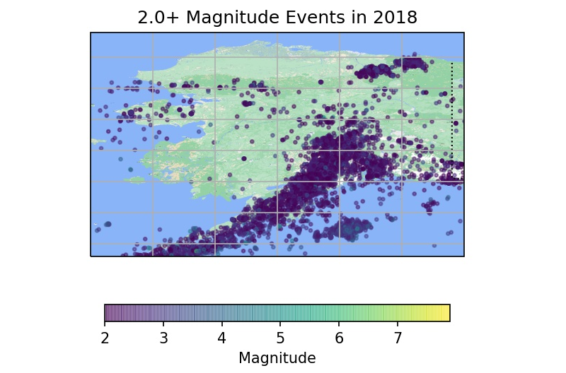
Analysis: Identifying fault lines
Image courtesy of DGGS: https://dggs.alaska.gov/hazards/earthquakes.html
The plot of events that occurred in 2018 (left) in general agrees with the location of fault lines (right), where the North American Plate and the Pacific plate meet.

