Slide 1
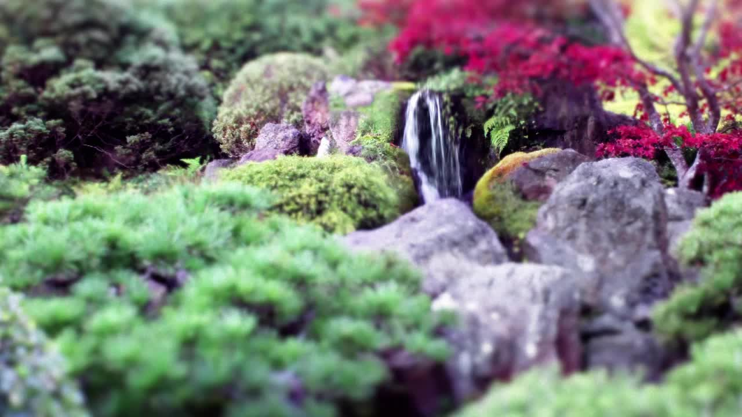
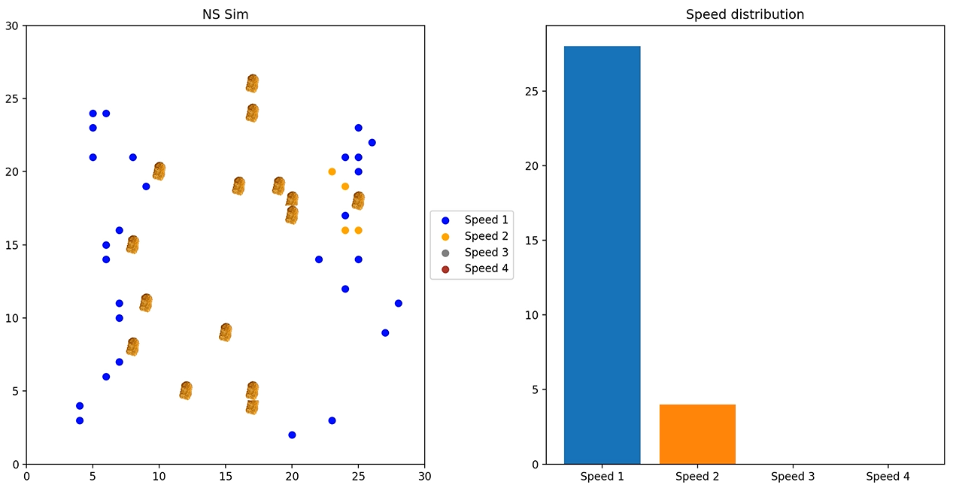
Random Natural Selection
By Geovanni Mojica

Slide 2
Topic: I used a Monte Carlo simulation and random walks
Method:
I created a (30 x 30) grid and placed food points randomly throughout the grid
I created 30 organisms that would move every iteration accordingly:
A% chance they move towards the closest source of food
B% chance they perform a random walk
For an organism to evolve (create two offspring) it must consume 2 pieces of food
The two offspring will have a 33% of having the same speed, 1 more speed, or 1 less speed than their parent
Each organism can survive 15 turns and for each food it consumes it gains 15 more turns

Slide 3
Iterations = 80 N = 30 A = 75 B = 25
A% chance they move towards the closest source of food
B% chance they perform a random walk

Slide 4
Iterations = 80 N = 30 A = 50 B = 50
A% chance they move towards the closest source of food
B% chance they perform a random walk

Slide 5
I added a size to each organism
The bigger the size the more energy it consumes per movement
33% chance of staying the same, 1 larger, or 1 smaller than the parent size

Slide 6
I start with 1 organism

