Slide 1
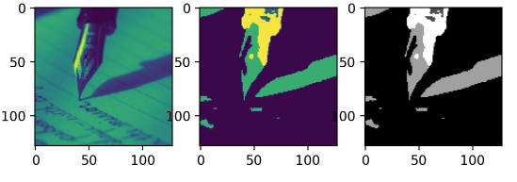
Image Segmentation with Random Walks
Tushar Goyal

Slide 2
Random Walker Segmentation Algorithm
If a random walker leaving the pixel is most likely to first reach a seed-bearing label s, assign the pixel to label s.
1
5
Map the image intensities to edge weights in the lattice.
Obtain a set, VM, of marked (labeled) pixels with K labels, either interactively or automatically
Solve outright for the potentials or solve for each label.
Obtain a final segmentation by assigning to each node, the label to maximum probability.
2
4
3
L. Grady, "Random Walks for Image Segmentation," in IEEE Transactions on Pattern Analysis and Machine Intelligence, vol. 28, no. 11, pp. 1768-1783, Nov. 2006, doi: 10.1109/TPAMI.2006.233.
Jain, M.K. (no date) Mannjain1609/image-segmentation-using-random-walker: Image segmentation using Random Walker following the Leo Grady Research Paper., GitHub. Available at: https://github.com/MannJain1609/Image-Segmentation-Using-Random-Walker (Accessed: November 29, 2022).

