Slide 1
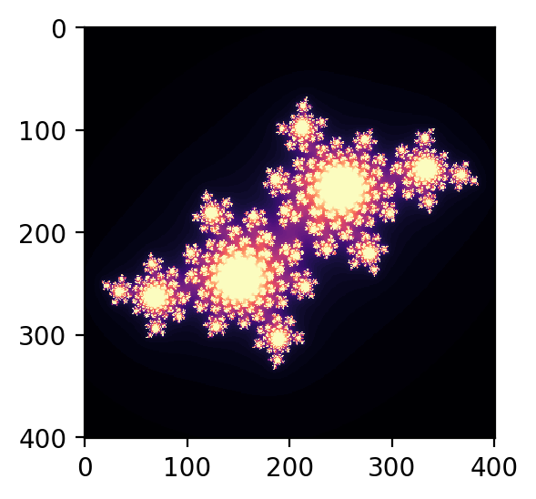
3D Fractals
Benedict Taguinod
EPS 109

Slide 2
Method and Experiments
Method
Higher Resolution
Inverting Structure
Mandelbrot Set
z_n+1 = z_n**2 + C
C: -0.4+0.6j
Zoom Info:
X: 0.040594
Y: -0.0698
Final Length: 0.00001
How to Run Using Notebook
Helper function makes mp4 file
Takes in different parameters for different effects
Removing Border
Allowing More Graphics

Slide 3
Final Animation
High Resolution + More Graphics + No Borders

