Slide 1
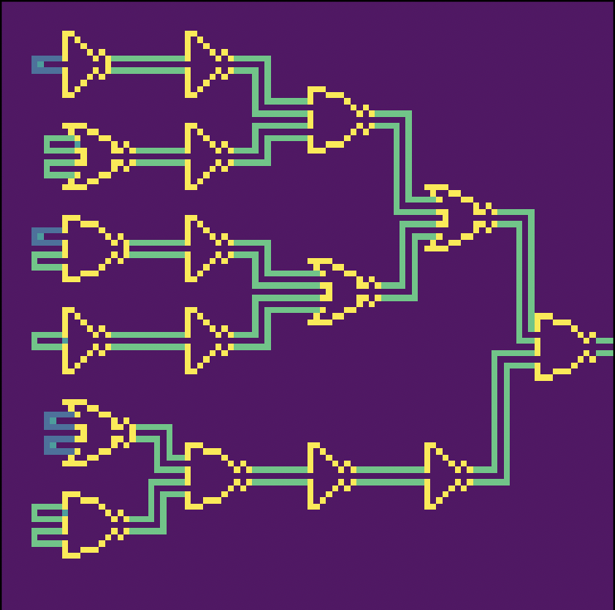
Simulating Basic Logic Gates
Theresa Trang Tran

Slide 2
Random Walks & Logic Gates
Random walks to simulate current flowing through a circuit
Show how changes in input change the outputs of inverter, NAND, and NOR gates
NAND
NOR
Inverter
A | B | Output
0 | 0 | 1
0 | 1 | 1
1 | 0 | 1
1 | 1 | 0
A | B | Output
0 | 0 | 1
0 | 1 | 0
1 | 0 | 0
1 | 1 | 0
A | Output
1 | 0
0 | 1

Slide 3
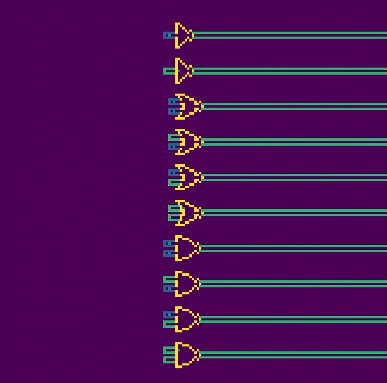
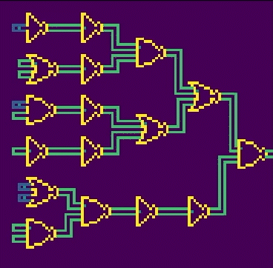
Blue wires represent 1, green wires represent 0
Behavior of individual gate: inverter, NOR, NAND (from top to bottom)
More complex circuit

