Slide 1
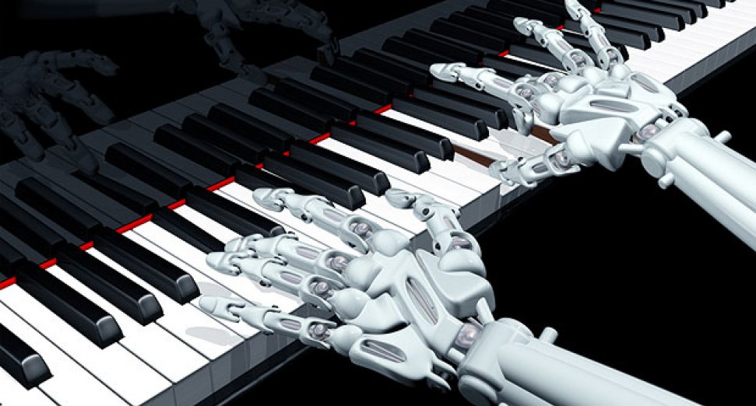
gENERATING PIANO MUSIC USING RANDOM WALKS
MAANAV KHAITAN eps 109 – final project

Slide 2
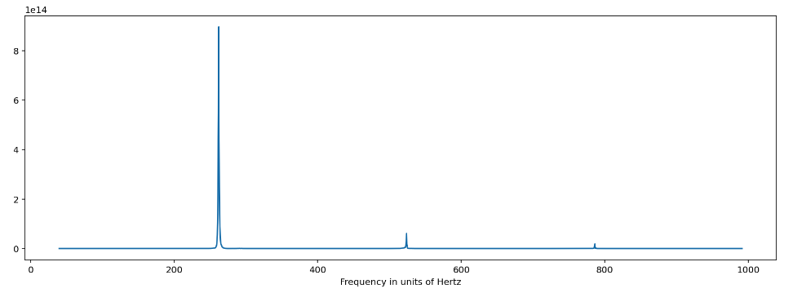
overview OF THE SIMULATION
Methods used
I started by producing the sound of a middle C note on the piano, since the sine-wave method from Homework 13 doesn’t produce a piano-like sound:
Downloaded this C piano sound from Katie He’s online sound repository
Used a Fourier Transform to deconstruct this sound and identify the frequencies in Hertz (shown in graph in bottom left on this slide)
Next, I calculated the ratio of the fundamental frequency in the C sound to the other frequencies found in this sound, as well as the ratios of their amplitudes
Used this info to construct piano sounds for every other note across two octaves (using the sine-wave method from Homework 13), and added a fade at the end
Now, I used the random walk simulation method to generate the musical tune:
Started the tune on the A note, and then the program randomly decides whether to go 1, 2, or 3 notes above or below the current note at each step, or whether to remain at the current note for another step. In total, the tune has 20 notes/steps
Finally, I visualized the tune on piano sheet music by sequentially plotting each note on a musical staff using Matplotlib, and then overlaying this with the music
Technologies used: NumPy, Matplotlib, Scipy.io wavfile, SimpleAudio
This simulation uses the concept of random walks to generate a musical tune on the piano
The animation is a visualization of the sequence of notes in the generated tune on piano sheet music, where the x axis is time and the y-axis is the pitch of each note
The musical tune which is programmatically generated is also included in the animation
Notes:
Goals: In this project, I aim to use random walks to generate a musical tune. I aim to programmatically play the sound of the music as well as visualize the notes generated by the random walk using Python, NumPy, and Matplotlib.
I will use the random walks simulation method. I will start by just using a one-dimensional random walk and increasing/decreasing/maintaining the pitch of each note depending on the result of each step in the random walk. I will then try to write a two-dimensional random walk which changes not just the pitch of each note but also the duration at each step of the random walk.
My animation will show the sequence of all the notes in the musical tune generated by the random walk. I aim to create a 2-D visualization where the x-axis is time and y-axis is the pitch of each note, and the animation will show each note in the music as it’s being played out, and the pitch and duration of the note. I also aim to add audio to the animation so the music can be heard along with the visualization.

Slide 3
ANIMATION
MUSIC AND VISUALIZATION CREATED BY PROGRAM

