Slide 1
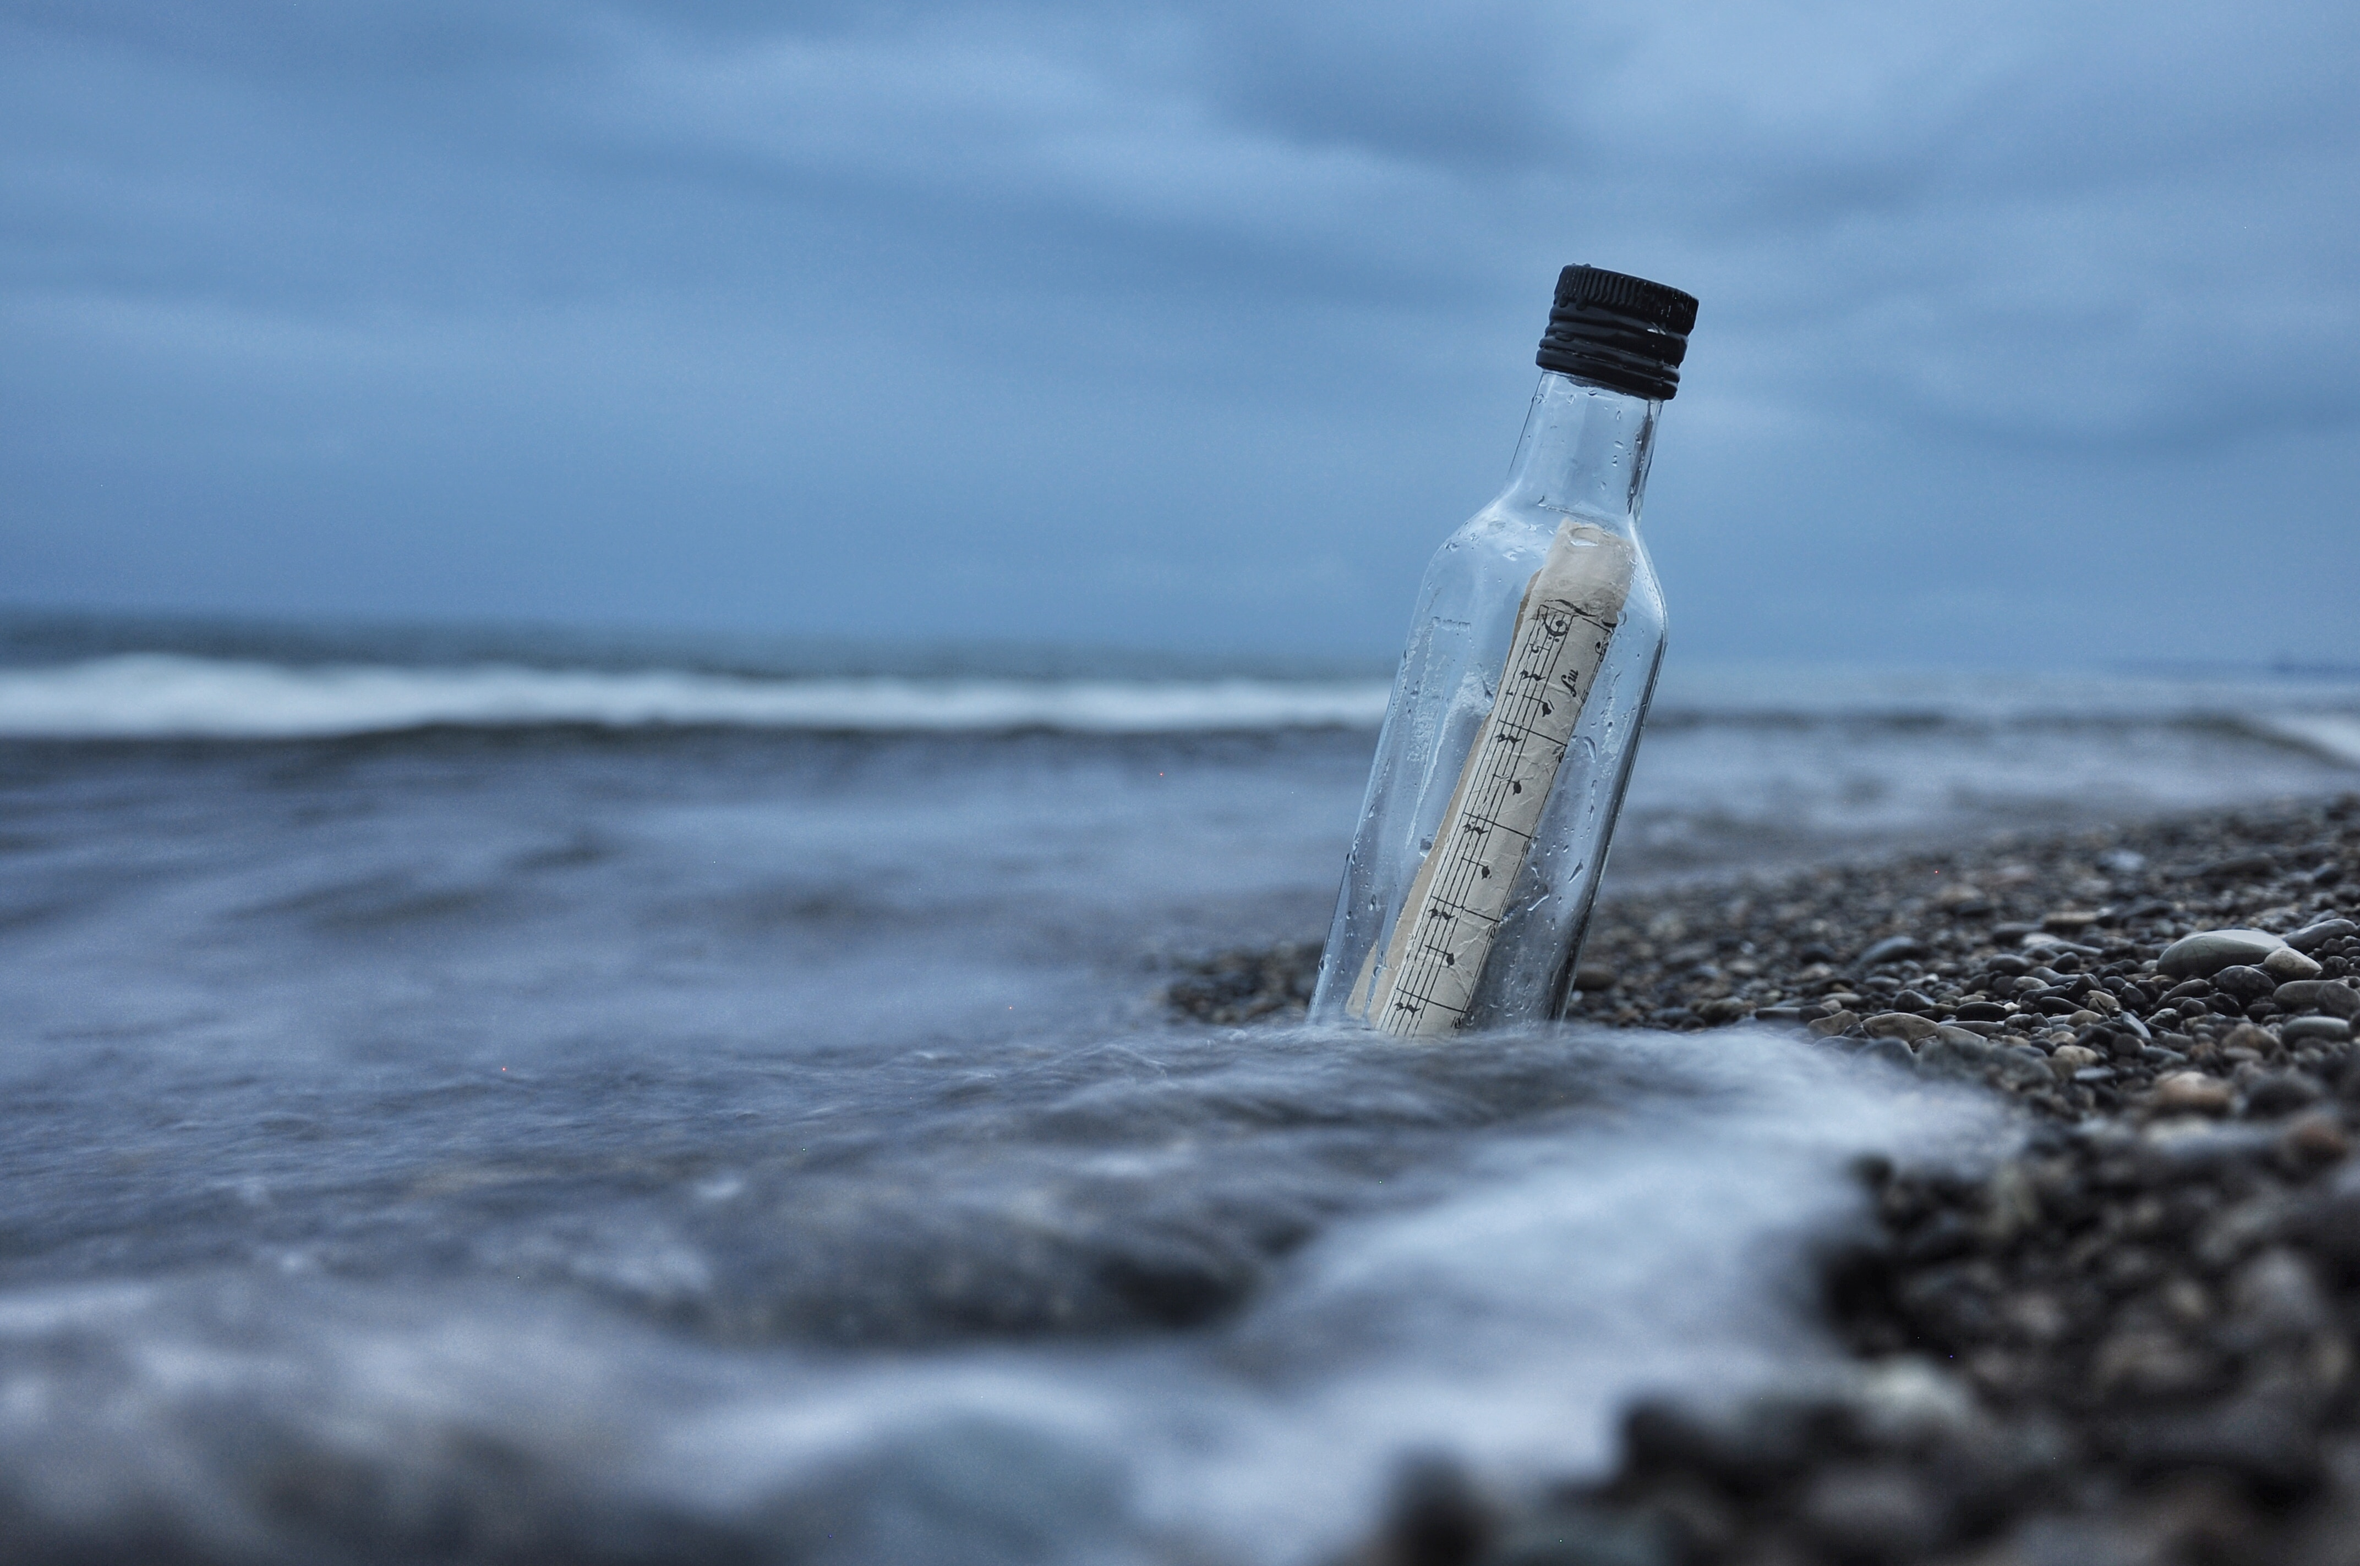
ocean
Messages
in Bottles
Emily Holmes
EPS 109
water

Slide 2
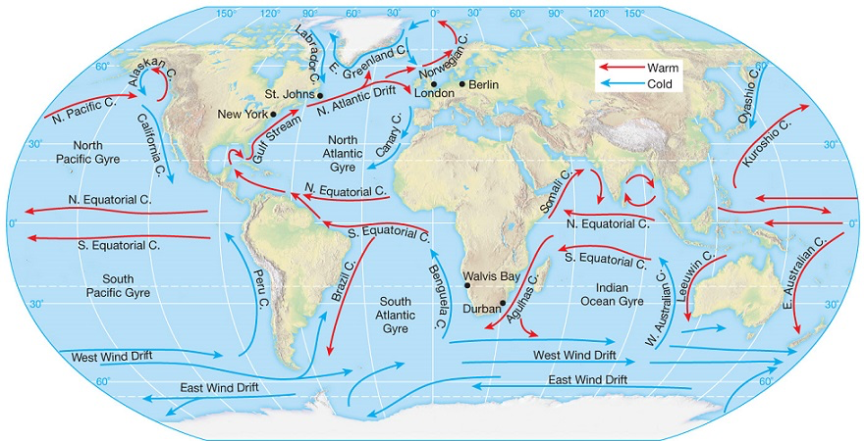
Driving Question + Methods for Simulation
What kind of current does a bottle need from Maryland to Ireland?
Cartopy map projection
Random walks to simulate potential bottle movement
Vary probabilities to roughly model currents
Stop movement when they hit land
global_land_mask package
Explore where bottles end up!
Notes:
I followed a procedure somewhat similar to what we did with DLA,

Slide 3
Equal Probability Movement
25% chance of each direction

Slide 4
More Advanced Modeling with Currents
West of Newfoundland: use Gulf Stream
approx. 65° N of equator
62% chance North, 28% chance East
East: use N. Atlantic Drift
approx. 25° N of equator
18% chance North, 72% chance East

