Slide 1
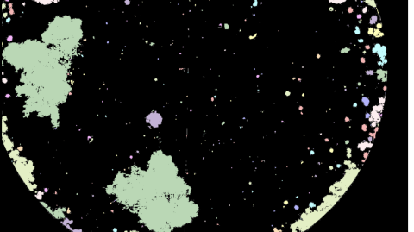
Particle characterization for ocean carbon export
EPS 109, Nov 30th
Yunhao Li
Source: Bourne, H. L., Bishop, J. K. B., Connors, E. J., and Wood, T. J.: Carbon export and fate beneath a dynamic upwelled filament off the California coast, Biogeosciences, 18, 3053–3086, https://doi.org/10.5194/bg-18-3053-2021, 2021.

Slide 2
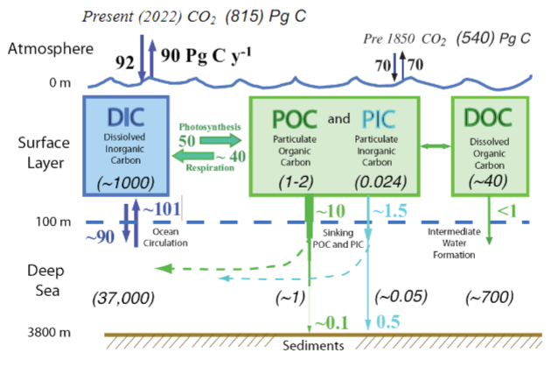
Introduction: Ocean Carbon Export
Carbon sequestration: A portion of Particulate organic carbon and inorganic carbon will sink and then be buried by the sediments. They will never come back to the atmosphere.
Important to understand the details and mechanism of carbon sinking, both the magnitude of flux and sinking character.

Slide 3
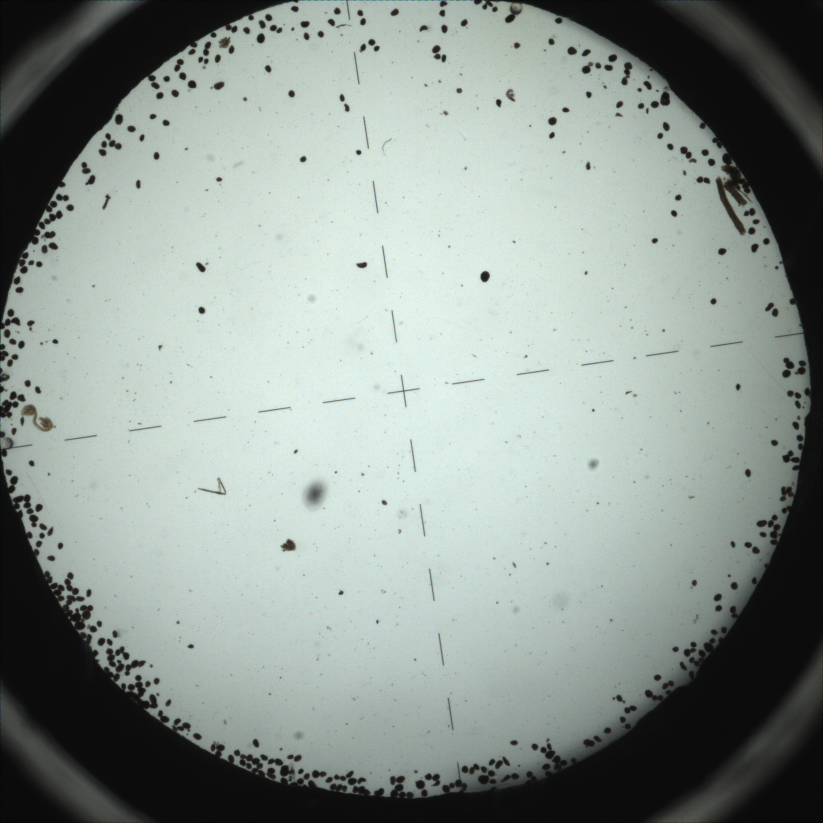
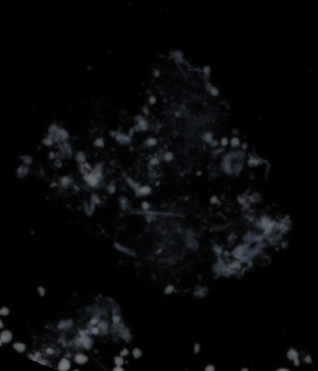
Project: An algorithm to process raw image
Normalize
Goal:
Produce an algorithm that can process particle images taken by camera system on the autonomous float.
The code should be able to differentiate aggregates and particulate grains.
Particle area and numbers should be calculated.
Produce a cumulative particle distribution that is similar to the one on the paper
Aggregates
Overlapping grains everywhere

Slide 4
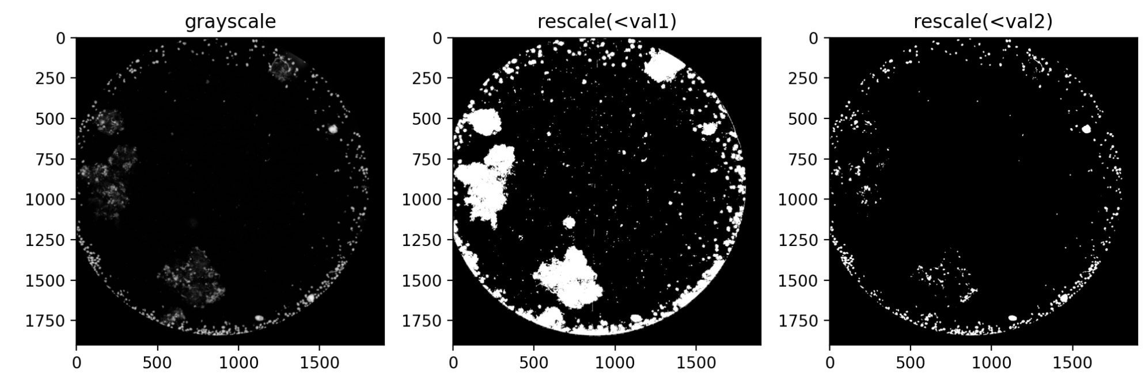
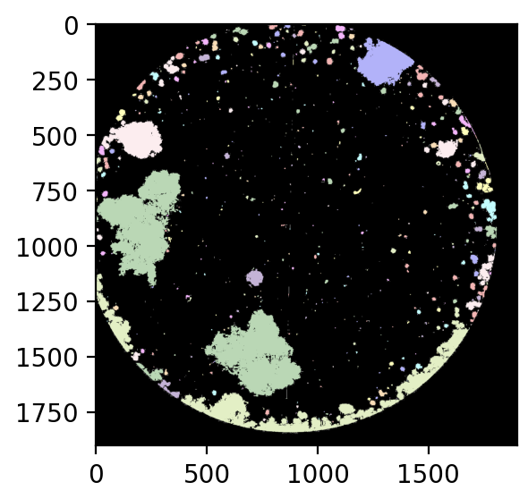
Algorithm
Convert image to grayscale
Thresholding the image twice, one focuses on aggregates, another one focuses on grains
Use the one with lower thresholding, and label each region (similar to what we did in the computer lab on bubbles)

Slide 5
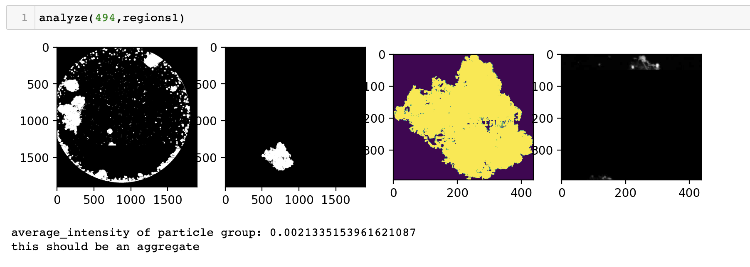
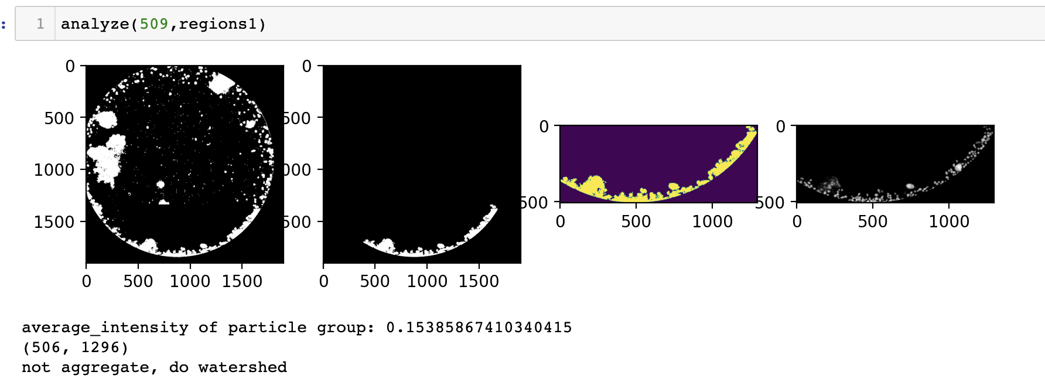
Region identification
Extract the bubbles and calculate the average intensity of the area. (aggregates are less reflective)
If the bubble is an aggregate, calculate the area for the entire region. Else, apply the watershed algorithm to the local image with high threshold to identify overlapping grains
low threshold local image
greyscale
local image
Intensity<<0.1, is aggregates
Yes (Intensity<0.1)
low threshold local image
Region identification
greyscale
local image
No (Intensity>0.1)
Is Aggregates?
Intensity>0.1, not aggregates
Tuning of parameters is important! It directly contributes to the results!
High threshold local image
Watershed result
New footprint generated by watershed, separate overlapping particles

Slide 6
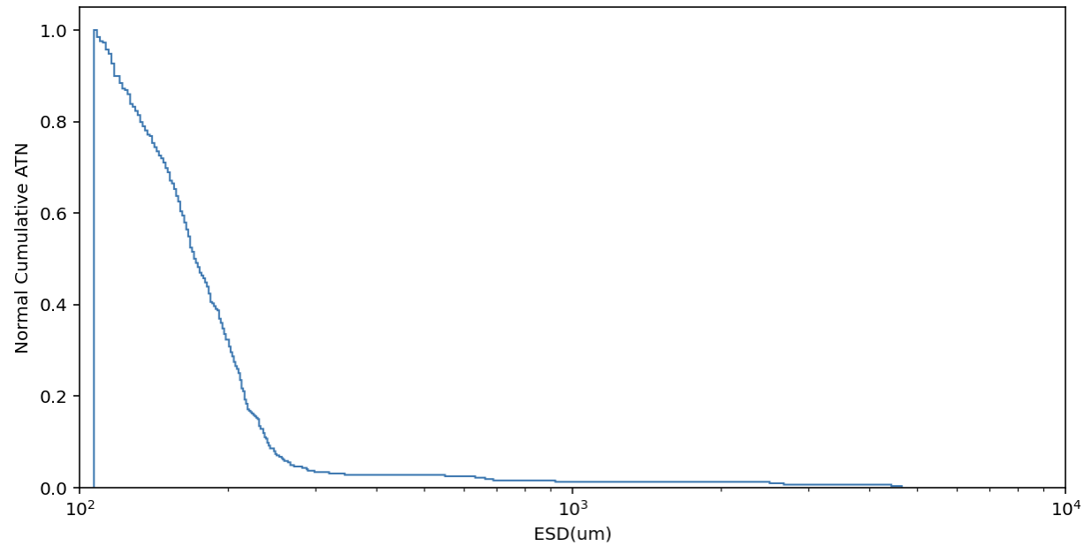
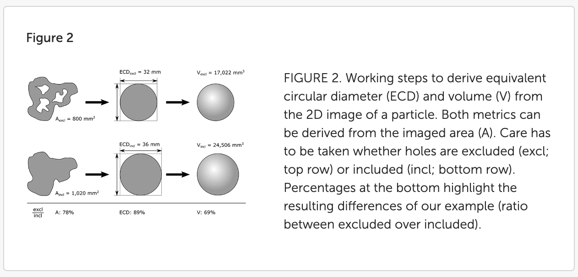
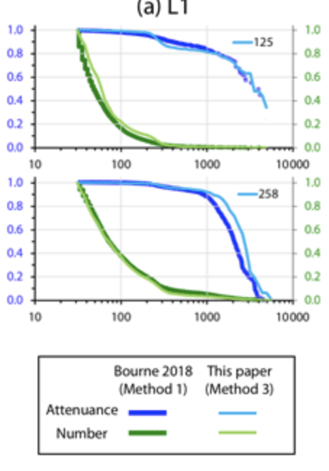
Calculation
One pixel=13um x 13um
ESD (Estimated spherical diameter)
My result (Top) and the result from the paper (Bourne et at.). The result is relatively consistent compared to the green curve. I neglected all particles smaller than 50 pixels
Method 1 is the threshold variation and method 3 is double processing through ImageJ.
Giering et al.
Notes:
Giering SLC, Cavan EL, Basedow SL, Briggs N, Burd AB, Darroch LJ, Guidi L, Irisson J-O, Iversen MH, Kiko R, Lindsay D, Marcolin CR, McDonnell AMP, Möller KO, Passow U, Thomalla S, Trull TW and Waite AM (2020) Sinking Organic Particles in the Ocean—Flux Estimates From in situ Optical Devices. Front. Mar. Sci. 6:834. doi: 10.3389/fmars.2019.00834

