Slide 1
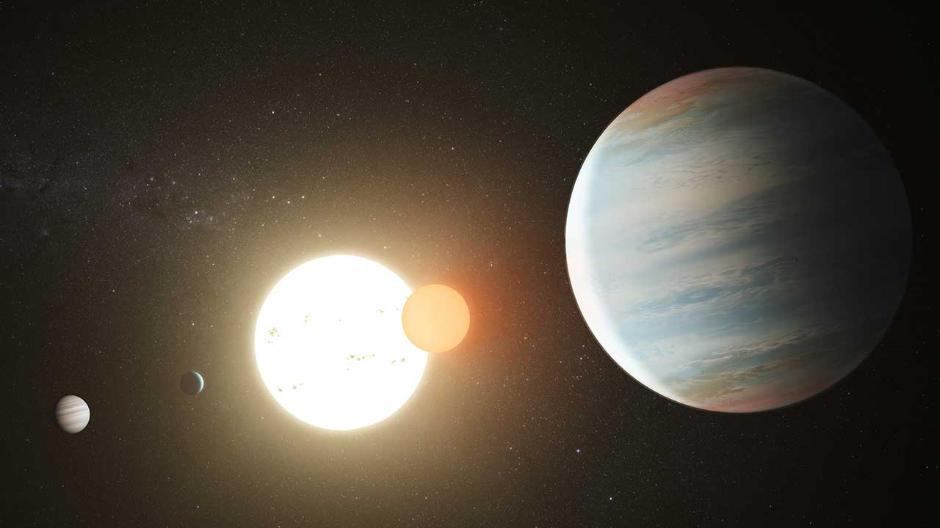
SIMULATING THE KEPLER-47 SYSTEM
EPS 109 Fall 2022
Amrutha Kalle
Artist rendition of Kepler-47

Slide 2
TOPIC AND GOALS
BACKGROUND
binary system
47A - Sun-like primary star
47B - red dwarf companion
47b, 47c, 47d - 3 Neptune-like planets
one of the first systems discovered where multiple planets orbit both stars in stable orbits
outer planet 47c in habitable zone– where liquid water could exist on surface of planet
GOALS
simulate the orbits of the planets and stars over 1 orbital period
should show that they are stable
track the movement of the habitable zone over time

Slide 3
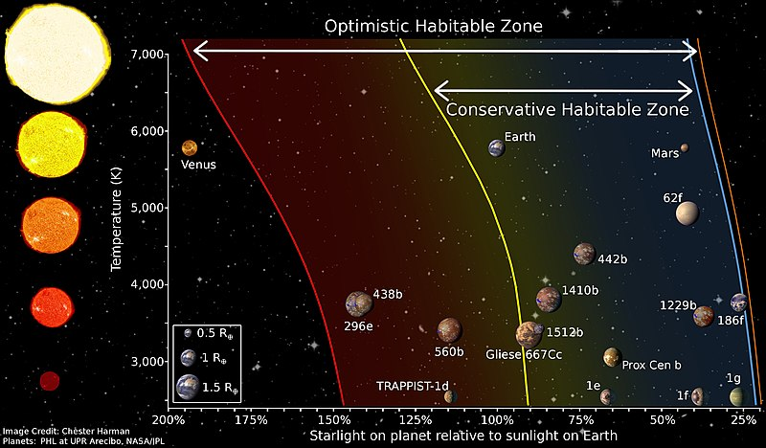
METHODS
Kepler ODE from Lab/HW 11 expanded to 5 bodies for orbits
habitable zone – used intrinsic luminosity of primary star to calculate distance where liquid water can exist
inner radius – where water vapor in atmosphere is vaporized (1.1 Solar Flux)
outer radius – where CO₂ condensation starts happening (0.53 Solar Flux)
Comparison of habitable zones of various stars

Slide 4
ANIMATION 1: ORBITS

Slide 5
ANIMATION 2: HABITABLE ZONE

Slide 6
Sources
Lab and HW 11
Orosz, J. A., W.F. Welsh, et. al., “Kepler-47: A Transiting Circumbinary Multi-Planet System,” Science, vol. 337, p. 1511, August 2012.
Orosz, J. A., W. F. Welsh, et. al. “Discovery of a third transiting planet in the kepler-47 circumbinary system.” The Astronomical Journal, vol. 157, p. 174, April 2019.
Doyle, L. R., J. Billingham, D. L. DeVincenzi, "Circumstellar habitable zones: an overview,", Acta Astronautica, vol. 42, p. 599-605, 1998.
Image 1: https://www.nasa.gov/feature/discovery-alert-a-third-planet-in-kepler-47-system
Image 2: https://astrobiology.nasa.gov/nai/annual-reports/2013/vpl-uw/stellar-effects-on-planetary-habitability-and-the-limits-of-the-habitable-zone/index.html

