Slide 1
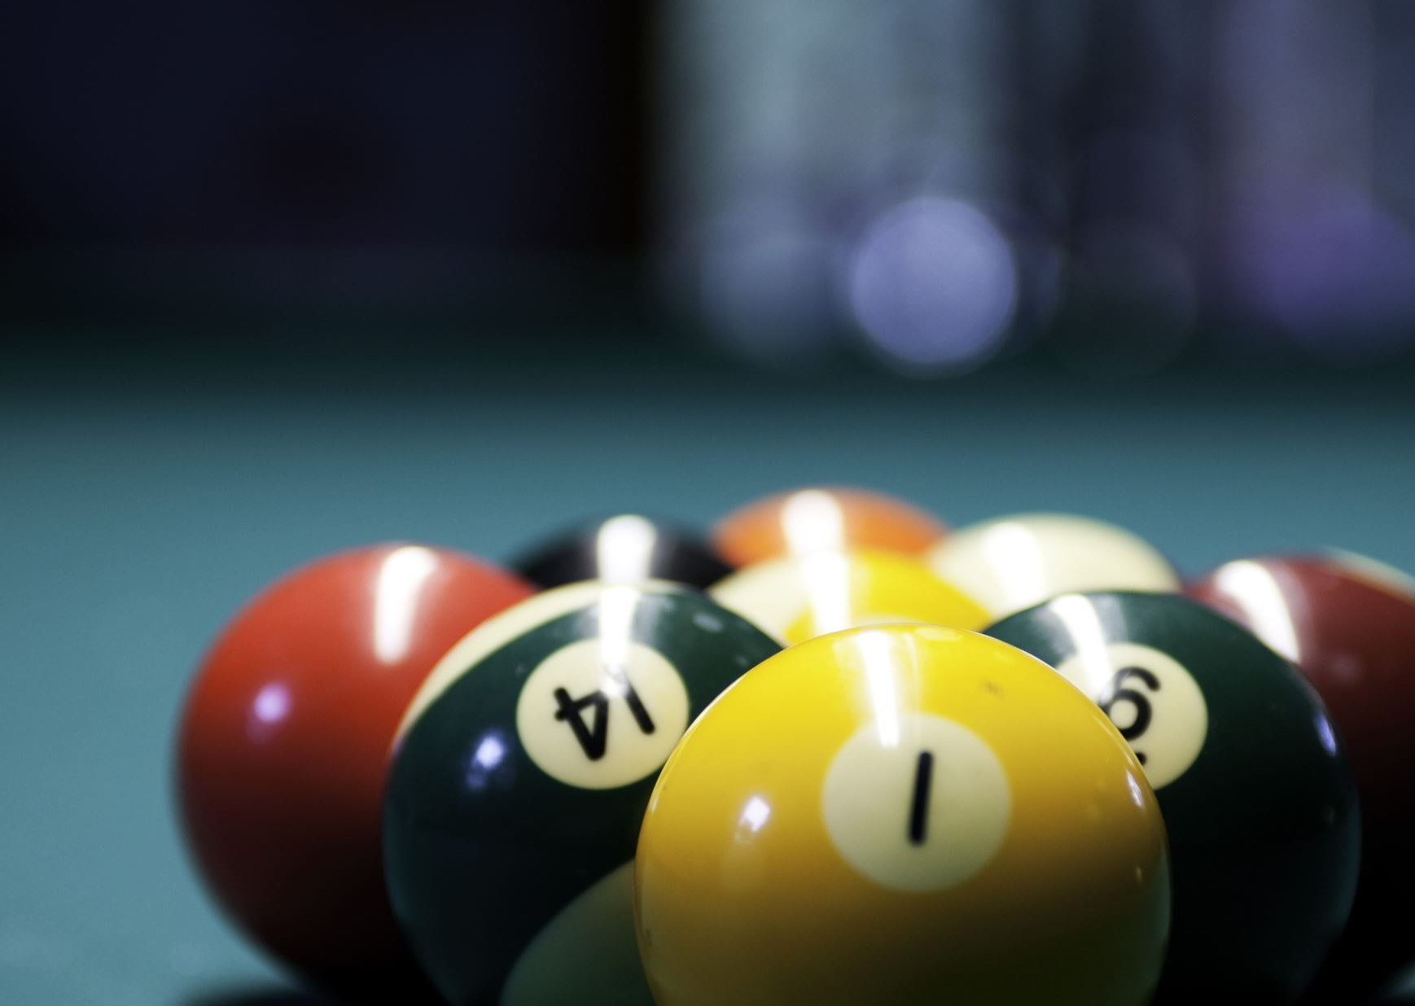
Pool Simulation
- Mridang Sheth

Slide 2
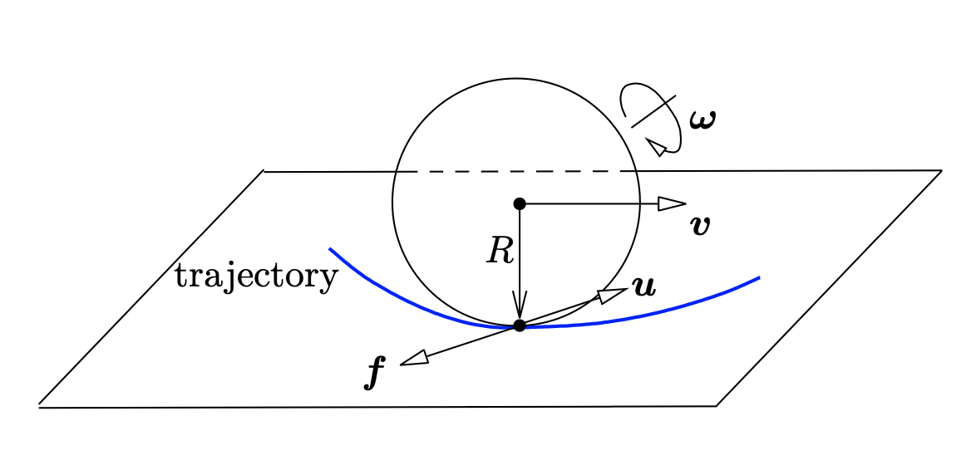
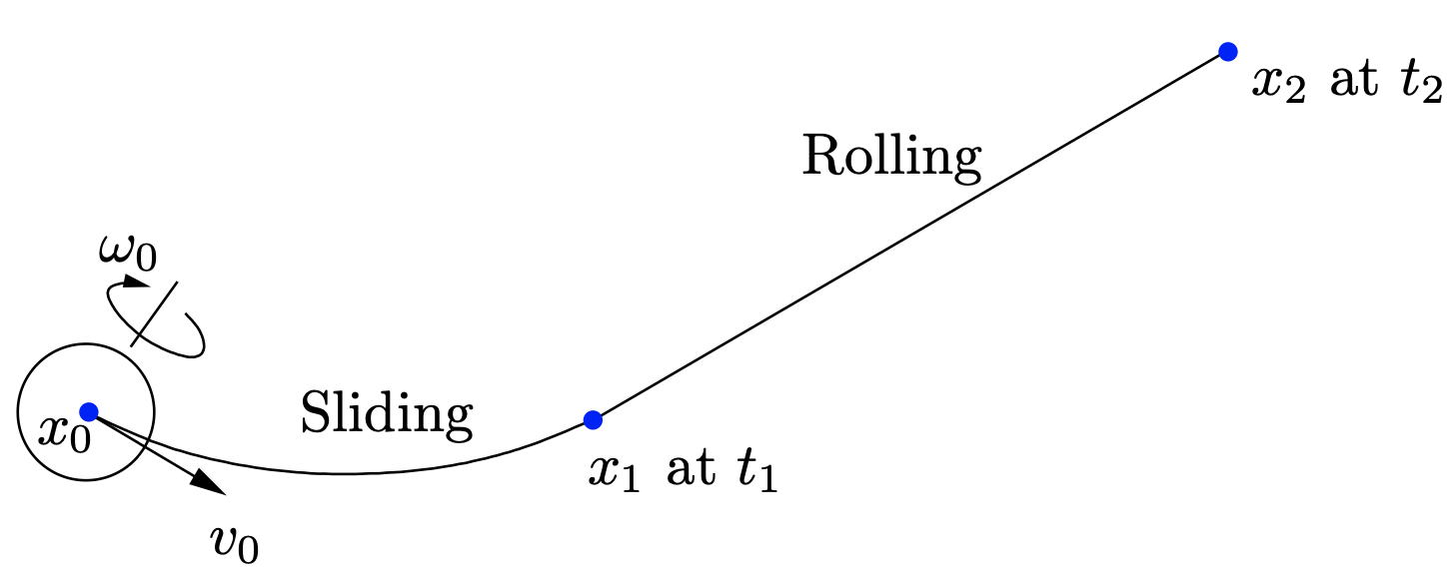
Ball – Cloth Interaction & Ball’s motion evolution
Sliding State
Rolling State
State evolved using ODE!

Slide 3
Collisions
Ball – Ball Collision
Collisions modeled as perfectly elastic collisions with only translational velocity transfer. Balls keep their angular velocity on impact.
Ball – Table Collision
Same as above, but since the table’s mass >>> ball’s mass, implemented as simple reflection of direction.

Slide 4
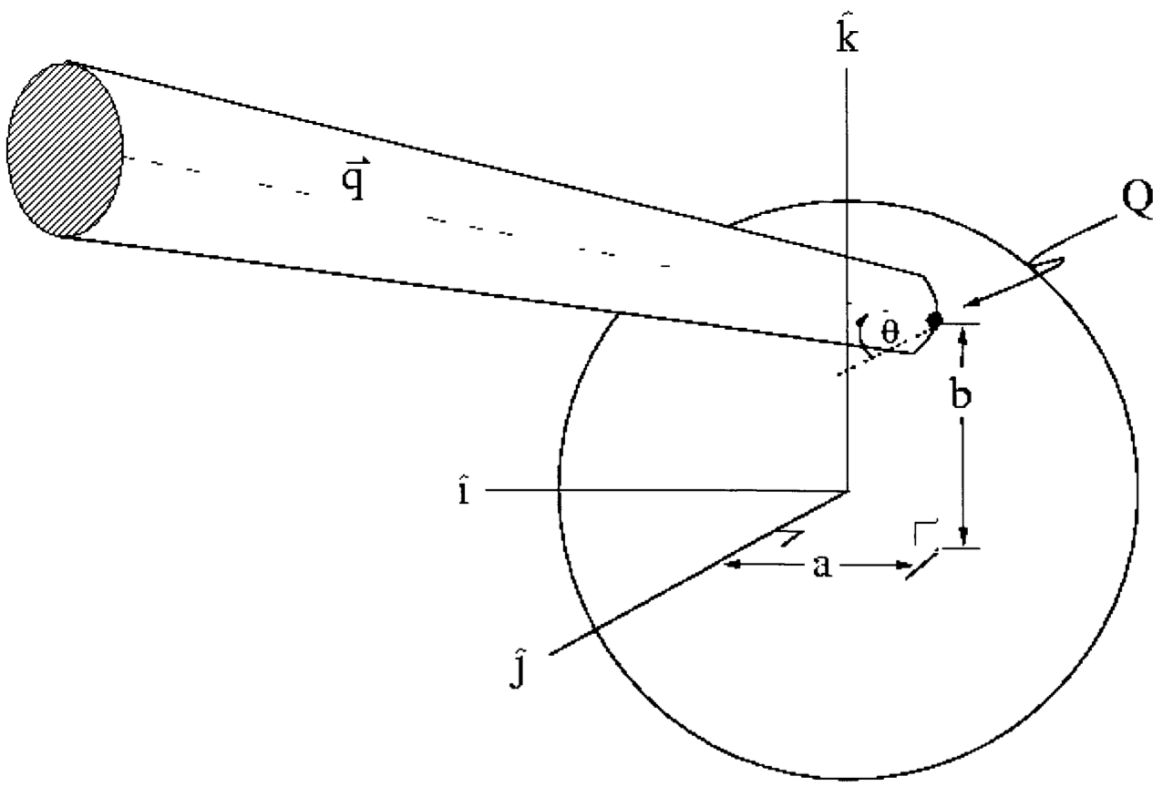
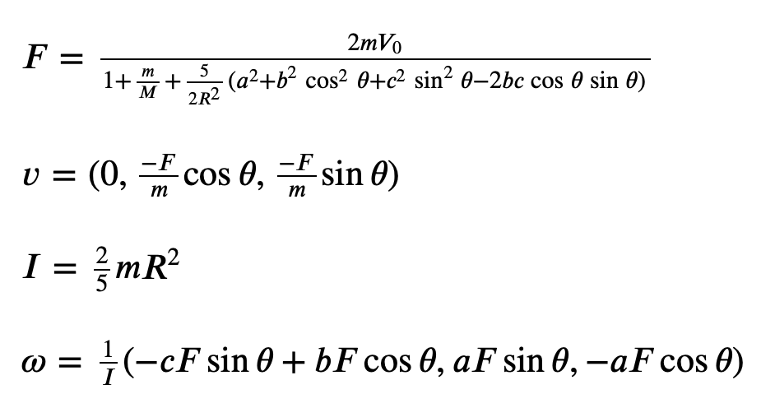
Ball – Cue Stick Interaction
Determines the initial velocity and angular velocity of the cue (white) ball.

Slide 6
Any Questions ?

Slide 7
References
Ball – Cloth Interactions and Ball’s motion evolution
Jia B., Mason M. & Erdmann M., Trajectory of a Billiard Ball and Recovery of Its Initial Velocities, https://faculty.sites.iastate.edu/jia/files/inline-files/billiard-analysis.pdf
Elastic Collision
https://en.wikipedia.org/wiki/Elastic_collision#Two-dimensional
Ball – Cue Stick Interaction
Leckie, W., & Greenspan, M. (2005). Pool Physics Simulation by Event Prediction 1: Motion Transitions. ICGA Journal, 28(4), 214–222. doi:10.3233/icg-2005-28403

Slide 8
Thank You!

