Slide 1
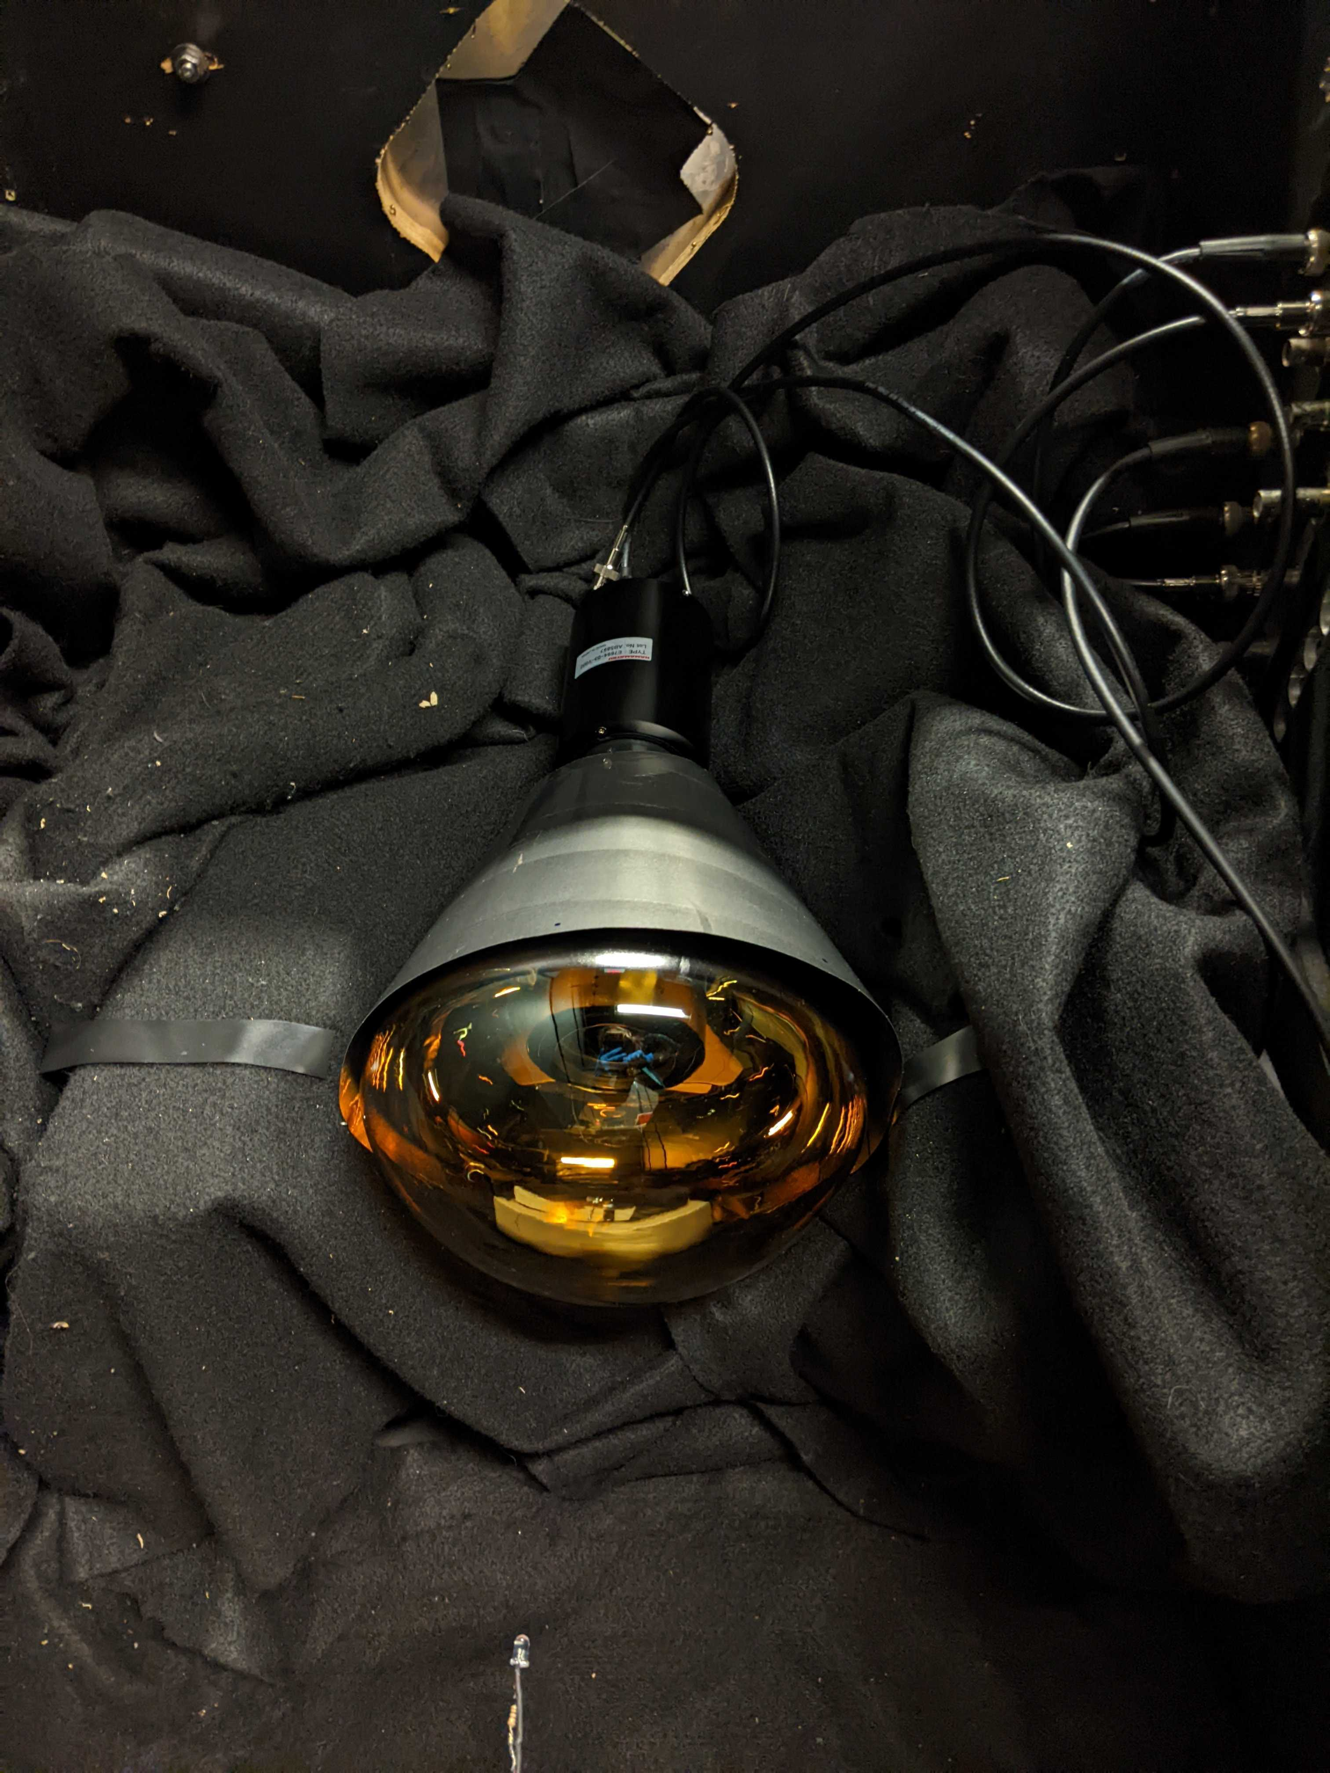
Simulation of Photomultiplier Tube (PMT) Afterpulsing Author: Ashley Rincon
LED photoelectron source releases photons that interact with electrons on the surface, that translates to pulses of electricity
The internal vacuum is imperfect, so residual gasses can get ionized in this process that result in additional “afterpulses”

Slide 2
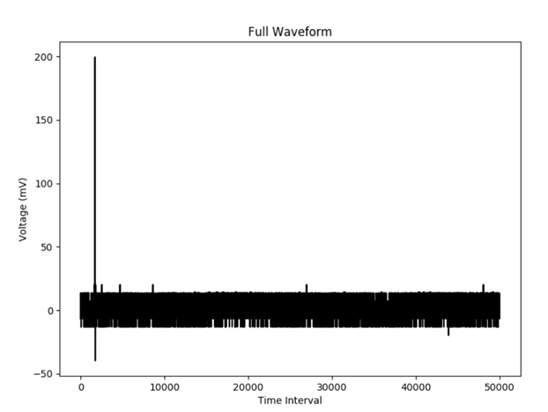
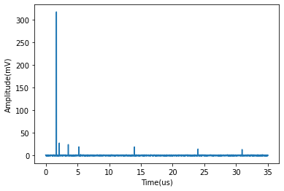
This is a simulation of the afterpulsing effect within PMT tubes. Technically, a simulation of this nature could be used to help quantify and predict error in particularly sensitive PMT testing results when measuring low-level signals.
This simulation is based on generating many random values to simulate the probability of afterpulsing events. Each time you run the code it generates a waveform that may or may not include afterpulses based on coded probabilities
Actual acquired data from the lab
Simulated Data (time intervals displayed differently)

Slide 3
Variable Data
While I still have a little work to do to acquire more accurate probability and timing data, these are based on only a few test cases, and this can easily be adjusted. These values also vary by PMT and would require testing for each one individually to acquire these probabilities.
Successive afterpulses might have a lower/different probability of occurring, this simulation assumes this, but affirmation of those results are in progress. (Also depending on the type and quantity of residual elements)
We know the probability of any afterpulse increases with a higher main pulse charge.
While the timing suggests what kind of element is present within the PMT vacuum, the exact timing can vary more than my simulation currently represents. This is possibly because of the variable distance of the element from the photocathode when ionized.

Slide 4
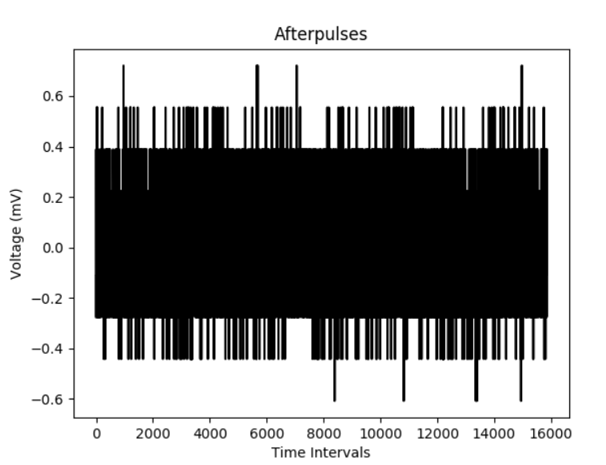
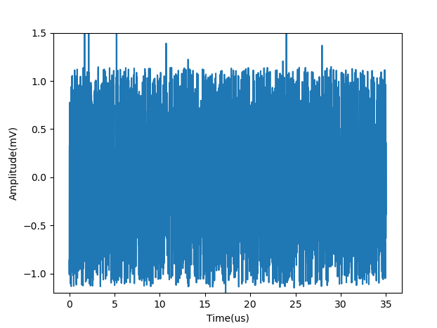
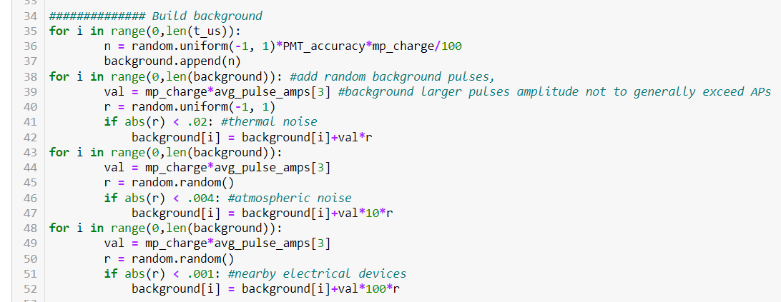
Methods
(Actual data)
First, I made the “background” noise, accounting for a number of potential sources.
Created using random numbers to replicate the calculated probability and limited the amplitude to what we usually see in the lab

Slide 5
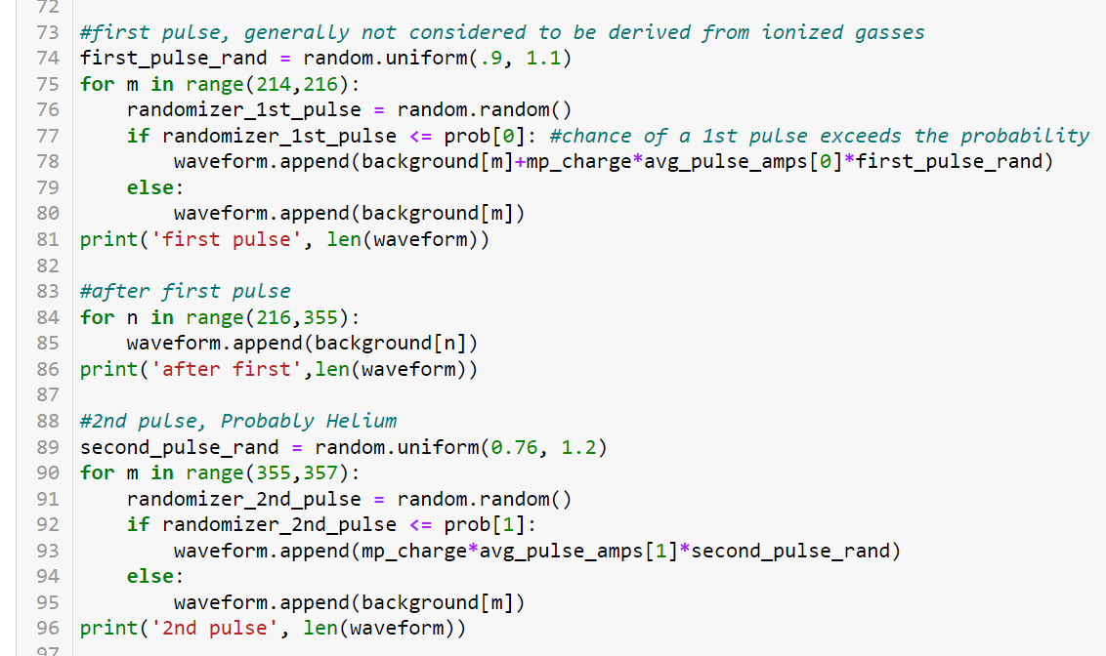
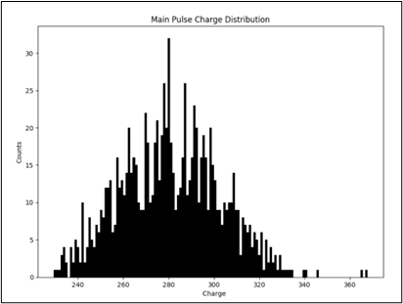
Methods, continued
Then, I implemented the main pulse and afterpulses, using more random numbers, and limiting thresholds to address occurrence probability, and a generalized amplitude variance

Slide 6
Amplitude of the light pulse at each array interval was normalized and the radius of the circle was scaled with respect to it, representing it as a pulse of “light.” There aren’t enough photons to actually be able to see with our eyes. This is also technically a slowed down version of ~ 500 microseconds
Main pulse of 280 mV charge: ~175 photons collected

Slide 7
Same thing
Main pulse of 280 mV charge: ~175 photons collected

