Slide 1
Algae Growth in the Bay Area
Emma Drake

Slide 2
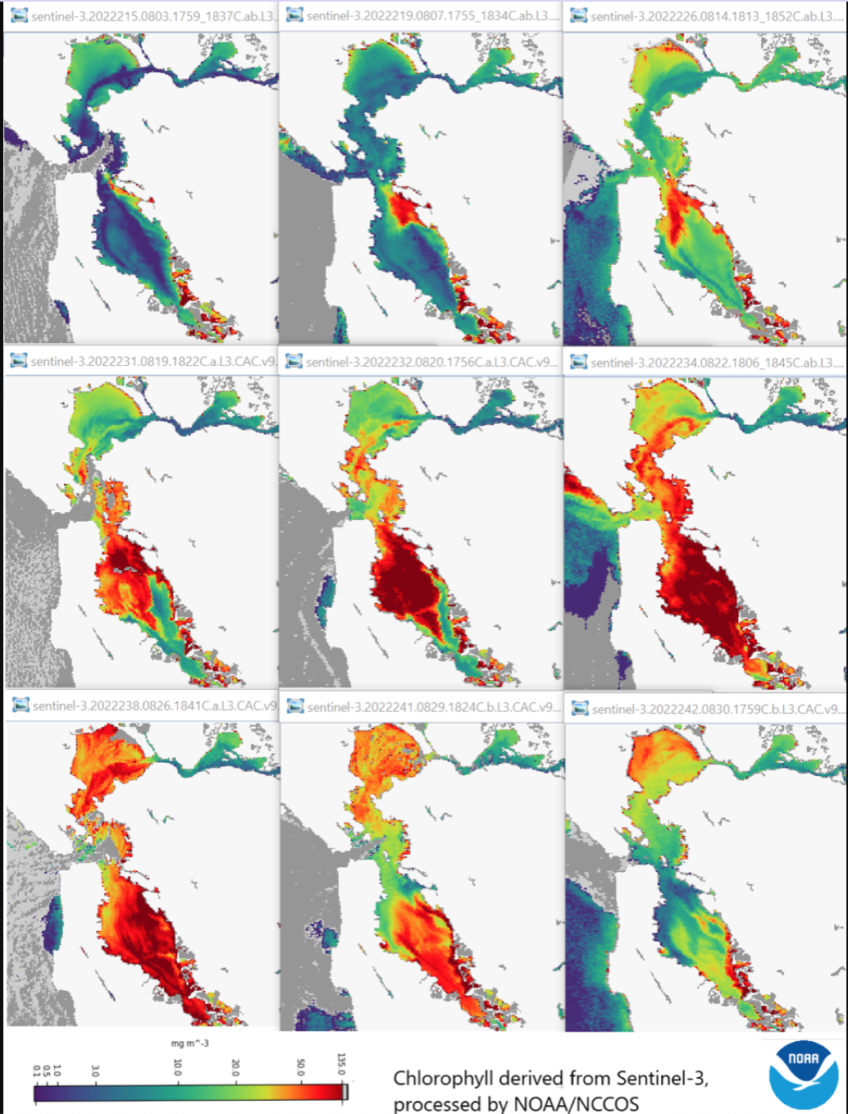
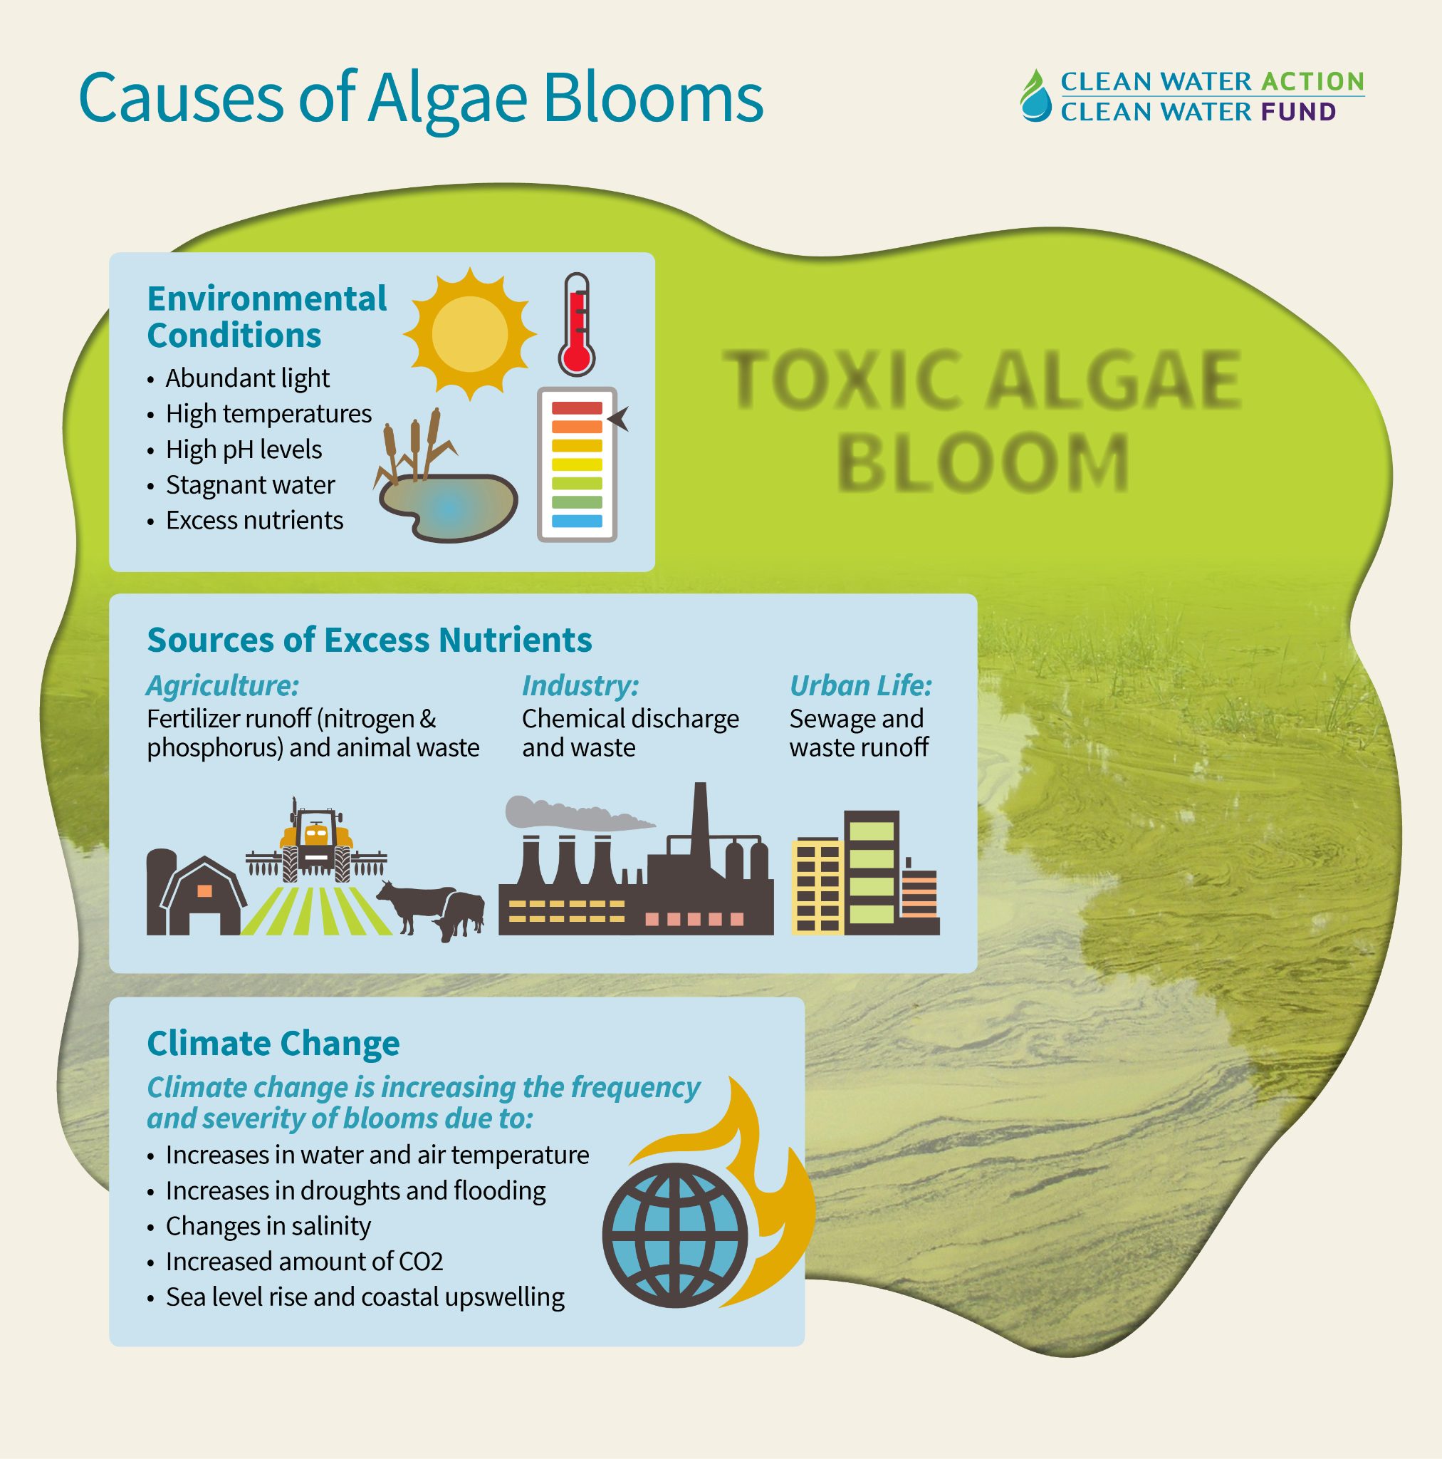
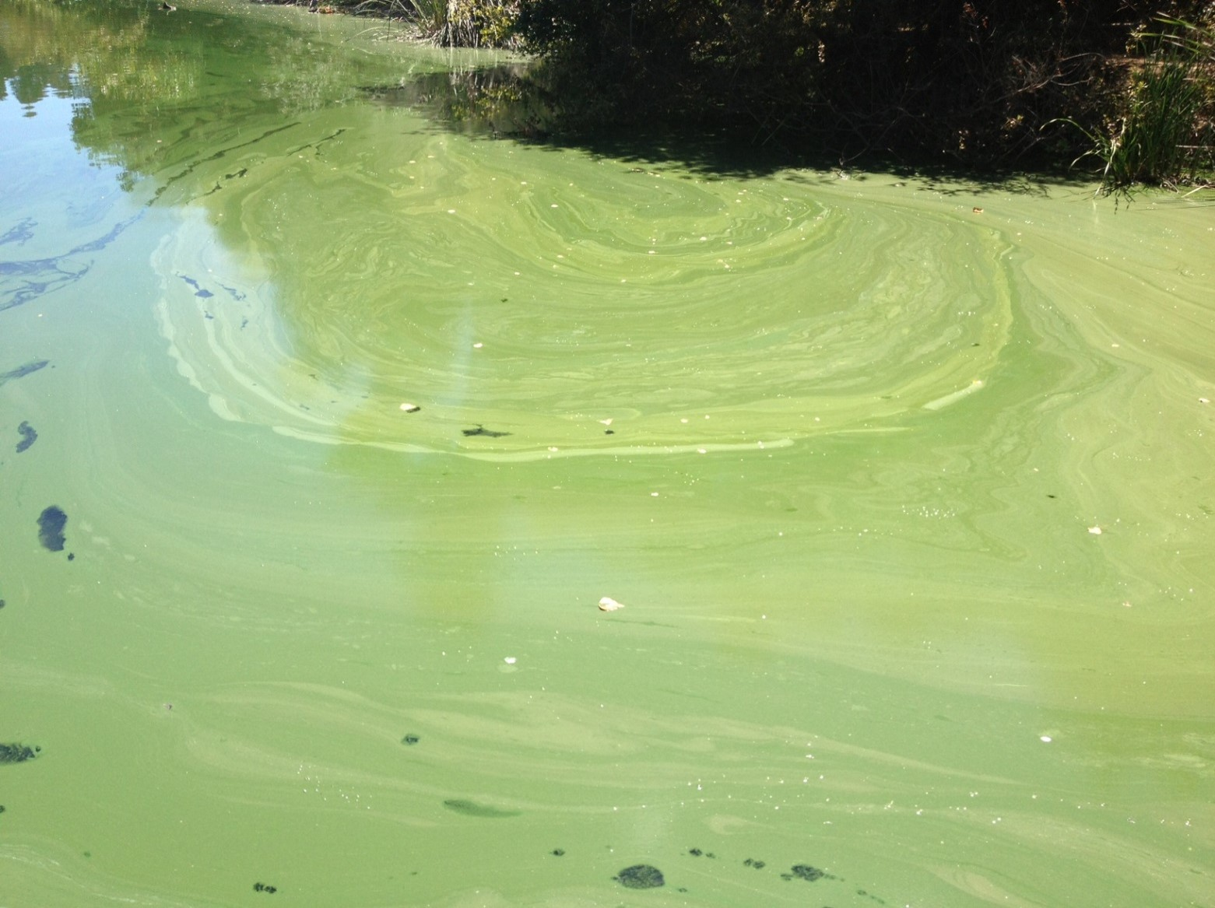
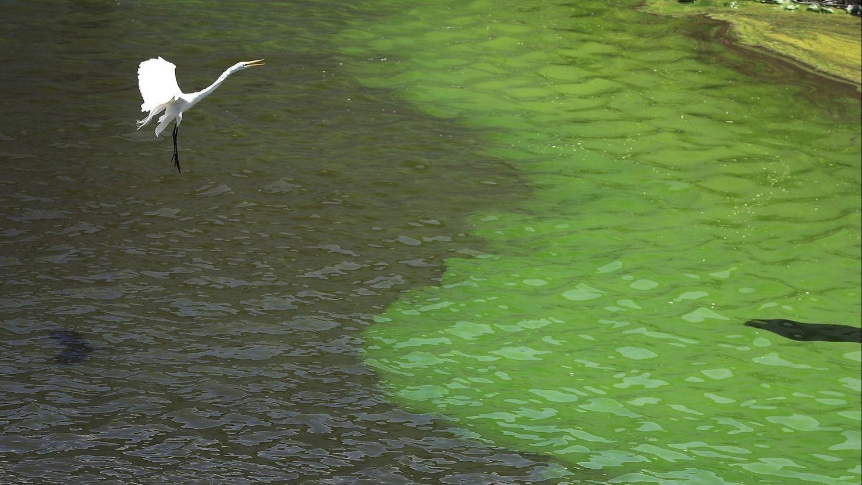
Background
Bay Area algae. Source: Conservatory of the SF Bay
Algae increase in late summer 2022. Source: NOAA
Source: Clean Water Action
Notes:
I was interested in this topic because there’s been lots of news recently about toxic algae blooms increasing due to global warming. The temperature of a region, as well as the amount of anthropogenic runoff, has been increasing the amount of algae growing in our area, so I wanted to map it.

Slide 3
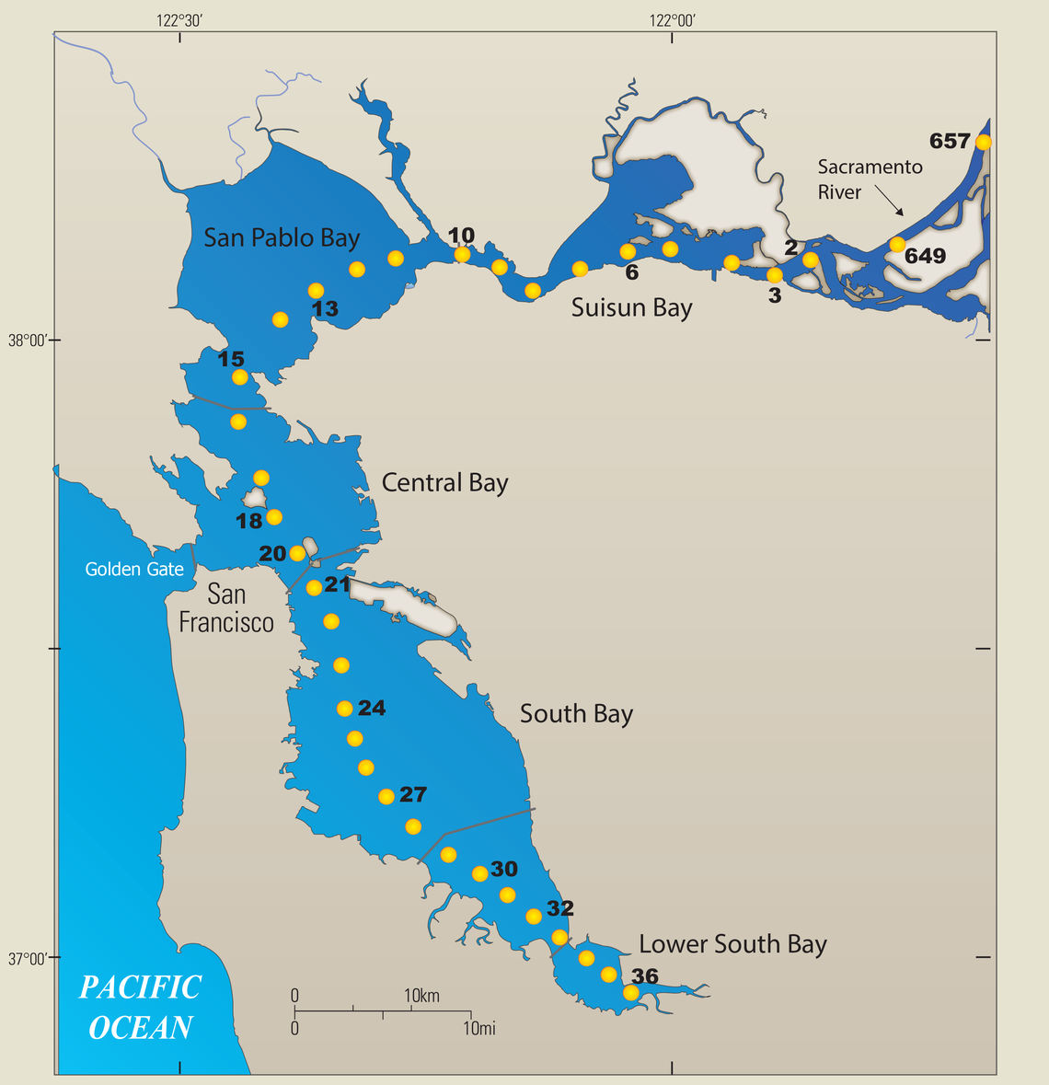
Data
USGS has monitored water quality in the SF Bay since 1969, measuring chlorophyll-a abundance, temperature, and many other metrics
Chlorophyll-a: μg/l
Temperature:
°C

Slide 4
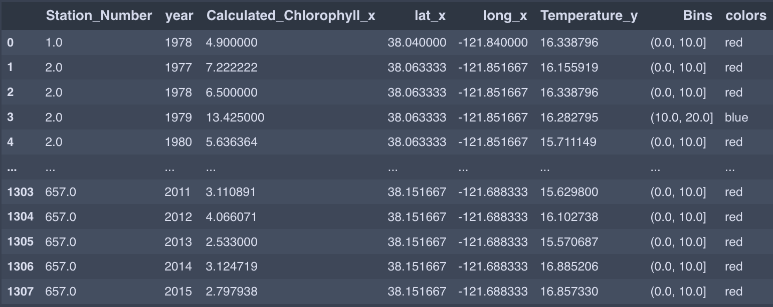
Data
Notes:
Averaged the algae growth for each station each year, and the temperature for each year overall. Then assigned colors to the chlorophyll values, putting them in 4 groups.

Slide 5
Model
Yellow/green = higher algae abundance
Purple/blue = lower algae abundance
Temperature measured in Celsius
Years start in 1978 and end in 2015

