Slide 1
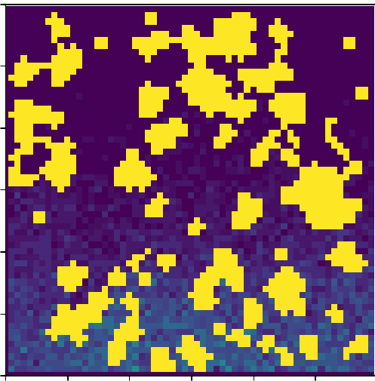
Diffusion of Particles through Procedurally Generated 2D Caves
EPS 109 Final Project
Vinay Kanigicherla

Slide 2
Method
A cellular automaton is a collection of cells in a grid wherein the state of each cell changes as a function of time according to rules defined by the states of neighbouring cells at the previous timestep
To procedurally generate caves:
Initialize a grid with INITIAL_WALLS_PERCENTAGE% of the cells being walls
(4x) Rule 1: If >=6 of a cells neighbours are walls, the cell also becomes a wall
(3x) Rule 2: If <=3 of a cells neighbours are walls, the cell becomes empty
To simulate diffusion of gas particles through cave we use random walks:
Initialize 10000 particles distributed uniformly along bottom of cave
They move randomly move up, down, left, or right
If they hit cave boundary or a wall, they stay in their place
Particles move up with probability MOVE_UP_PROB
MOVE_UP_PROB = 0.5 → no external wind
MOVE_UP_PROB > 0.5 → external wind blowing upwards

Slide 3
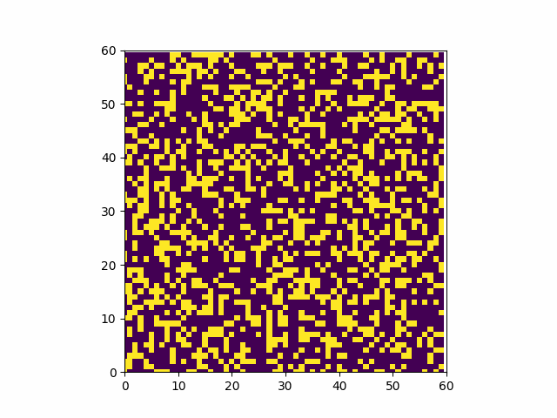
Cave Formation Animation (INIT_WALL_PCT=0.35)

Slide 4
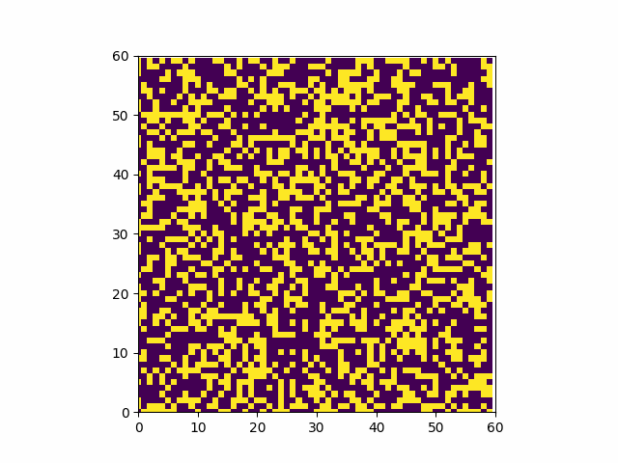
Cave Formation Animation (INIT_WALL_PCT=0.40)

Slide 5
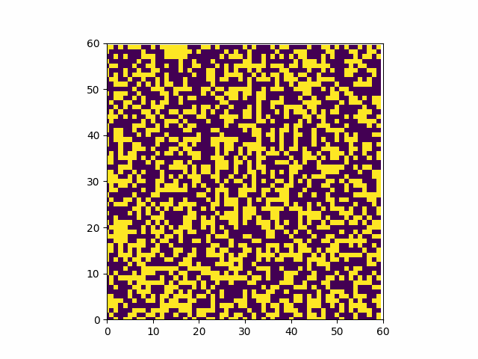
Cave Formation Animation (INIT_WALL_PCT=0.45)

Slide 6
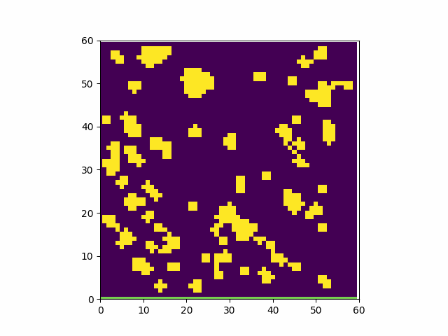
Particle Diffusion Animation (INIT_WALL_PCT=0.35, MOVE_UP_PROB=0.5)

Slide 7
Particle Diffusion Animation (INIT_WALL_PCT=0.35, MOVE_UP_PROB=0.65)

Slide 8
Particle Diffusion Animation (INIT_WALL_PCT=0.35, MOVE_UP_PROB=0.8)

Slide 9
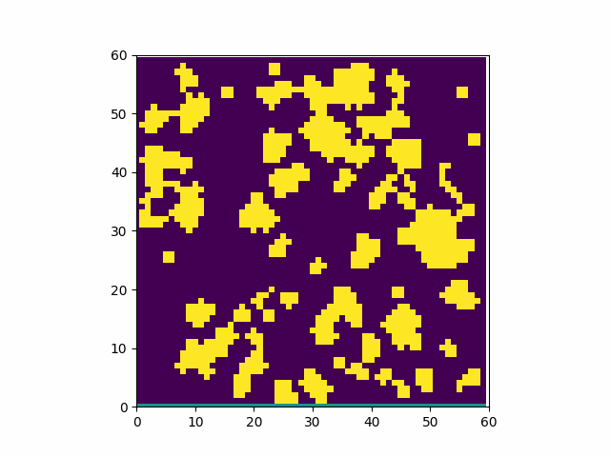
Particle Diffusion Animation (INIT_WALL_PCT=0.4, MOVE_UP_PROB=0.5)

Slide 10
Particle Diffusion Animation (INIT_WALL_PCT=0.4, MOVE_UP_PROB=0.65)

Slide 11
Particle Diffusion Animation (INIT_WALL_PCT=0.4, MOVE_UP_PROB=0.8)

Slide 12
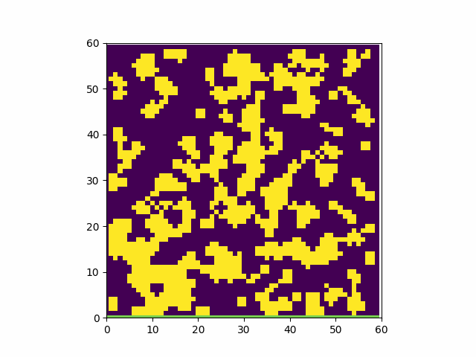
Particle Diffusion Animation (INIT_WALL_PCT=0.45, MOVE_UP_PROB=0.5)

Slide 13
Particle Diffusion Animation (INIT_WALL_PCT=0.45, MOVE_UP_PROB=0.65)

Slide 14
Particle Diffusion Animation (INIT_WALL_PCT=0.45, MOVE_UP_PROB=0.8)

