Slide 1
Musical Hurricanes
Ruchir Baronia

Slide 2
Project Statement
The goal is to simulate hurricanes on a map over time, and overlay music on the simulation. Each note for the song should represent the pressure of the hurricane. Higher pressure should yield higher notes, and correspond to the right point visually.

Slide 3
Section one:
Data Collection & Cleaning 🧽

Slide 4
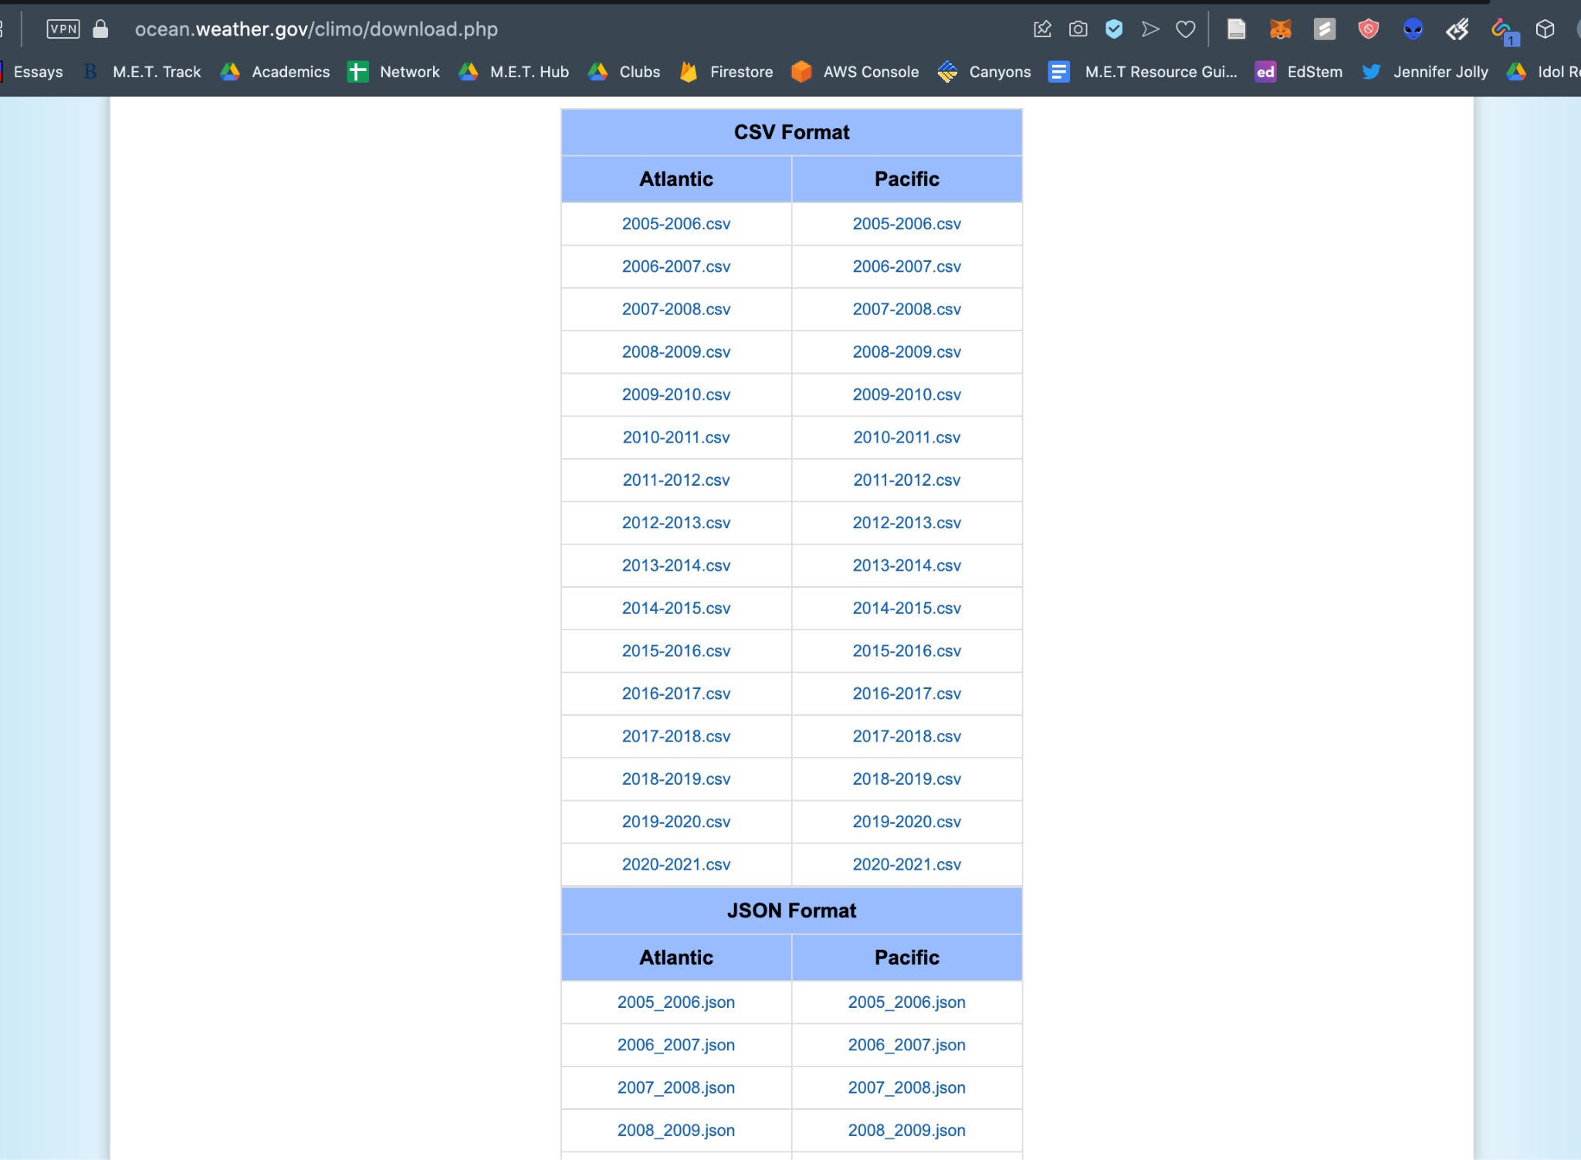

Slide 5
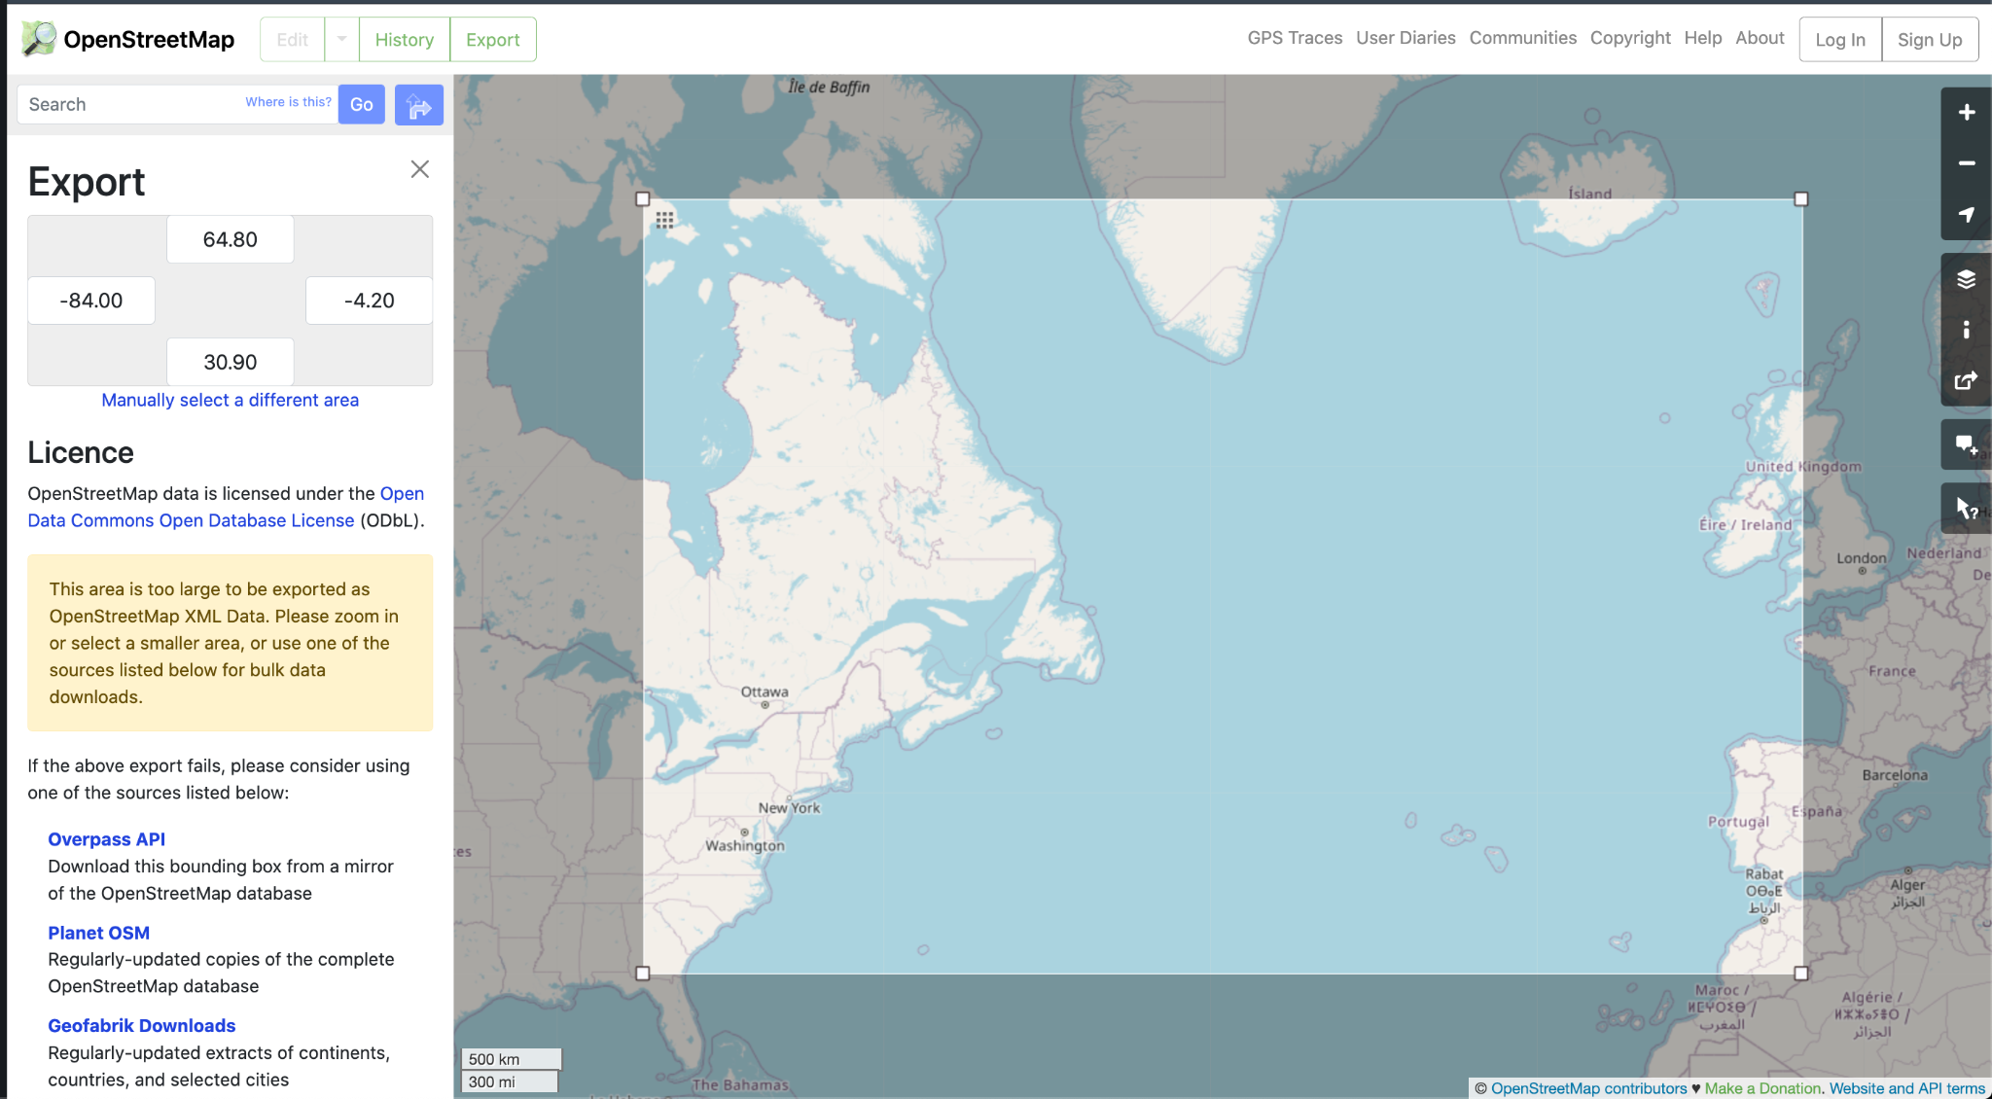

Slide 6
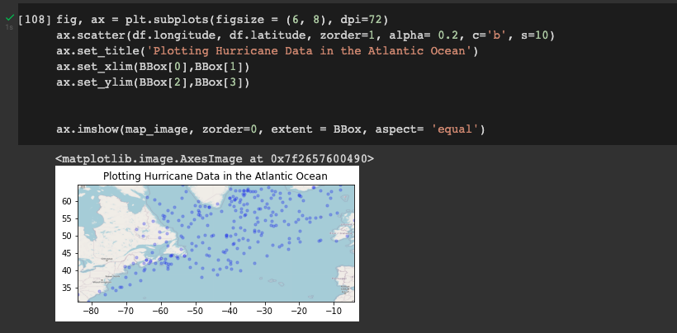
How to bound the map to the data?

Slide 7
Section Two:
Simulations 👨‍💻

Slide 8
FuncAnimation

Slide 10
Section Three:
Audio 🎶

Slide 11
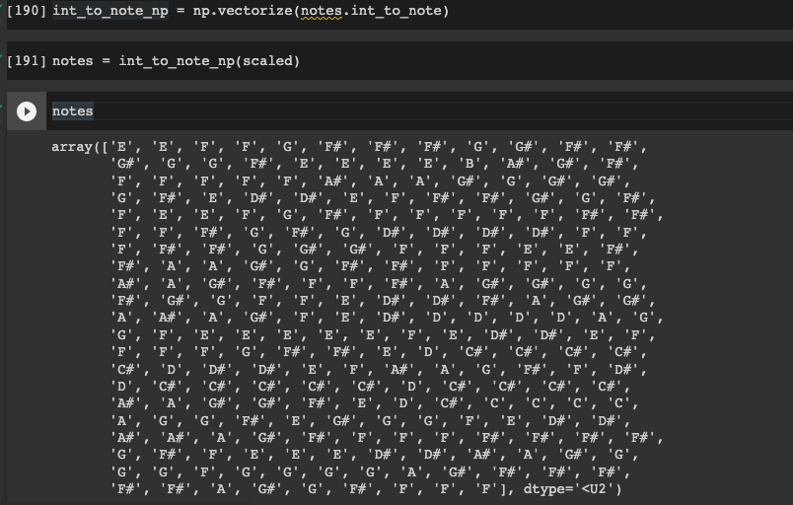

Slide 12
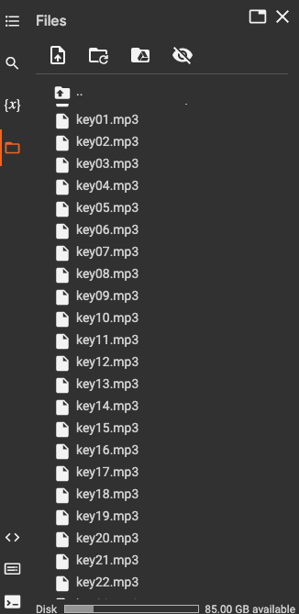

Slide 13
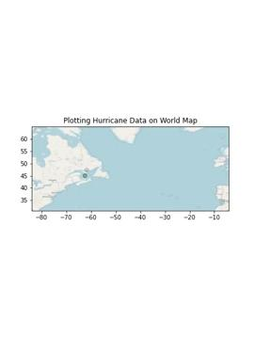
Higher Pitch = Greater Pressure

Slide 14
Thank You!

