Slide 1
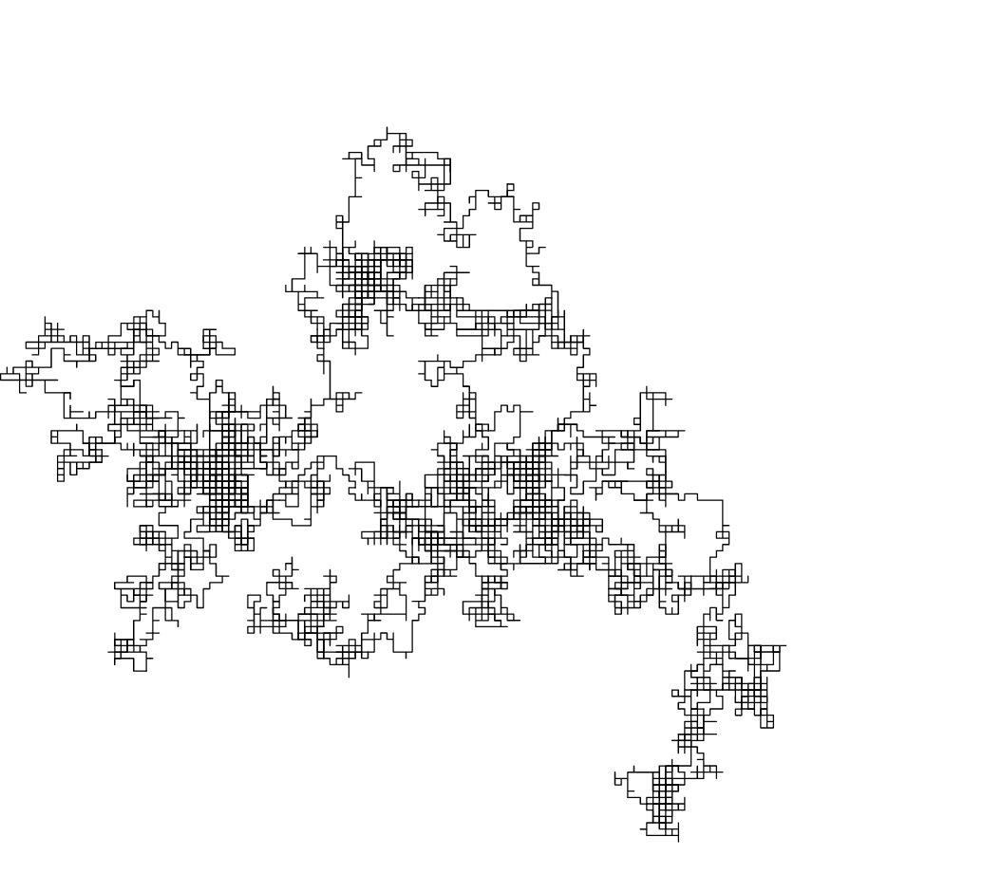
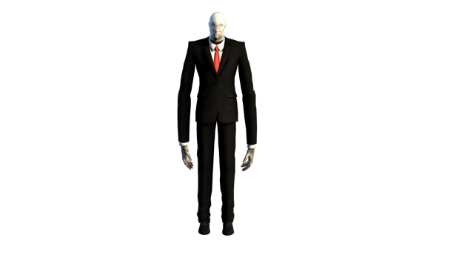
Random Walks with Slenderman
Gabrielle Stewart
https://en.wikipedia.org/wiki/Random_walk
https://www.pngall.com/slender-man-png

Slide 2
Methods:
“Slender: the eight pages” is a horror game
Chased around an enclosed forested park at night
Cannot see far into the darkness, it can seem like walking around in circles
Goal is to escape by collecting the randomly placed 8 pages
Implementation: a simplified version of the game with random walk
Random walk
Moves on a grid system with higher opacity per step for seeing the frequency of re-walks
Walks until all 8 pages are found, then character escapes slenderman’s clutches
How slenderman chases
Color of the steps indicates the level of danger character is in
Teleports n steps behind characters walk depending on page count
If character and slenderman positions are on the same x and y coord, character has been caught
Similar to initial plays of the game and not strategized speedruns of full map

Slide 3
Animation 1

Slide 4
Animation 2

Slide 5
References:
https://www.codingem.com/random-walk-in-python/
https://fromcodetoclinic.wordpress.com/2017/01/25/random-walks-w-python/
Images: Win-screen-image, Death-screen-image, forest-background

