Slide 1
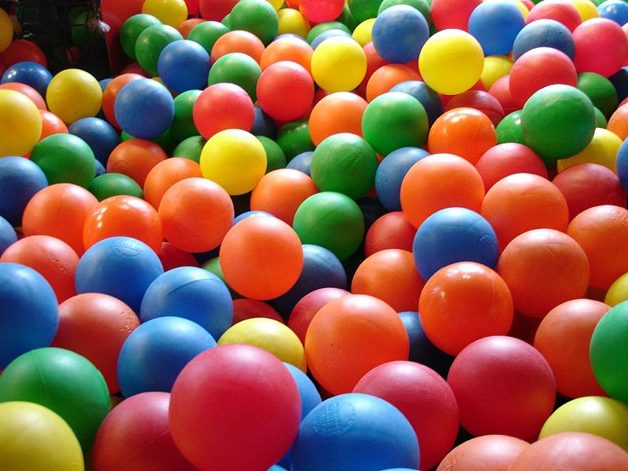
Elastic Collisions
Ava Joaquin

Slide 2
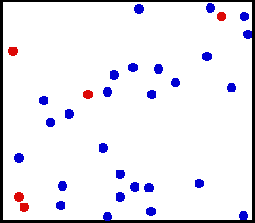
Goal
Goal: To simulate elastic collisions
Elastic collisions are when kinetic energy and momentum are conserved
Used the conservation of momentum and conservation of kinetic energy equations

Slide 3
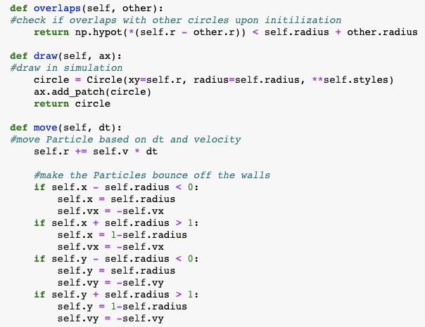
Particle class
Created a Particle class with position, velocity, radius, and color attributes
The color and initial velocity of the Particle are dependent on its radius
Has function to check if it overlaps/collides with another Particle
Has function to advance its position depending on some time (dt) and its own velocity, making sure to account for hitting walls

Slide 4
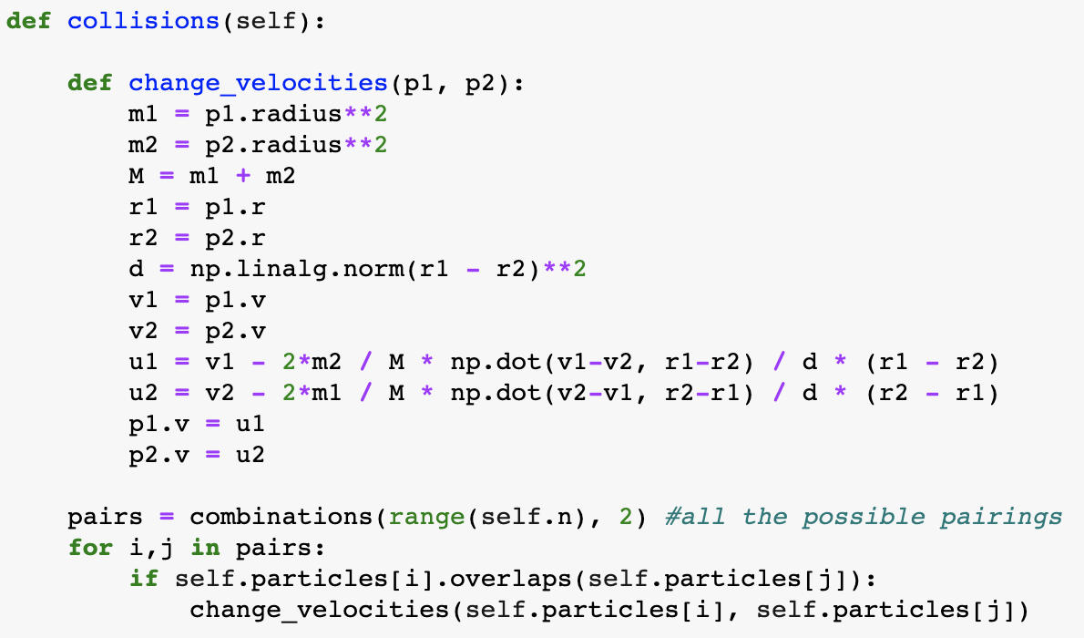
Simulation class
Has a function that handles collisions between Particles, which changes the velocities of Particles that collide
Some of my Simulation class was borrowed from christian’s post on scipython.com (https://scipython.com/blog/two-dimensional-collisions/), which helped me create the simulation. I edited it to fit my own project

Slide 5
Elastic collisions equations

Slide 6
Animation
50 Particles
25 Particles

