Slide 1
N-Body collisions playground
Edward Wolfe

Slide 2
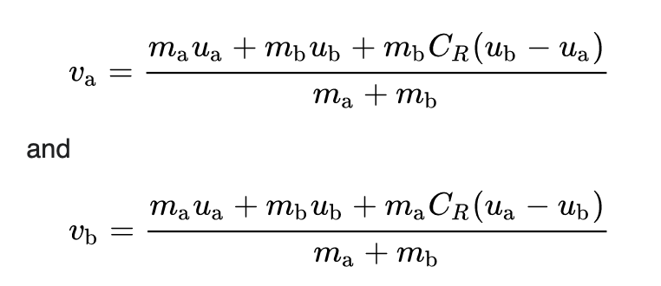
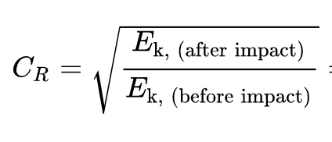
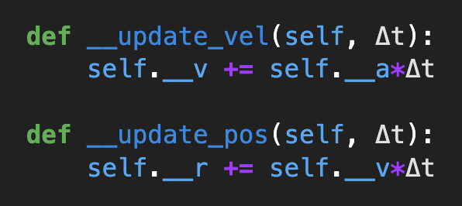
Background
Goal: to create a physic based interactive playground where you can explore physical scenarios involving particles with different properties and conditions, colliding with one another.
Methods:
Created Particle object that contains physical properties (i.e. position, velocity, acceleration, mass, and radius) of any given particle at any time.
Created Box object that implements the following:
Box collisions – when a particle collides with either side of the wall, the box determines the outcome. Assuming infinite mass and no loss of kinetic energy, collision is perfectly elastic by construction.
Particle collisions – when a particle collides with one or more particles, the outcome is decided based on COEFFICIENT OF RESTITUTION hyperparameter, denoted by C_{R}. The value is between 0 and 1. When 0, outcome is perfectly inelastic collision, when is 1 outcome is a perfectly elastic collision.
Time steps – Given a time step, dt, all particles velocities and positions are updated.

Slide 3
m_{g} = m_{y} , V_{g} = 10 m/s, V_{y}=0 m/s, C_{R}= 1

Slide 4
m_{o} = m_{b} , V_{o} = 10 m/s, V_{b} = 0 m/s, C_{R}= 0

Slide 5
N = 60, C_{R} = 1

Slide 6
N = 30, C_{R} = 0.6

Slide 7
N = 5, C_{R} = 0.6

