Slide 1
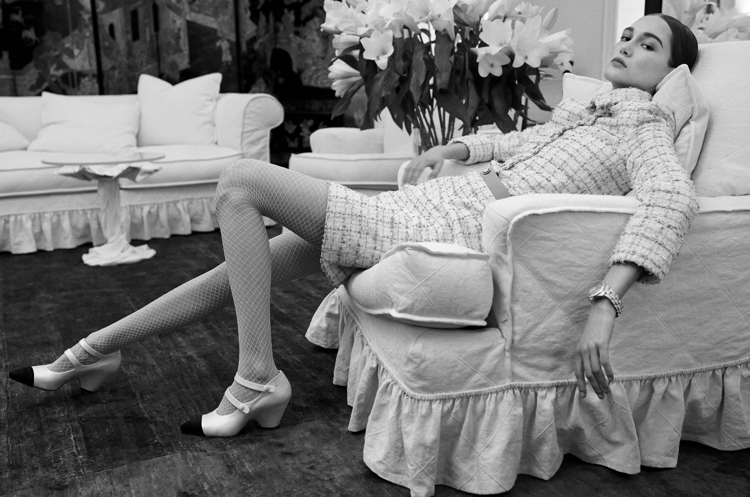
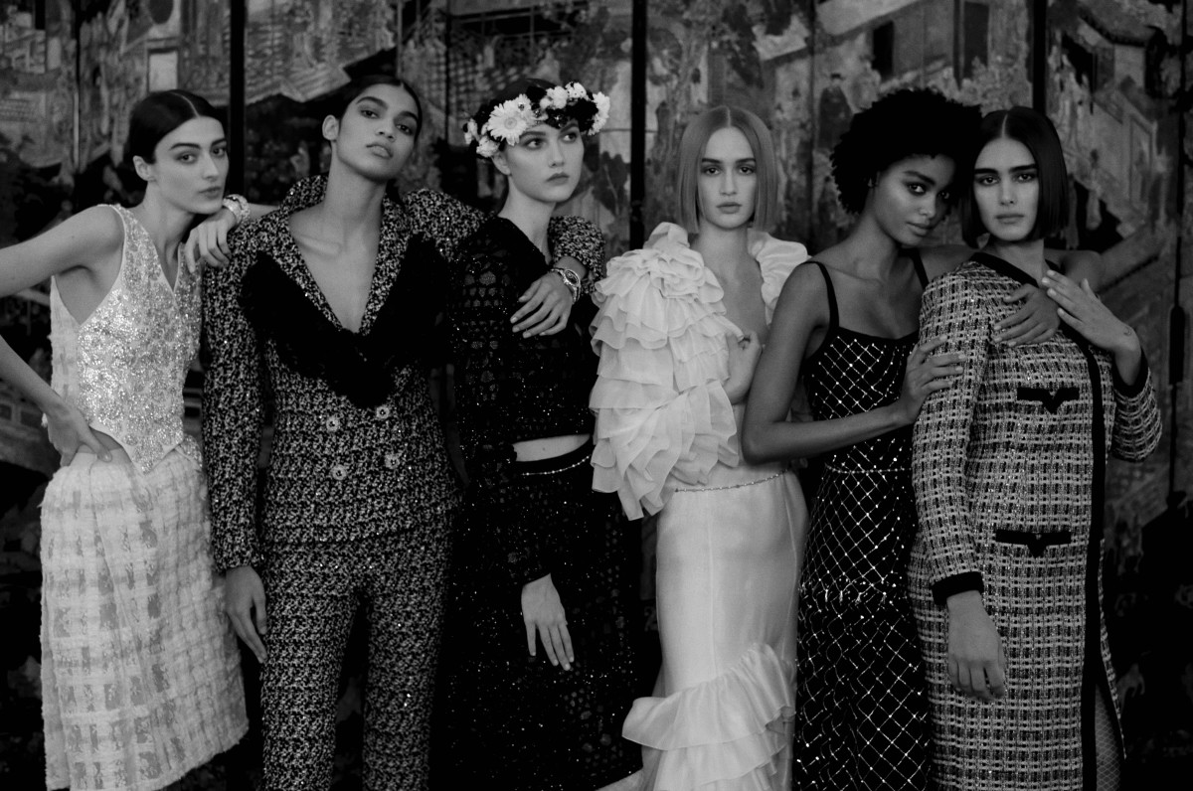
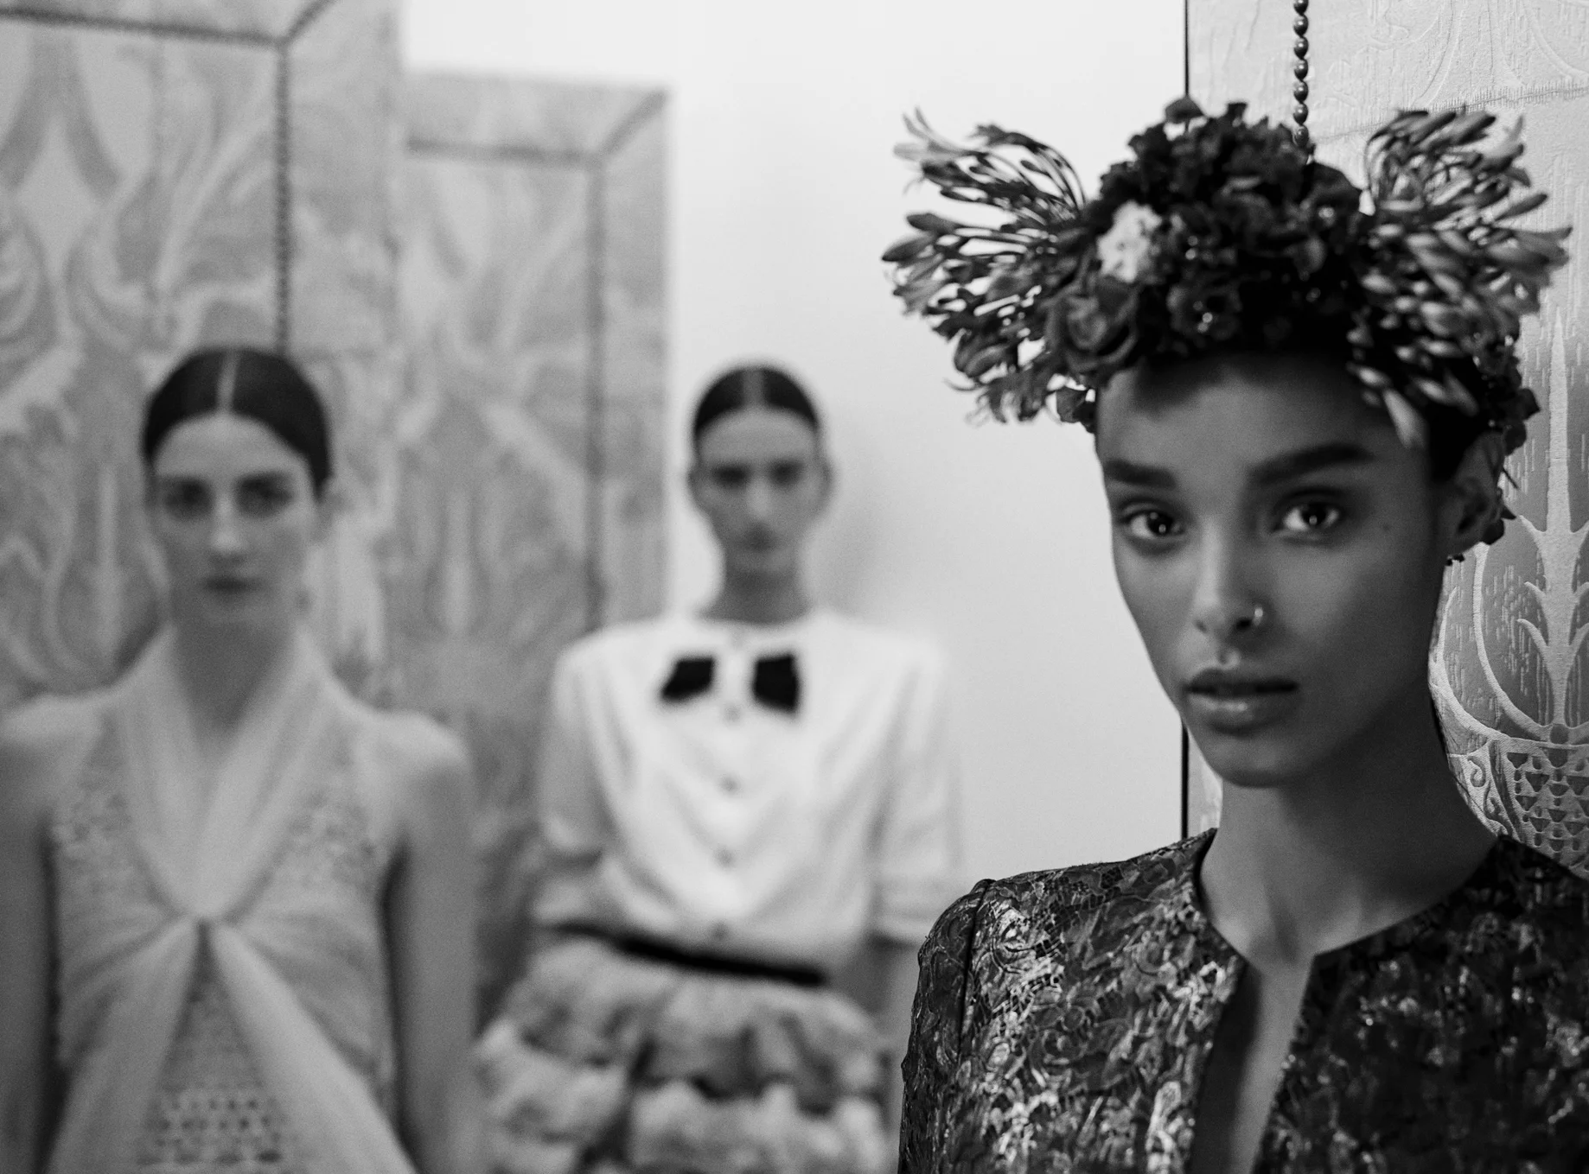
EPS 109:
Analyzing Colors in Chanel’s Spring Haute Couture
Abigail Delgado

Slide 2
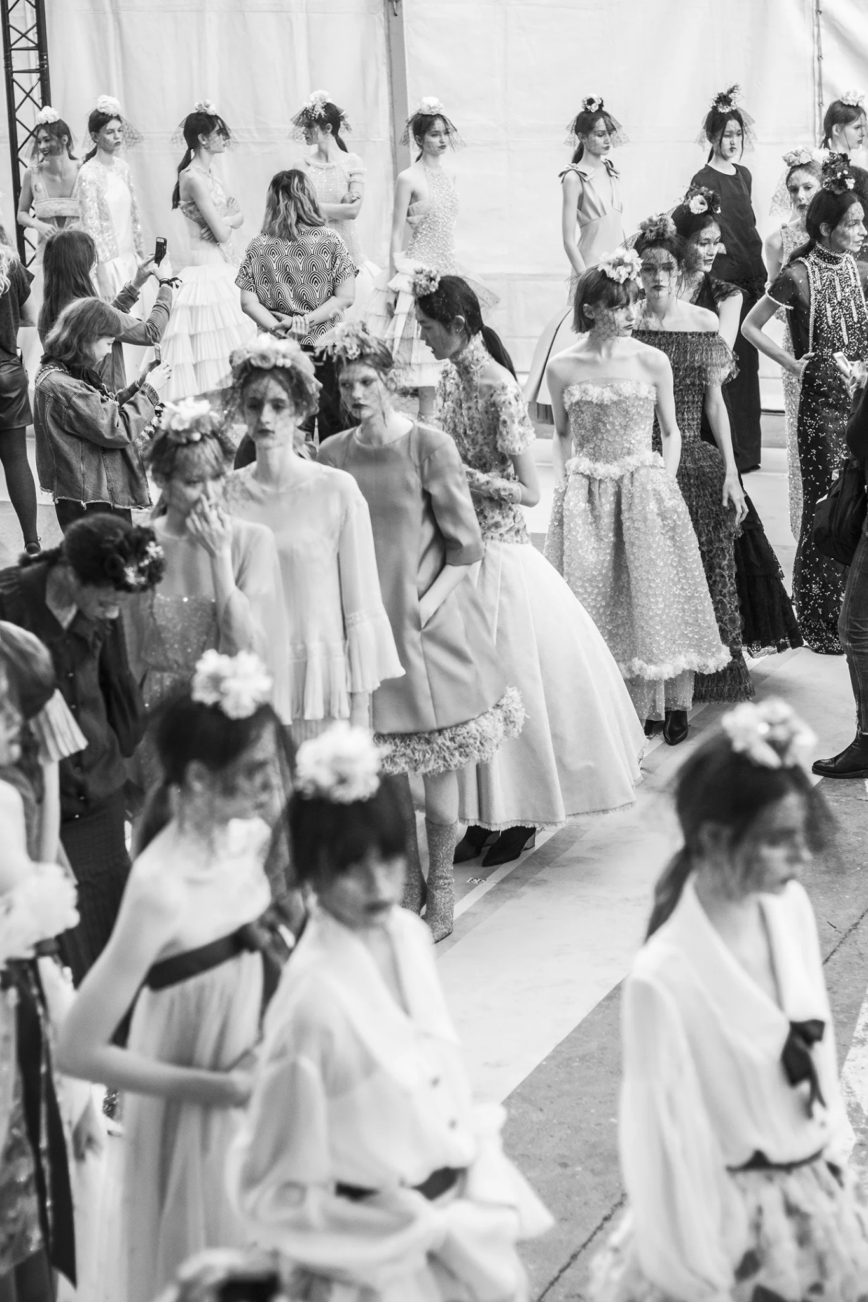
Topic and Methods
Challenges
I used color quantization and image processing to analyze hundreds of runway photos from Chanel’s past five spring couture collections.
Using the photos RGB values, I generated color bar plot to observe any recurring trends or patterns in Chanel’s spring designs.
To filter or to not filter out colors:
Dilemma of choosing which data is “good enough” to analyze what I wanted to represent in this case

Slide 3
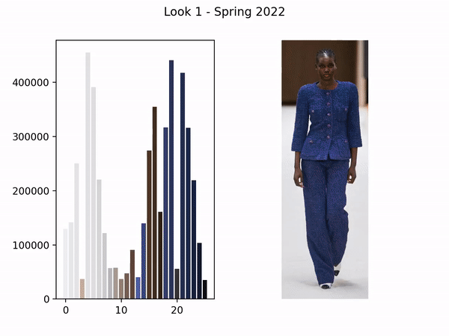
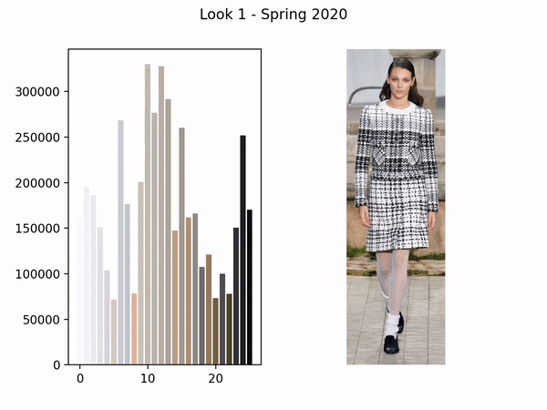
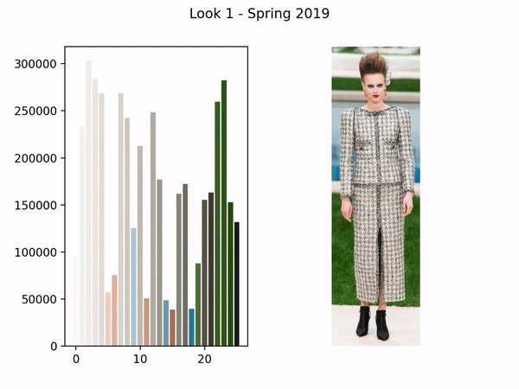
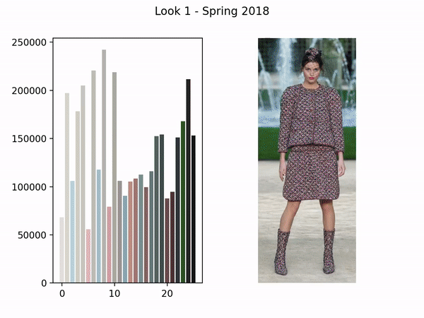
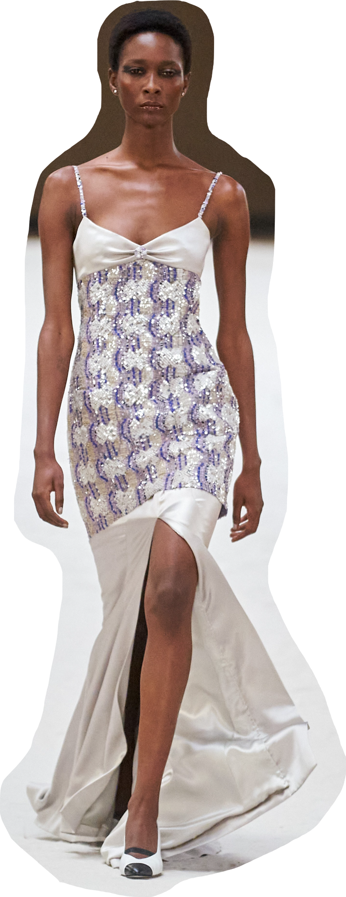
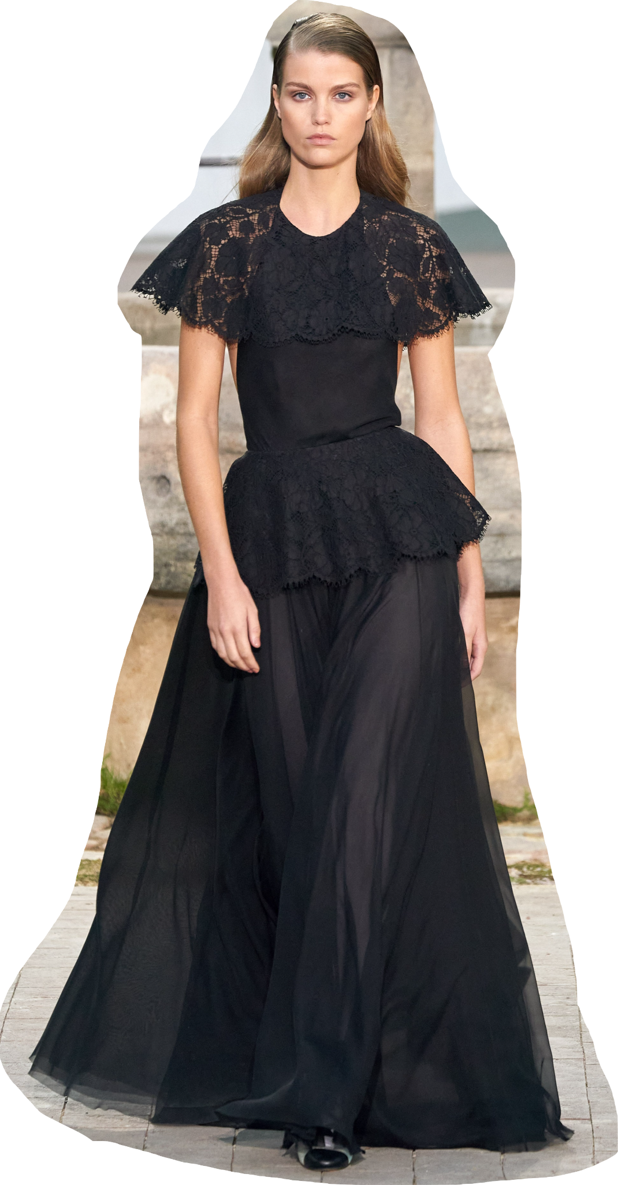
From top to bottom, left to right:
Chanel Spring 2023
Chanel Spring 2022
Chanel Spring 2020
Chanel Spring 2019
Chanel Spring 2018

