Slide 1
Waking up to Red Skies: Visualizing AQIs in September 2020
By: Catherine Lee

Slide 2
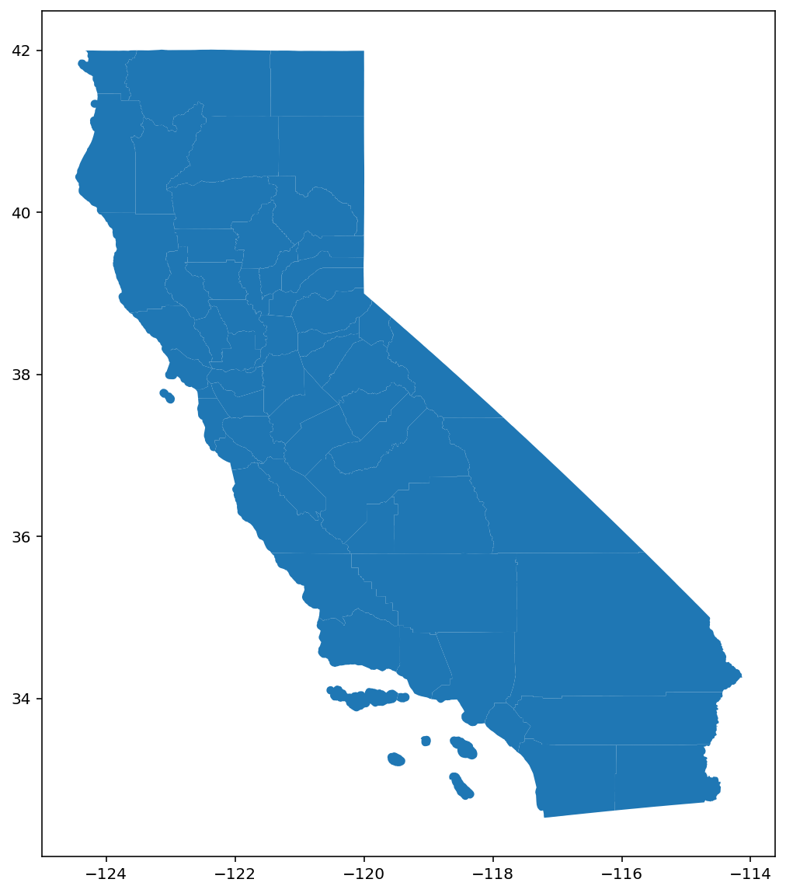
Methods
Data Source: https://aqs.epa.gov/aqsweb/airdata/download_files.html#AQI
Contains daily AQI values for almost all counties in the US from 1980-2022
Shape file: https://data.ca.gov/dataset/ca-geographic-boundaries
California county boundaries in vector form
Methods:
Downloaded a shape file and used Geopandas to process it
Exported the AQI data (2020 CSV file from epa.gov)
Cleaned the data
Only kept California data in the month of September
Left joined the shape file with the AQI data by county name
Some counties did not have AQI data – filled NA values with -20
Used Matplotlib colormaps to map the AQI data for every day
Used Matplotlib animation tools to create the video

Slide 3
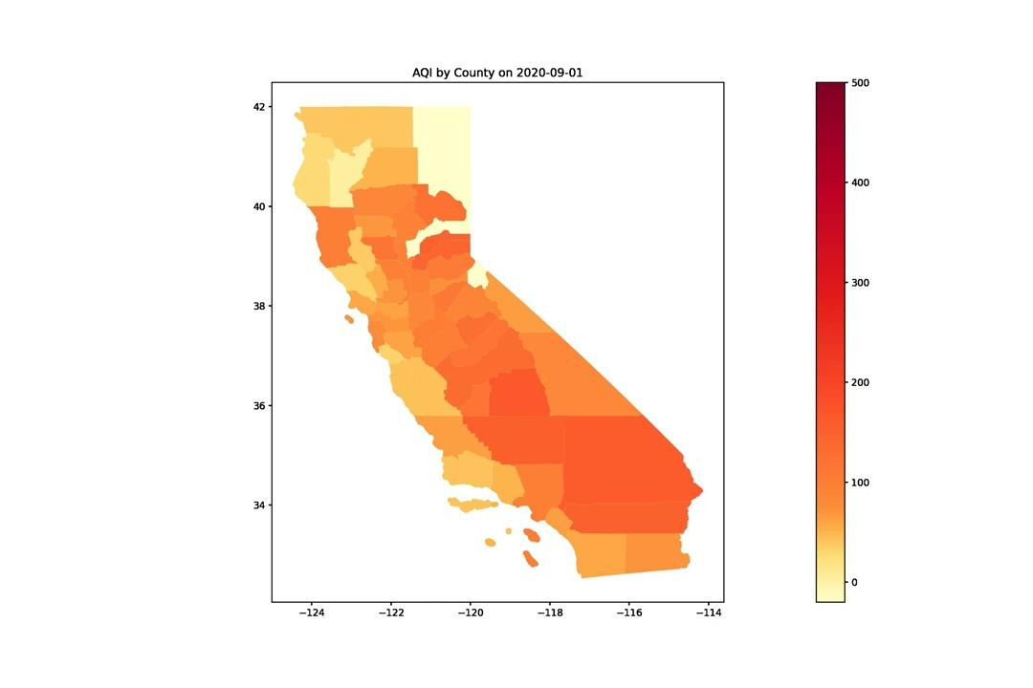
Animation (the pale yellow counties did not have AQI values – filled with -20)

