Slide 1
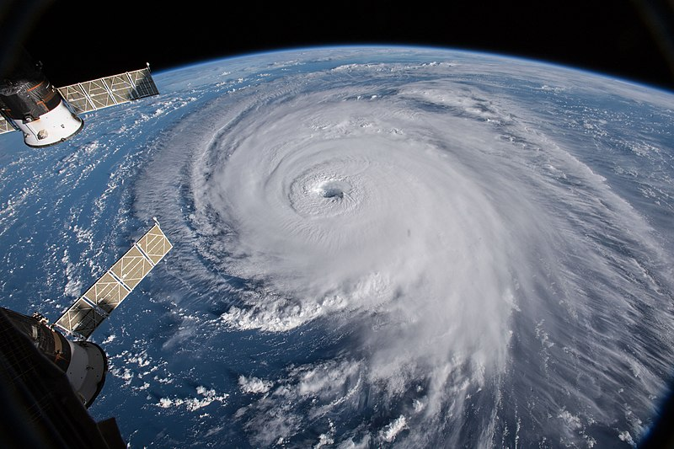
Wind Speeds in Hurricanes
Ari Diddams

Slide 2
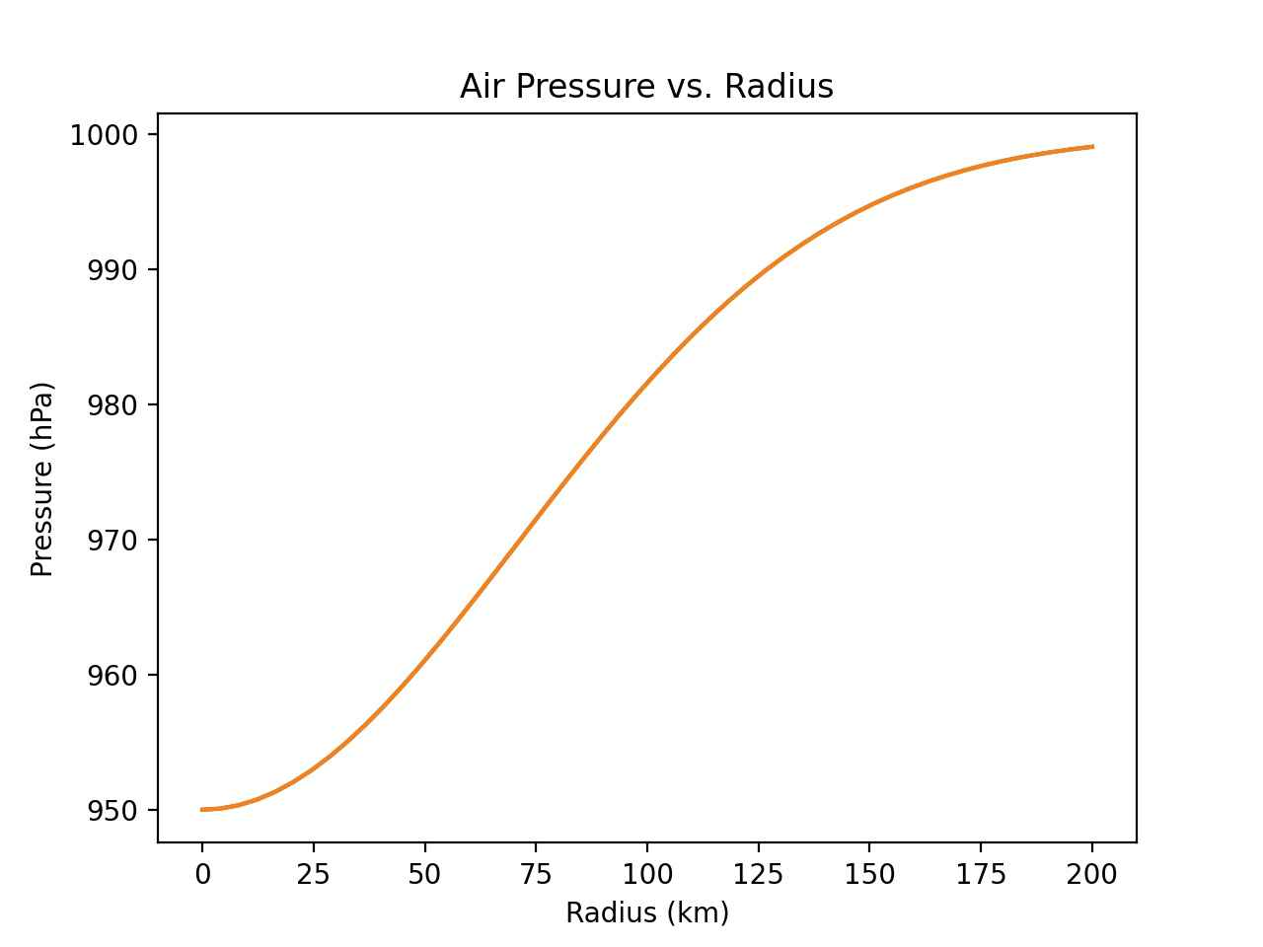
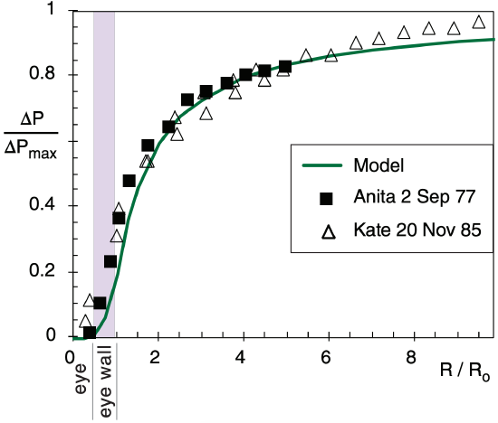
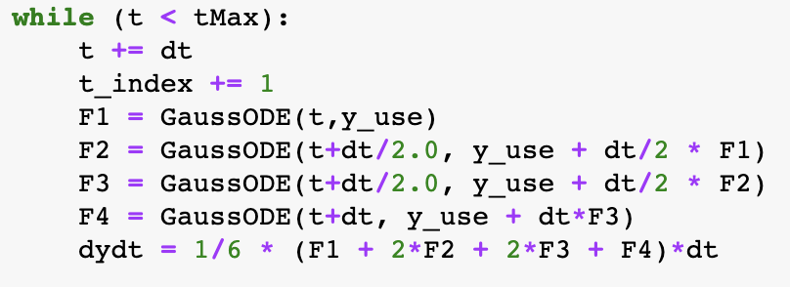
Pressure Gradient Wind and ODEs
Used ODEs to model the balance of forces that leads to circular motion of air in a hurricane.
Chose to test Gaussian pressure gradient against actual hurricane.
University of Rhode Island - hurricanescience.org
Roland Stull - UBC

Slide 3
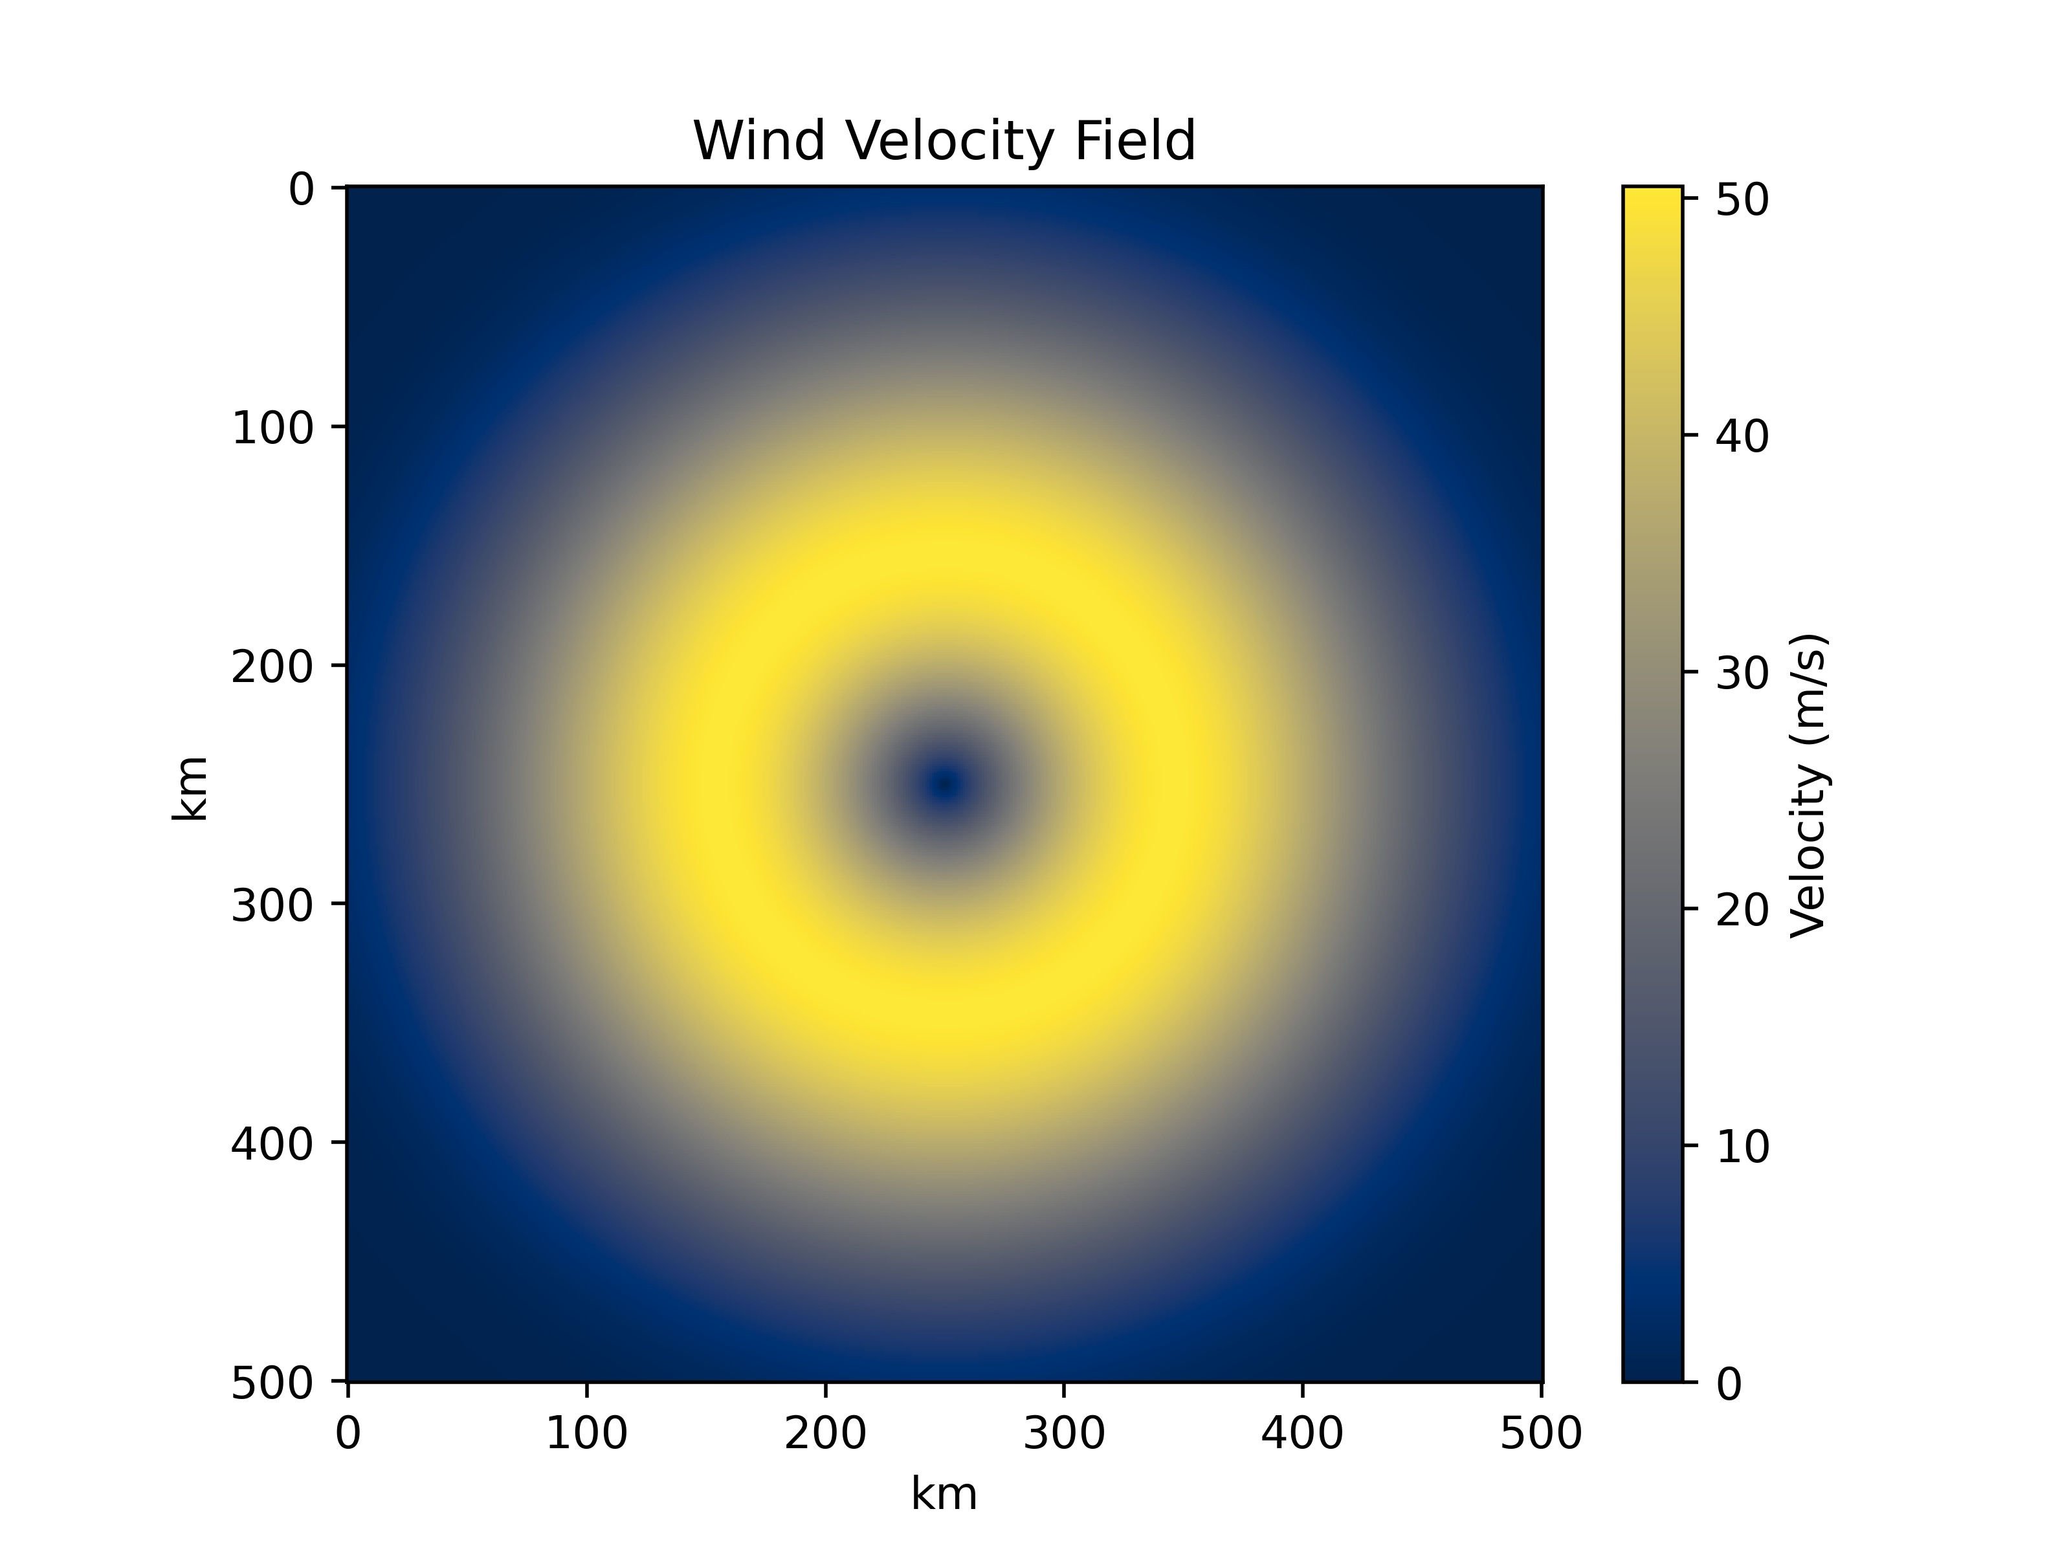
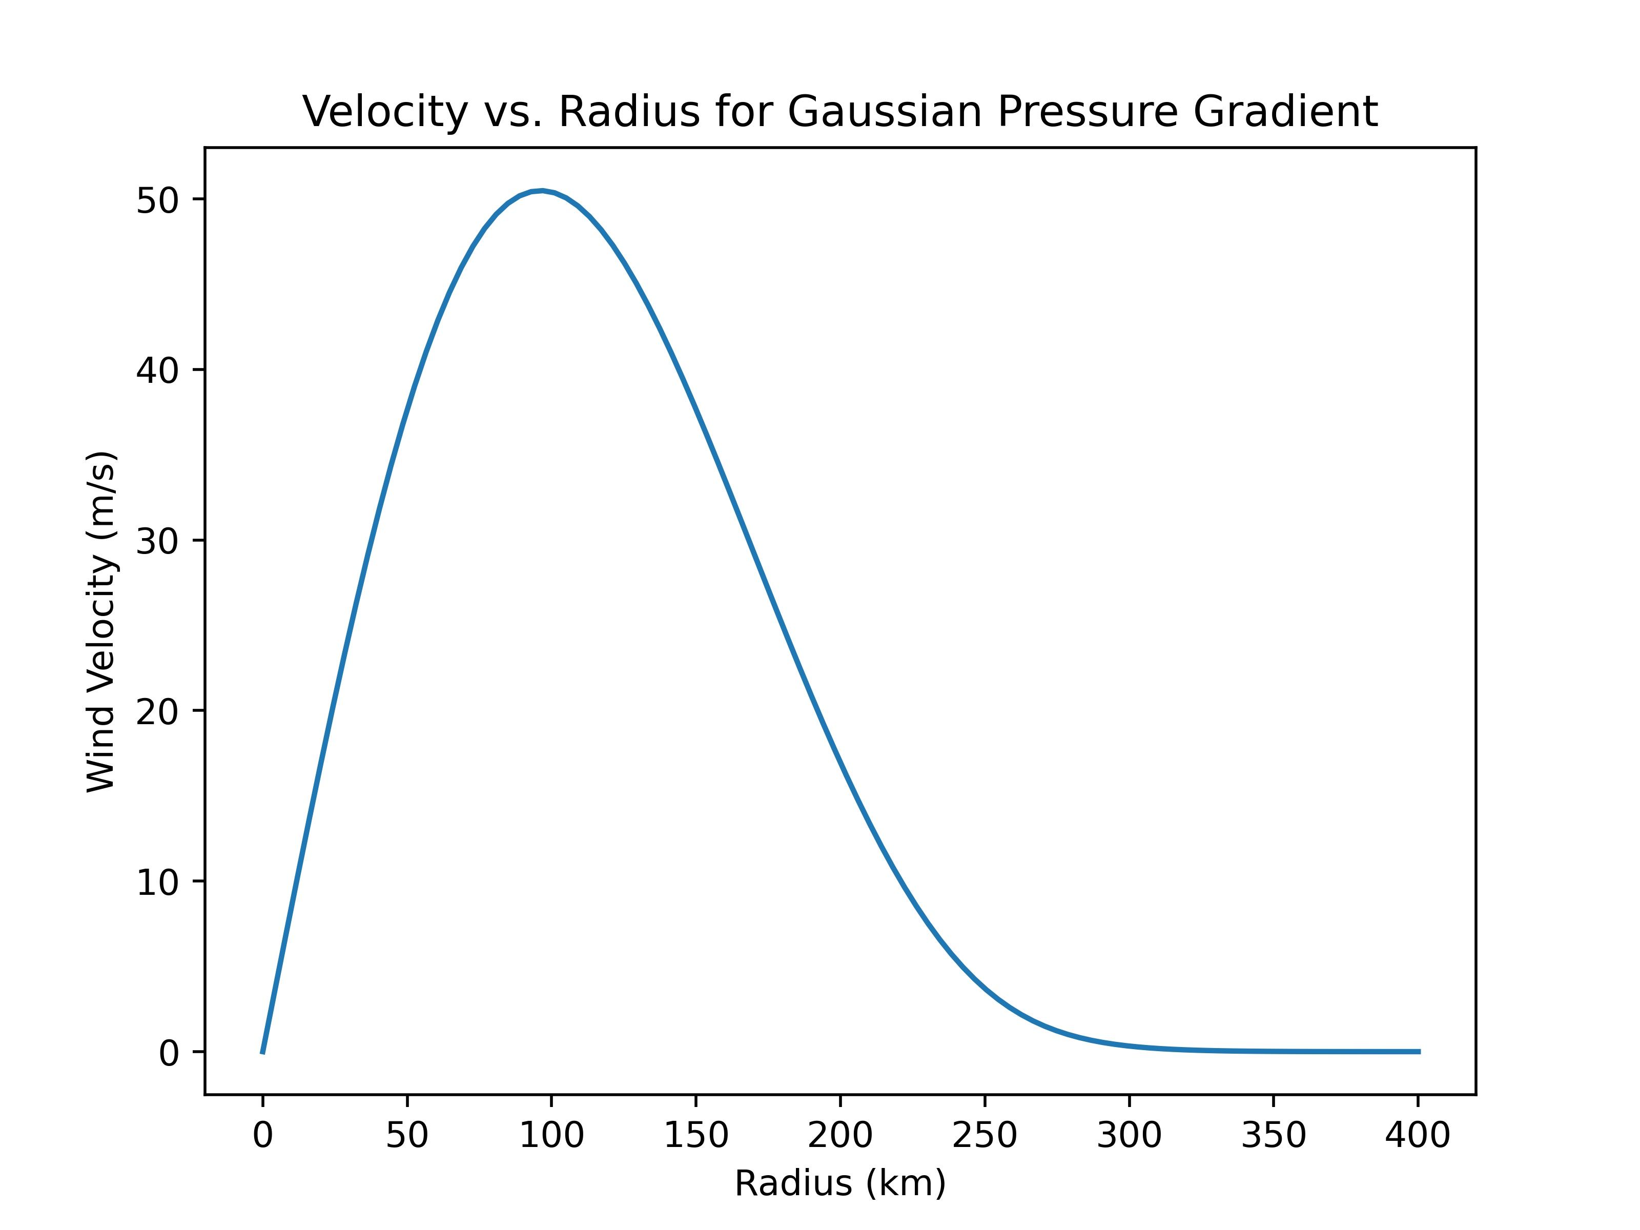
Circular Motion in a Hurricane

Slide 4
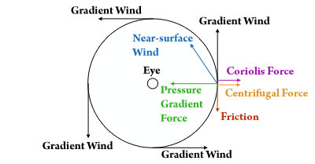
Further Coding!
University of Rhode Island - hurricanescience.org

