Slide 1
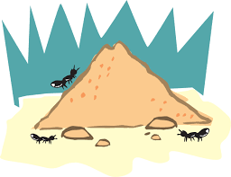
Ant Colony food Simulation
EPS 109
Arvind Vivekanandan

Slide 2
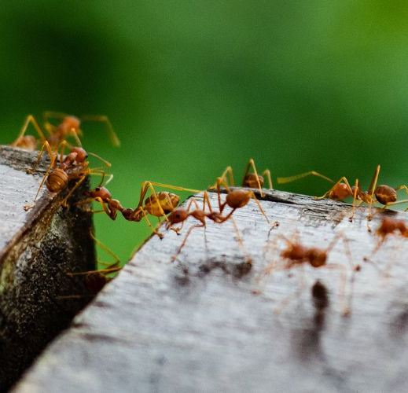
Ant colony background
Ants first leave the colony to scout for food
Once scouting ants find the food, they leave a pheromone trail towards the food source for other ants to find it
Other ants pick up on these pheromones and follow it to the food and bring it back to the colony

Slide 3
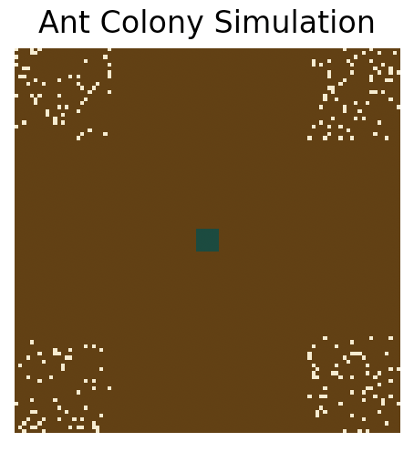
Simulation logistics
Simulation Construction
Created a 100 x 100 array with a patch in the middle representing the ant colony hole and where the ants spawn
Food was randomly placed in 4 corners of the area with a 10% chance of being generated in each pixel (approx. 240 total food pieces each time)
Ants were generated to leave the ant colony hole at random places
Random Walks
When ants first leave the colony, there is an equal chance (25%) to move left, right, up or down
When ants find food, they automatically go back to the colony with the food and leave a pheromone trail
When ants without food sense pheromones, they follow the trail instead of their completely random walk

Slide 4
Simulations
Simulation with 50 Ants
Simulation with 100 Ants
*Note: Simulations were stopped once there was less than 30% of the original amount of food remaining

Slide 5
References
“Chapter 12 Case Study: Ant Trails.” Case Study: Ant Trails, https://greenteapress.com/complexity/html/thinkcomplexity013.html.
Gorman, James. “How Ants Sniff out the Right Path.” The New York Times, The New York Times, 22 Jan. 2019, https://www.nytimes.com/2019/01/22/science/ants-navigate-scent.html.
NikoKun. “Python Ant Pheromone Simulation - WIP.” YouTube, YouTube, 9 May 2021, https://www.youtube.com/watch?v=XY8IzBfeWh8&ab_channel=NikoKun.

