Slide 1
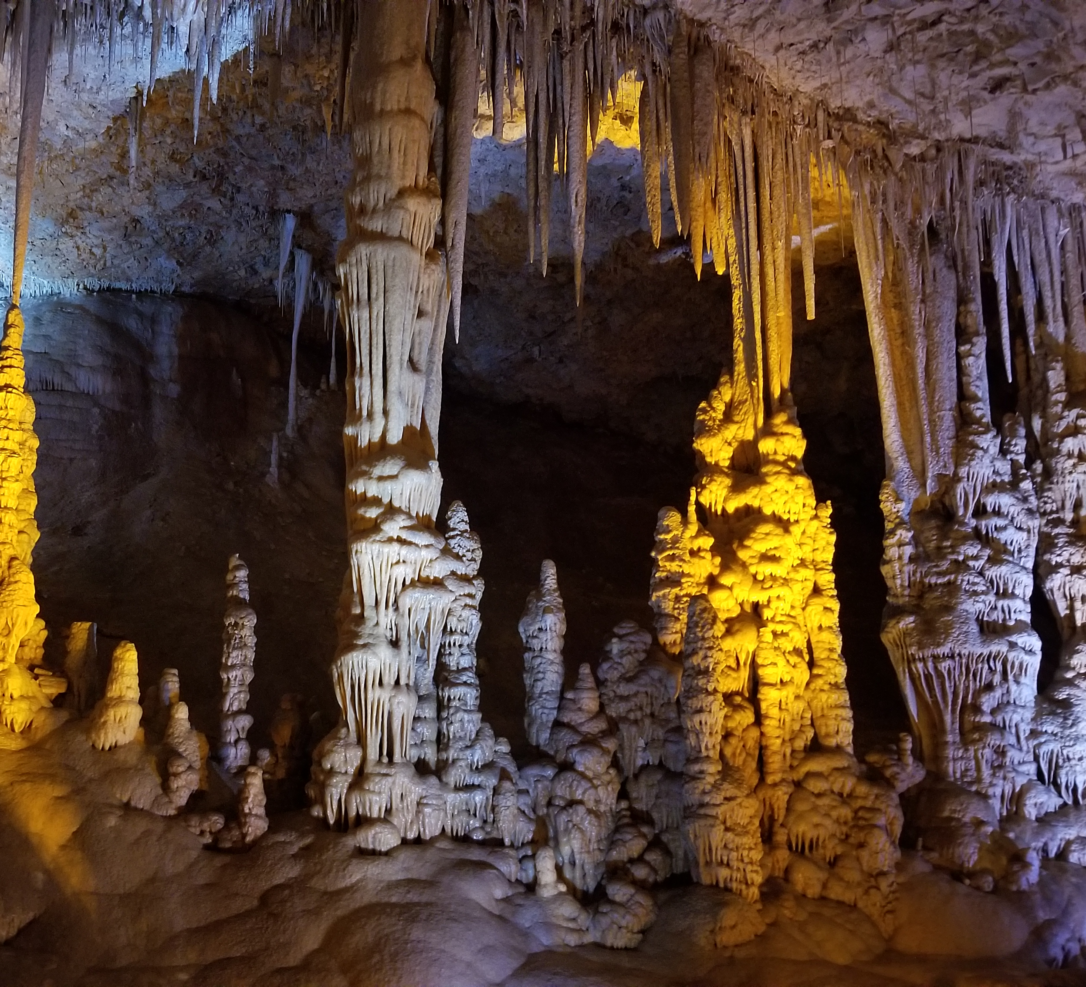
Formation of Stalactites/Stalagmites
Alex Rios

Slide 2
How are Stalactites and Stalagmites Formed?
Both are mineral formations commonly found in limestone caves.
Form over time when water containing dissolved calcium bicarbonate drips through the cave ceiling, depositing calcite via chemical reaction.
Water drops can deposit calcite in rings, forming “soda straws” from the ceiling.
If the straws are blocked, the water drops can flow around the structure, depositing calcite on its surface and forming stalactites
Drops that hit the ground can deposit calcite in layers, forming stalagmites.
Usually come in pairs. They can grow and combine to form a column.
I modeled this process using random walk methods.
Water drops of varying masses periodically fall from different locations in the cave ceiling
Drops can deposit part of mass into a neighboring surface w/ different probabilities (based on mass) to add to a stalactite/stalagmite
Drops also move horizontally (normal distribution)
Changing parameters lead to different structures.

