Slide 1
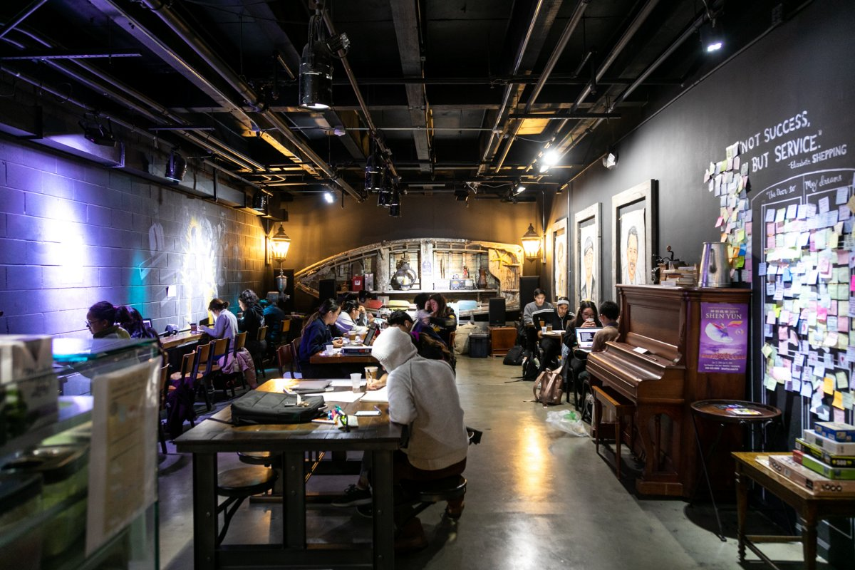
Simulating the Effectiveness of Berkeley Study Spaces
By: Alvaro Morales
Sodoi Tasting House

Slide 2
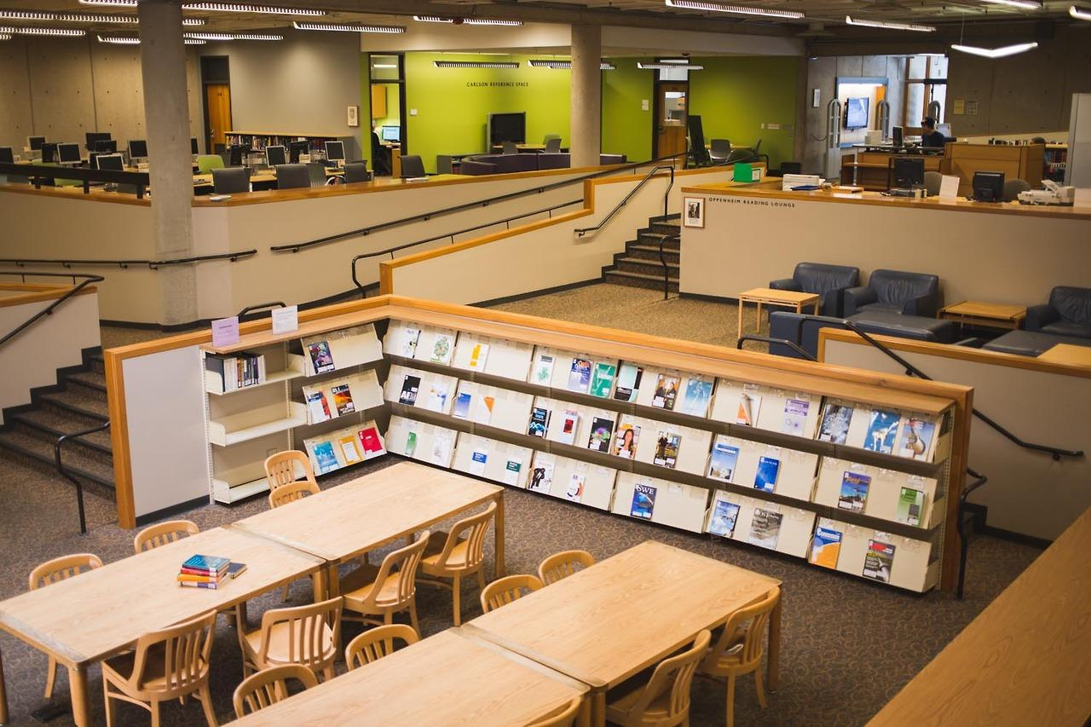
Kresge Engineering Library
Basic Idea:
Students enter a library, coffee shop, lounge, etc. and have relatively simple behavior
They will walk around the area looking for a seat
If a student loops back to a previous position in their path, they typically leave
This behavior can be simulated by a random walk.

Slide 3
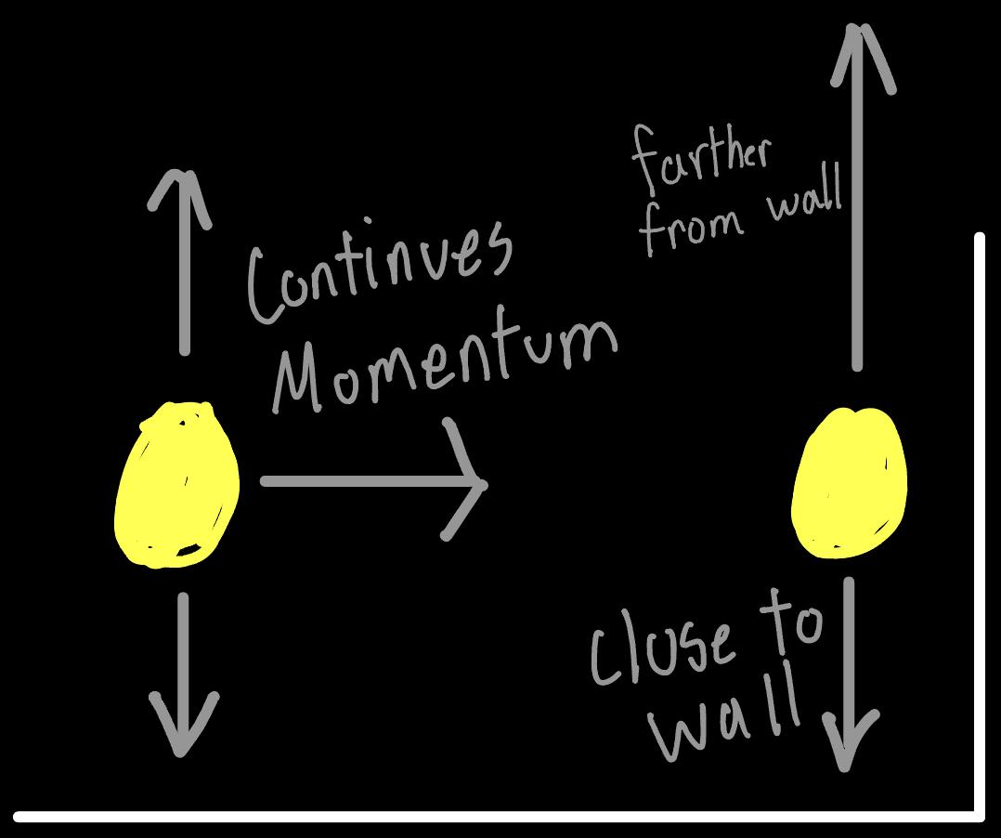
Simulation Principles:
Students prefer to keep walking in the same direction
Students prefer to take paths that lead away from walls, obstacles, etc.
Students upon creating a cycle leave the space
Seats that share tables are typically treated as one seat

Slide 4
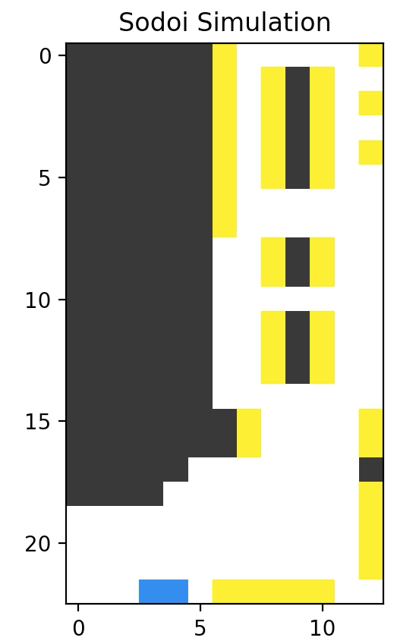
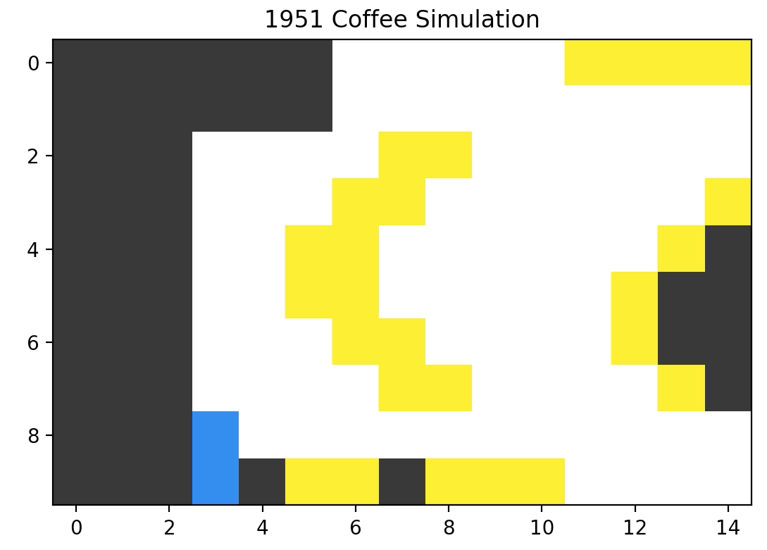
Off-Campus boards used for evaluation

Slide 5
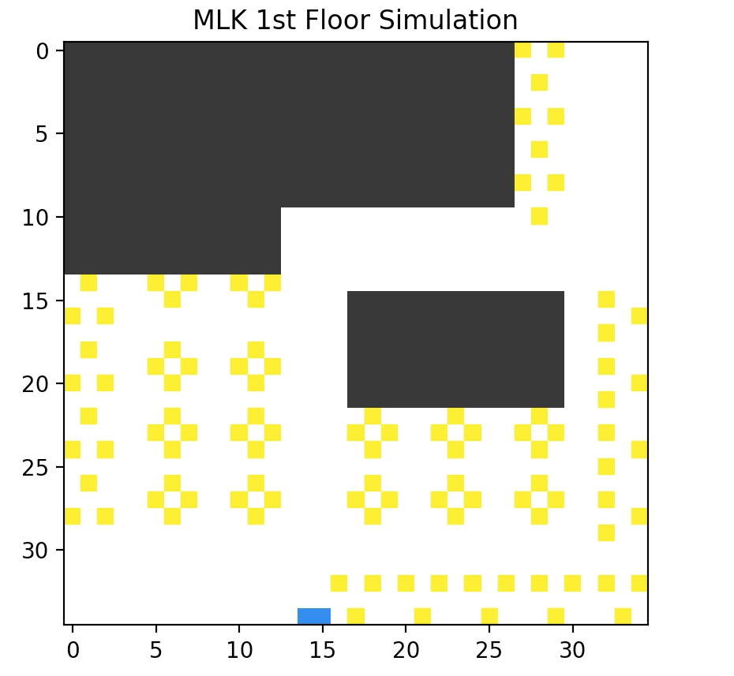
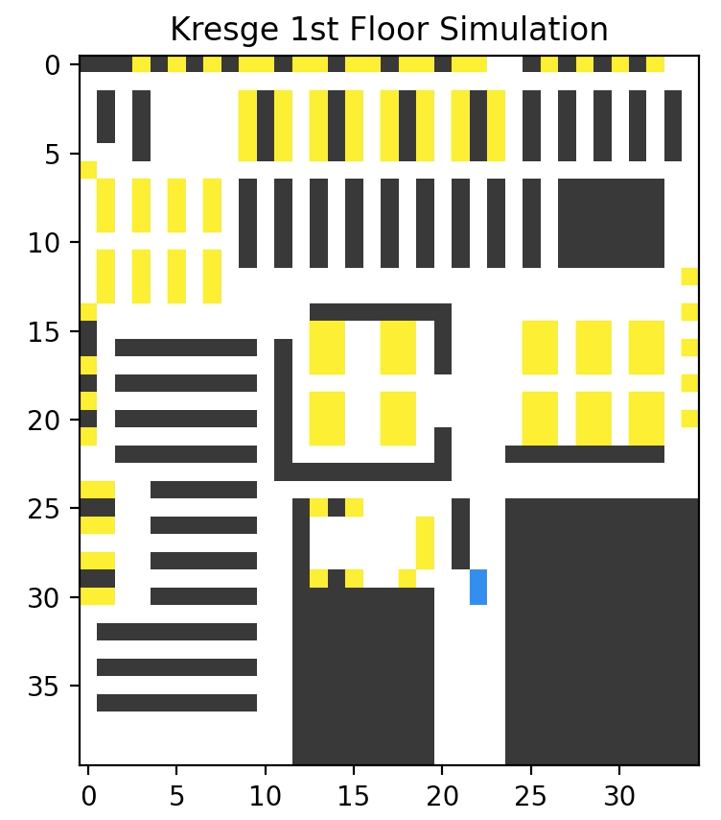
On-Campus boards used for evaluation

Slide 6
Simulations

Slide 7
Off-Campus final boards
Sodoi - 39/44 seats filled (~89%)
1951 Coffee - All seats filled (100%)

Slide 8
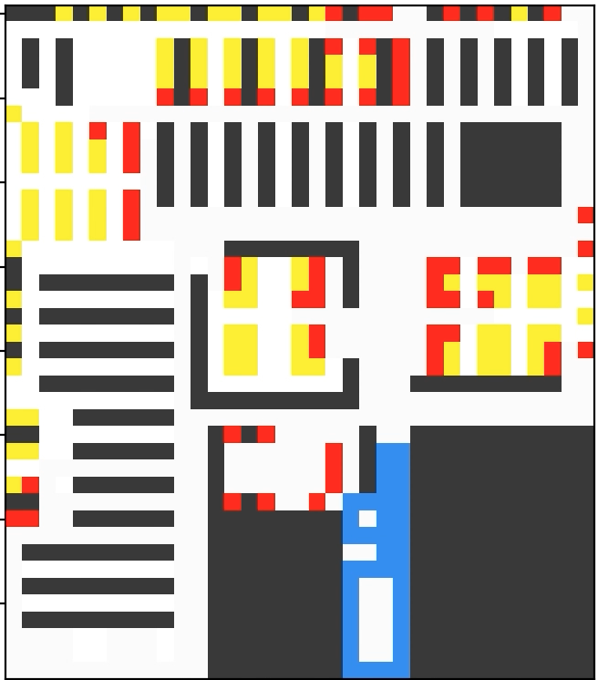
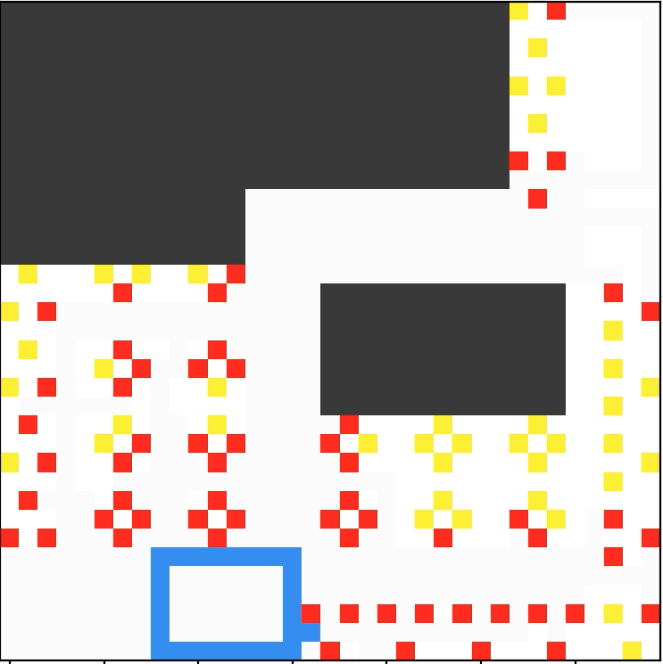
On-Campus final boards
MLK 1st Floor - 61/102 (~60%)
Kresge - 64/135 seats filled (~47%)

Slide 9
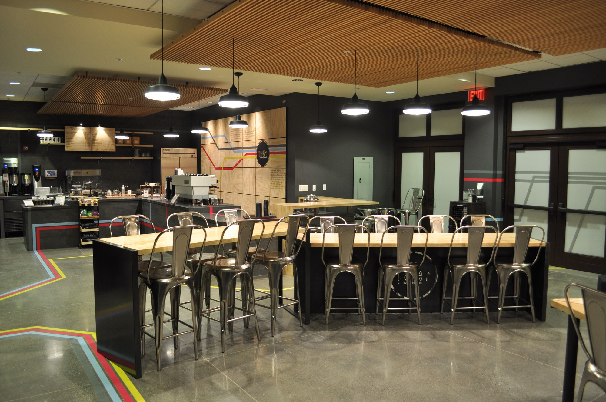
Future Improvements
Add simple vision to students
Prevent 360° turns that kill walks prematurely
Add students that come in groups
1951 Coffee

