Slide 1
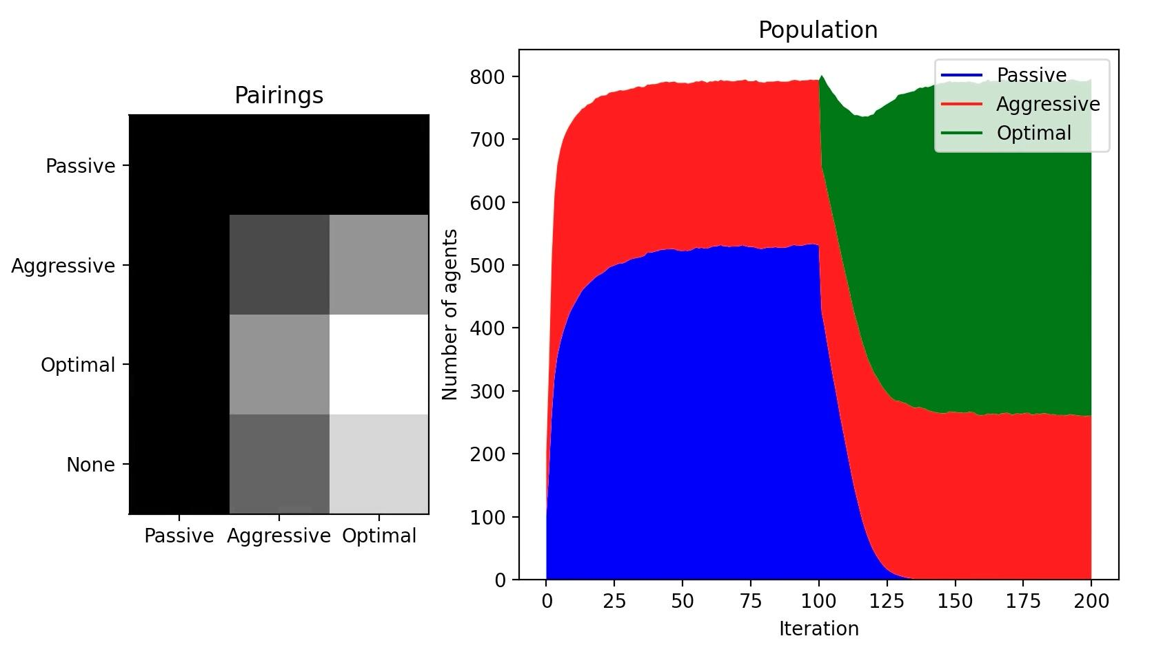
Simulating the Evolution of Conditional Aggression
Joshua Chen

Slide 2
Topic and Methods
Agents look for food to survive to the next iteration and reproduce
If two agents arrive at the same food, they compete
Optimal agents will choose the strategy that performs best for them given their opponent
Method: Monte Carlo Simulation
200 separate worlds
Each world has 200 agents with 400 units of food available
Run each world for 200 iterations
Average results for each world
 | Passive | Aggressive
Passive | 100%, 100% | 50%, 150%
Aggressive | 150%, 50% | 0%, 0%

Slide 3
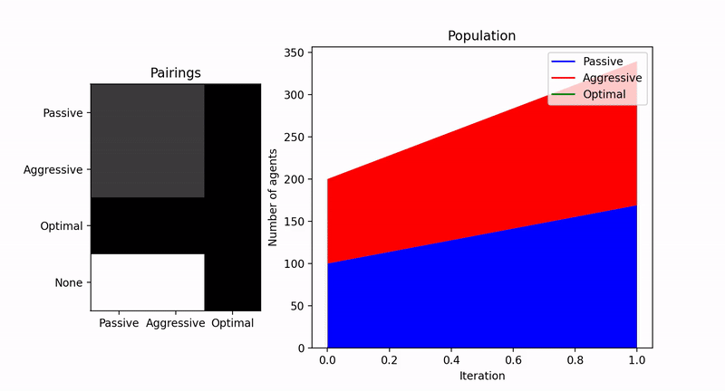

Slide 4
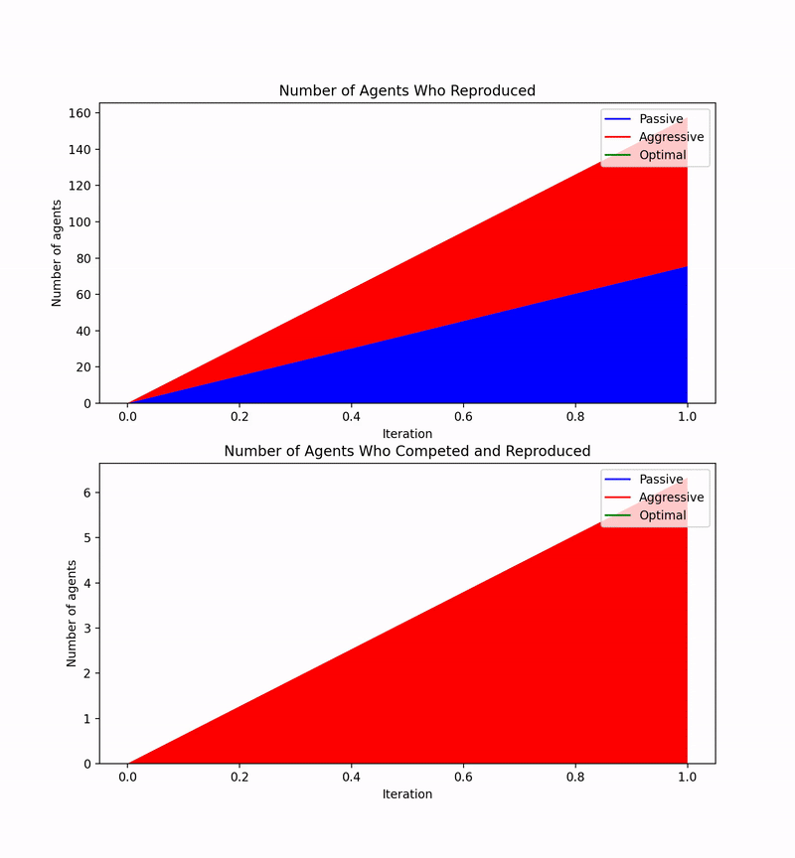

Slide 5
Trying to Improve Passive Performance
Passive agents can only reproduce if they find food that is uncontested
 | Passive | Aggressive
Passive | 125%, 125% | 50%, 150%
Aggressive | 150%, 50% | 0%, 0%

Slide 6
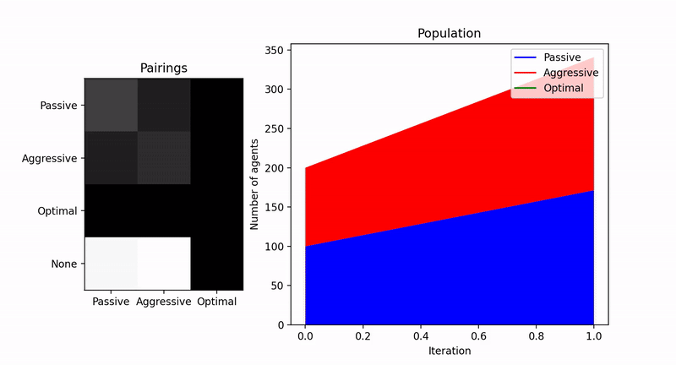

Slide 7
