Slide 1
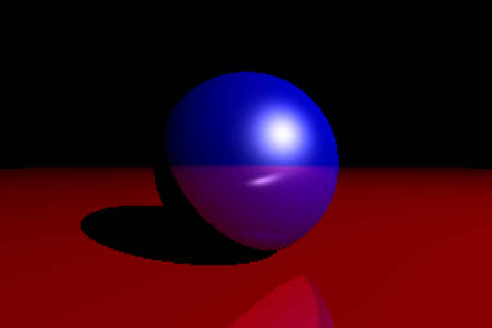
Simulating Optical Properties with ray tracing
Rhea Senthil Kumar
EPS 109 Fall 2022

Slide 2
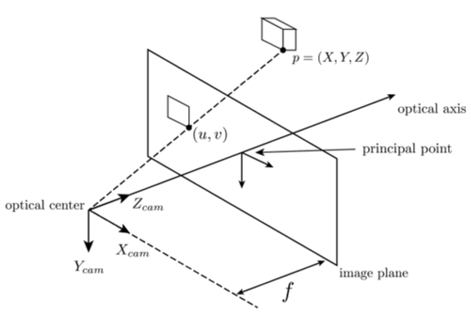
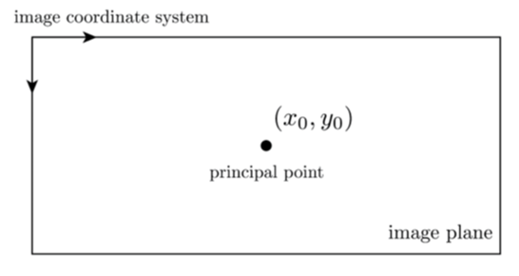
An overview of Ray tracing
Ray tracing: rendering technique to compute visibility between points
- Compute intersection of origin ray with geometries in environment
Pinhole Camera Model: defines geometric relationship between a 3D point and its 2D corresponding projection onto the image plane
What is needed to perform ray tracing:
Camera (3D position)
Screen (boundaries of FOV, aspect ratio)
Light source(s)
Object(s)
Simple! I only used NumPy and some geometry.

Slide 3
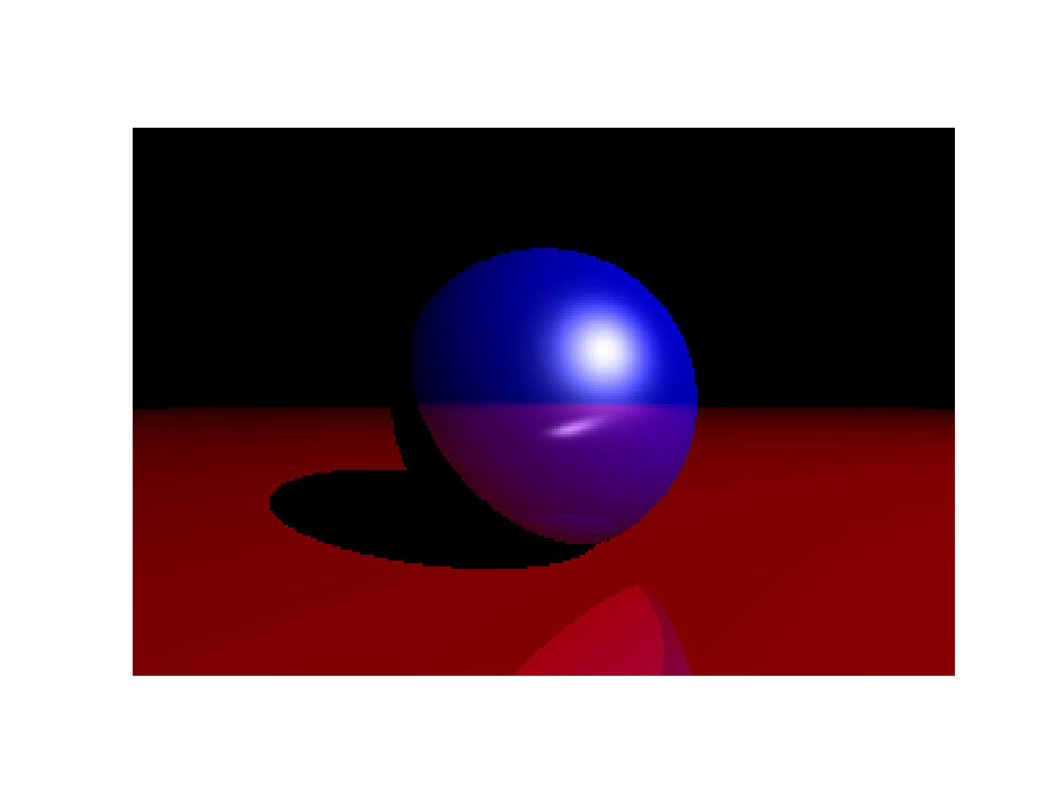
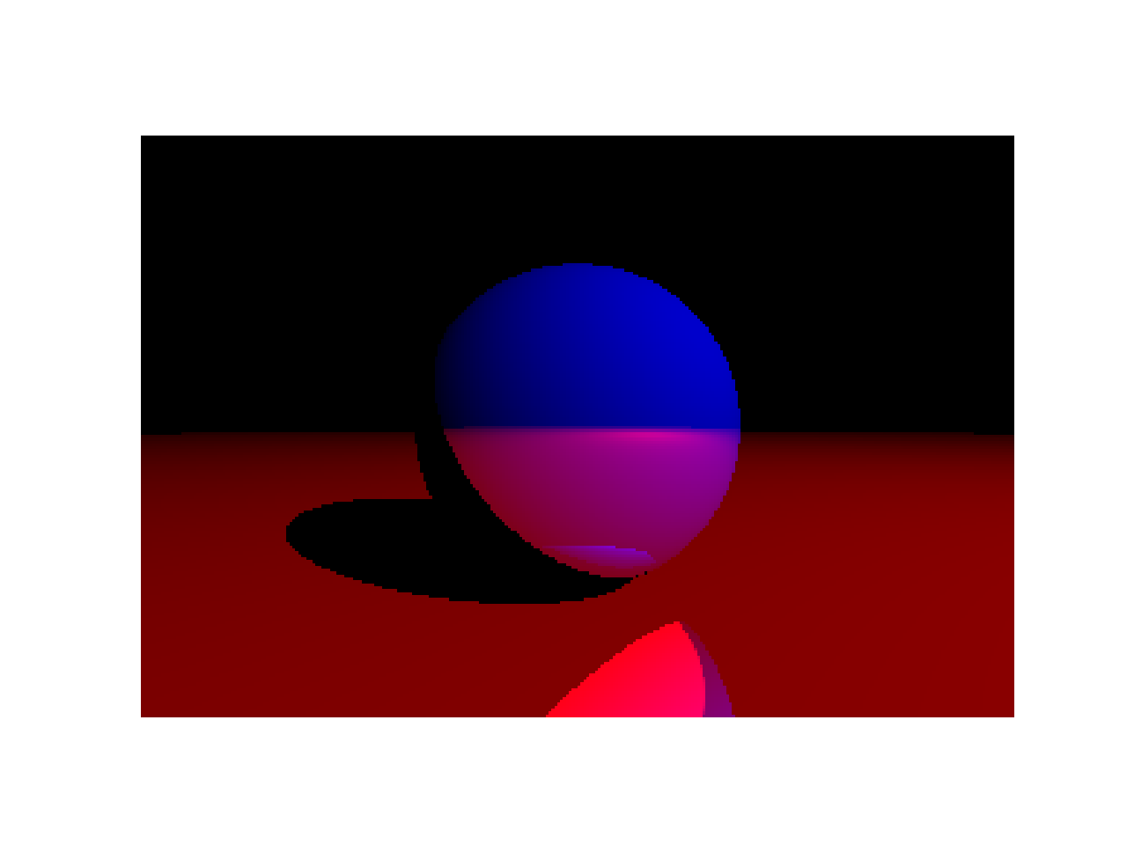
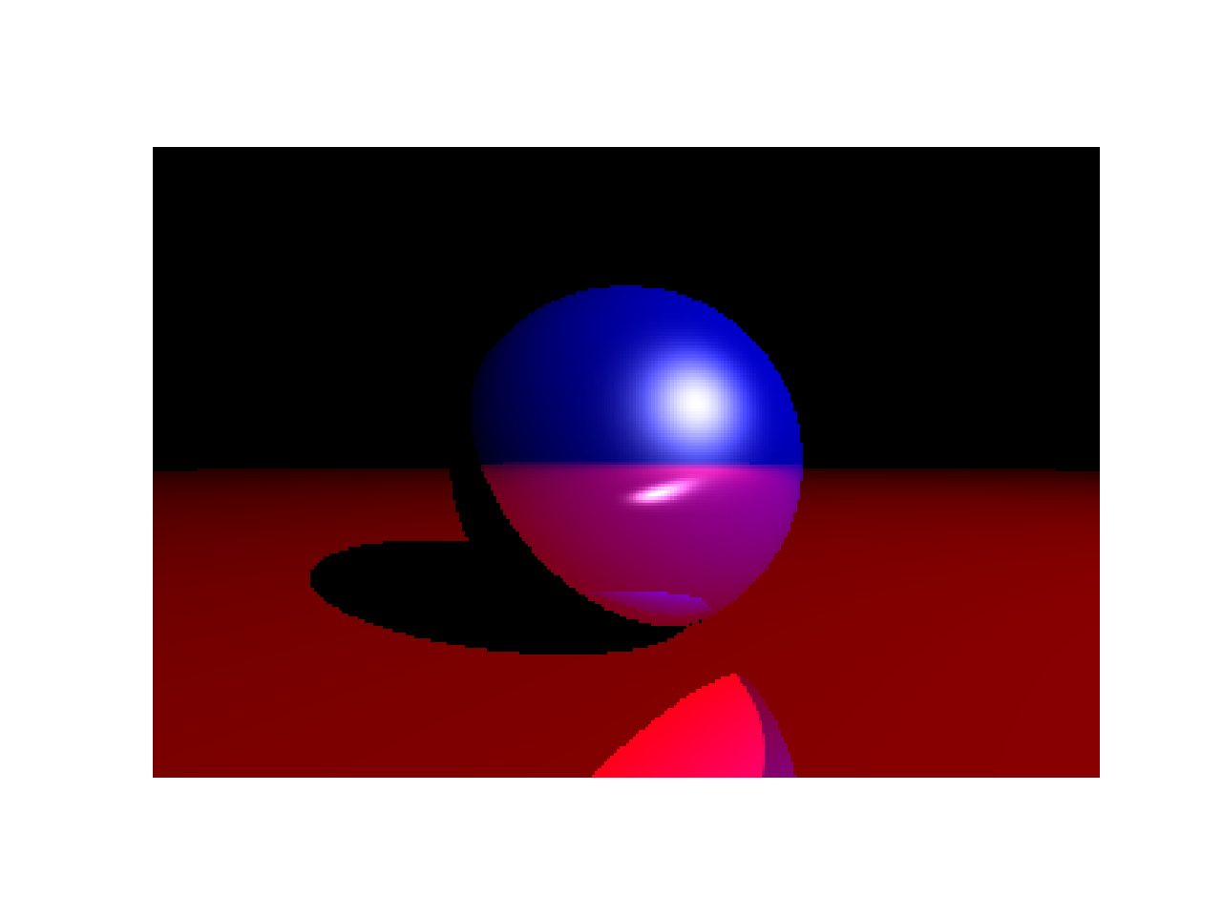
Properties of light: Blinn-phong Model
Ambient: color in the absence of light
Diffuse: color of the object under isotropic white light
Specular: color of the shiny part of an object when light hits it
Shininess: numerical coefficient denoting how shiny an object is
Reflection depth: how many times light reflects off objects; intensity decreases as depth increases

Slide 4
Experimenting with RGB Values
Moving Light Source
Moving Object
Camera Pan 2

Slide 5
THANK YOU!
References:
https://ucb-ee106.github.io/eecs106a-fa22/
https://www.scratchapixel.com/lessons/3d-basic-rendering/ray-tracing-generating-camera-rays/generating-camera-rays
https://github.com/ProgrammierPatrick/sightpy-lab
https://learnopengl.com/Advanced-Lighting/Advanced-Lighting

