Slide 1
CALIFORNIA WILDFIRE SIMULATOR
Hector Ramos

Slide 2
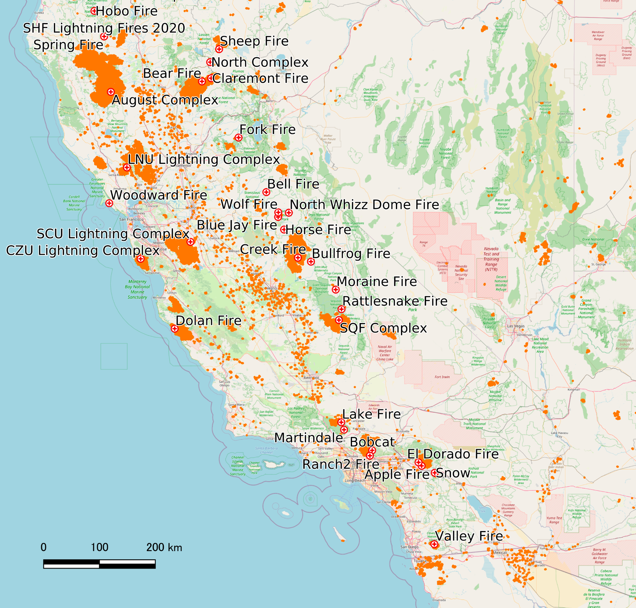
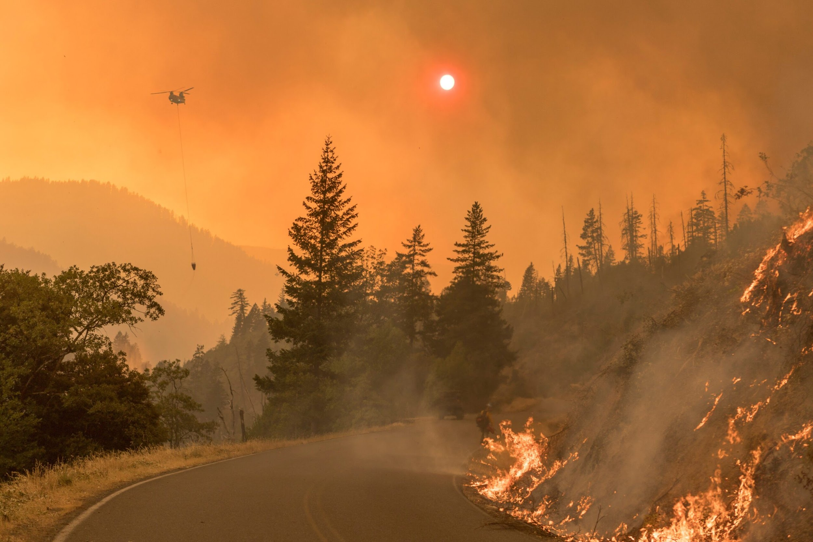

Slide 3
2,568,948 Acres
Burned alone in the 2021 Wildfire Season...

Slide 4
Creating the Landscape
1
Weather Data & Landsat Imagery

Slide 5
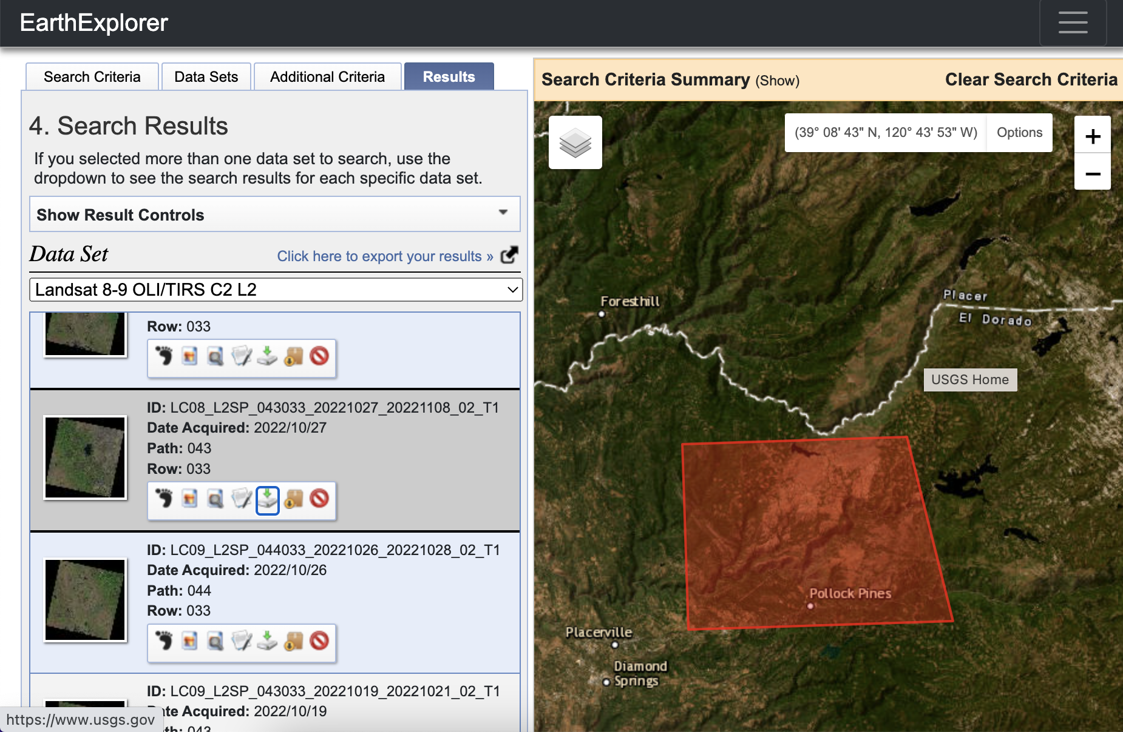
FILES TO RUN IPNYB
usgs.gov
Tahoe_band#.TIF
Download LinktoFiles
image_manipulation.py
Tweaked functions to crop and rotate correctly
pip install Meteostat
from meteostat import Point, Daily

Slide 6
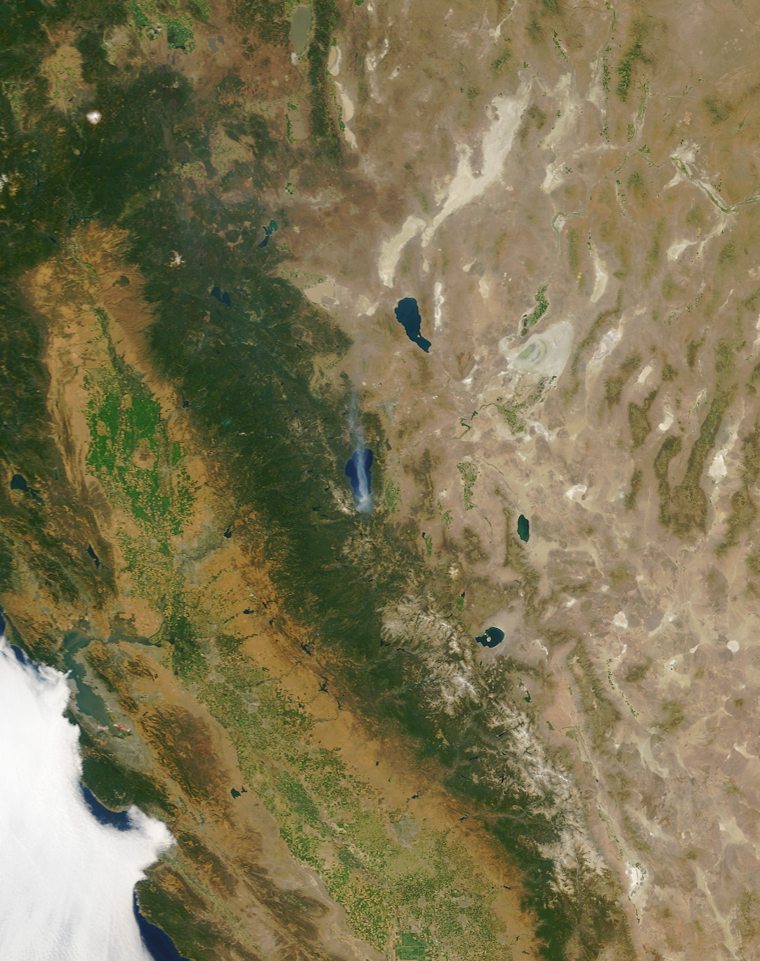
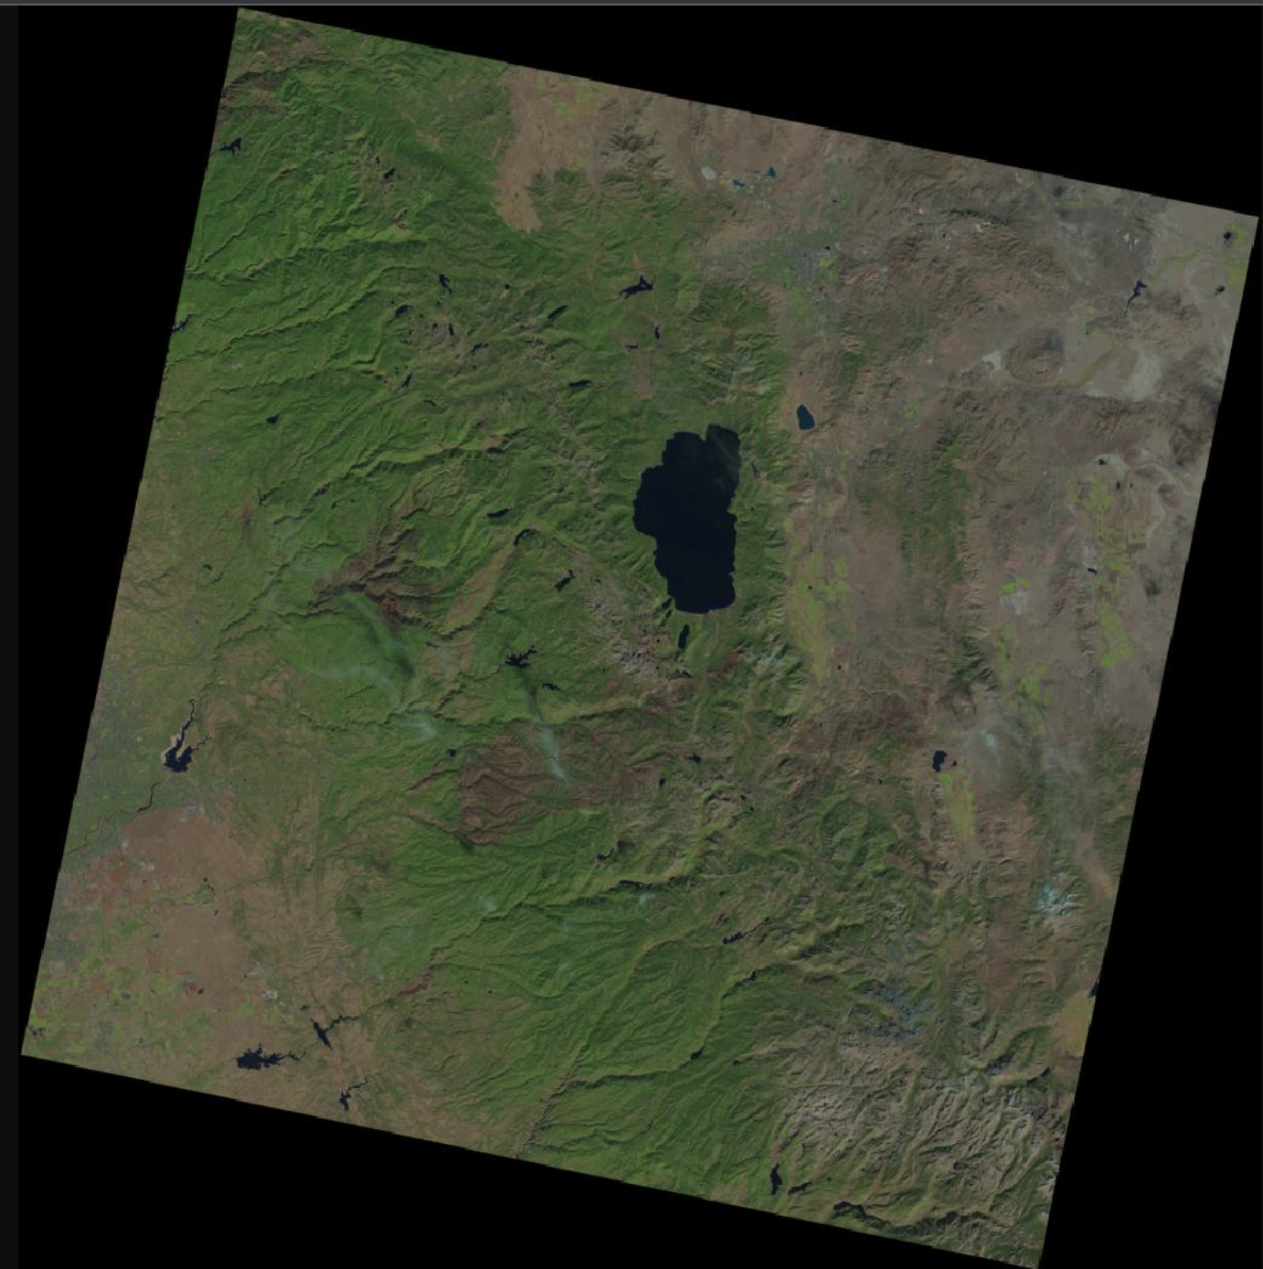
CHOSEN POINT OF ANALYSIS
LANDSAT BAND IMAGE

Slide 7
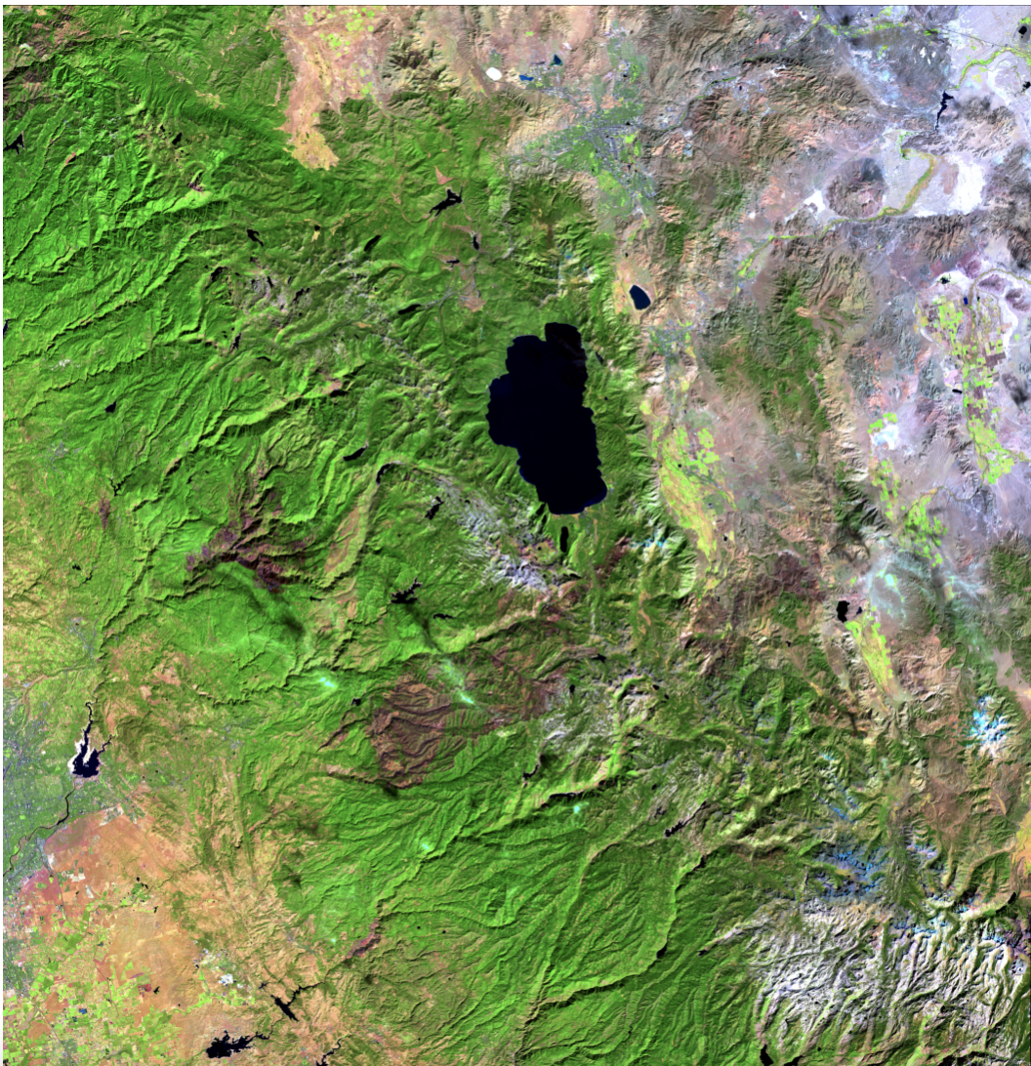
BAND 2
Distinguishing soil from
vegetation
BAND 5
Emphasizes biomass content and shorelines
BAND 6
Discriminates moisture content of soil

Slide 8
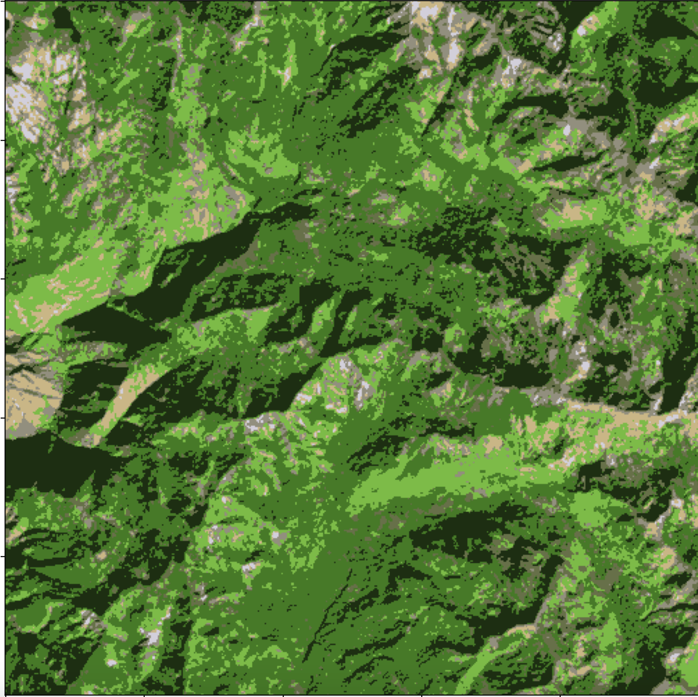
SIMULATED TERRAIN

Slide 9
Random Walk Bins
2
Probability Bins and Landscape Simulation

Slide 10
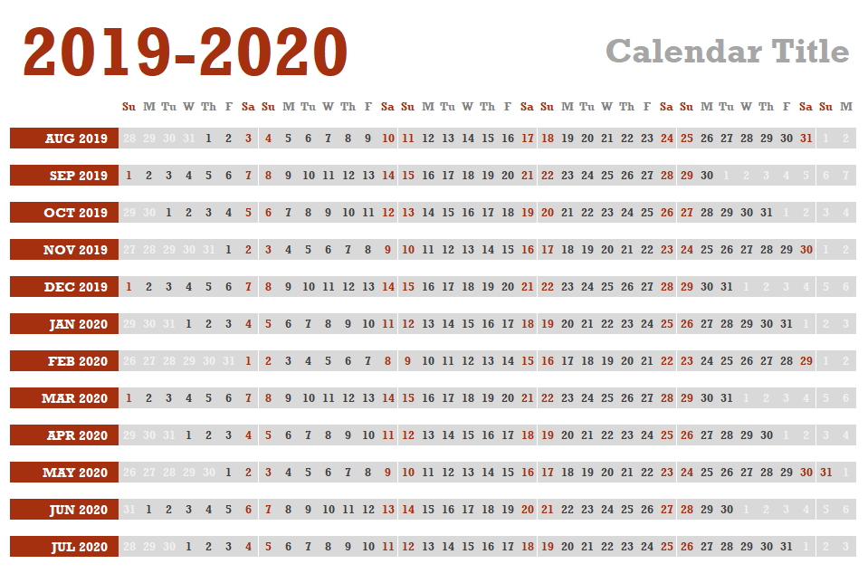
DATE RANGE
YELLOW-
Northern California Wildfire Season
RED-
Southern California Wildfire Season

Slide 11
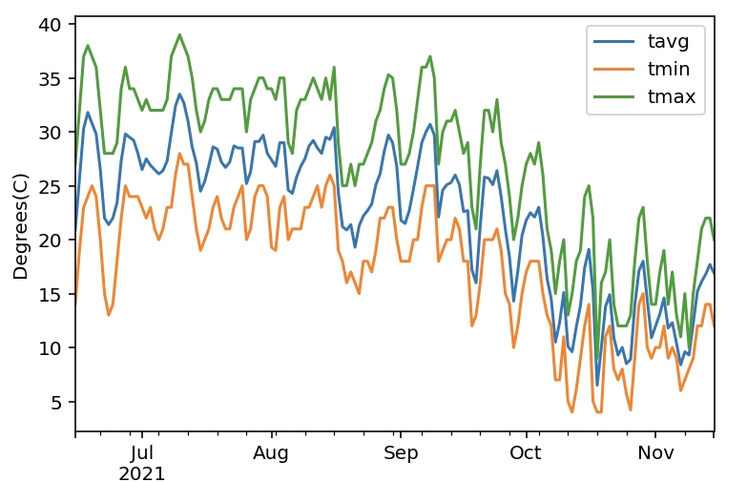
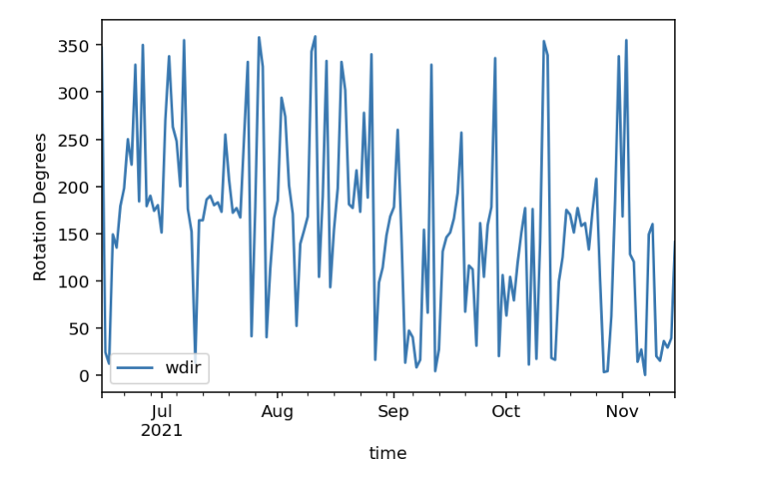
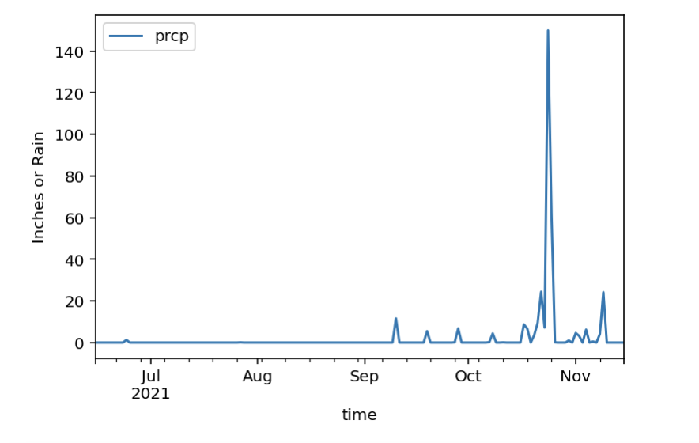
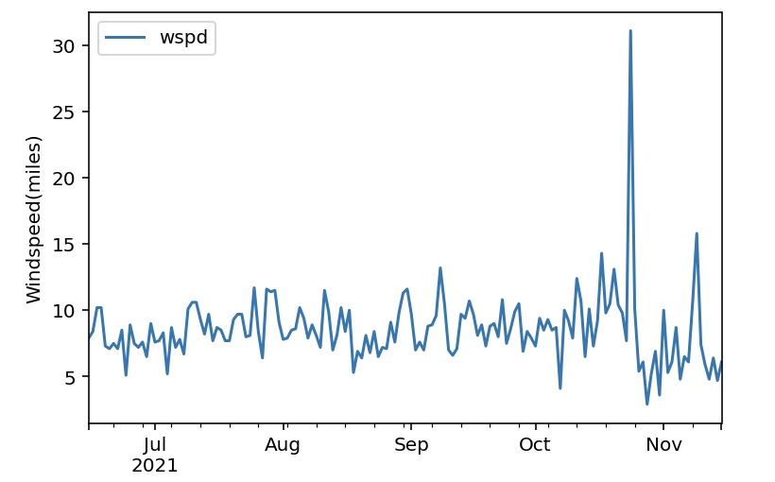
DATA FOR PROBABILITY BINS

Slide 12
BIN CREATION
Wind Direction
The Wind Direction will be used for deciding the probability of which Direction simulated particle will go similar to normal random walk simulation.
Landscape
Each Pixel will burn for a certain number of iterations. More Vegetation will mean a longer burn, and previously burned areas will be unable to burn.
Temperature & Rain
Decides the number of fire pixels to add. Higher temperature and lack of precipitation will mean more pixels to sample per iteration.
WInd Speed
This will decide the range of how far the wind direction can carry fire pixels. Higher wind implies a higher range.

Slide 13
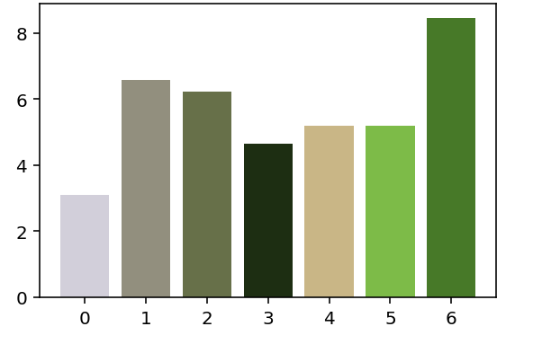
FIRE PROGRESSION
HIGH VEGETATION BURN PROGRESSION
MID VEGETATION BURN PROGRESSION
UNBURNABLE PIXELS
Pixels that are boundaries such as snow, water or rock.
LOW VEGETATION BURN PROGRESSION

Slide 14
Simulation
3
Iterated Random Walk Simulation

Slide 15
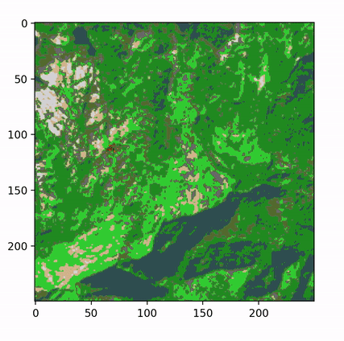
FIRE SIMULATION

Slide 16
FIRE SIMULATION
In this simulation, wind speed was given a bigger emphasis causing the fire to spread more in the same northeastern directions as the previous simulations
The fire also couldn’t advance north or south because of natural barriers, giving it that stretched look.

Slide 17
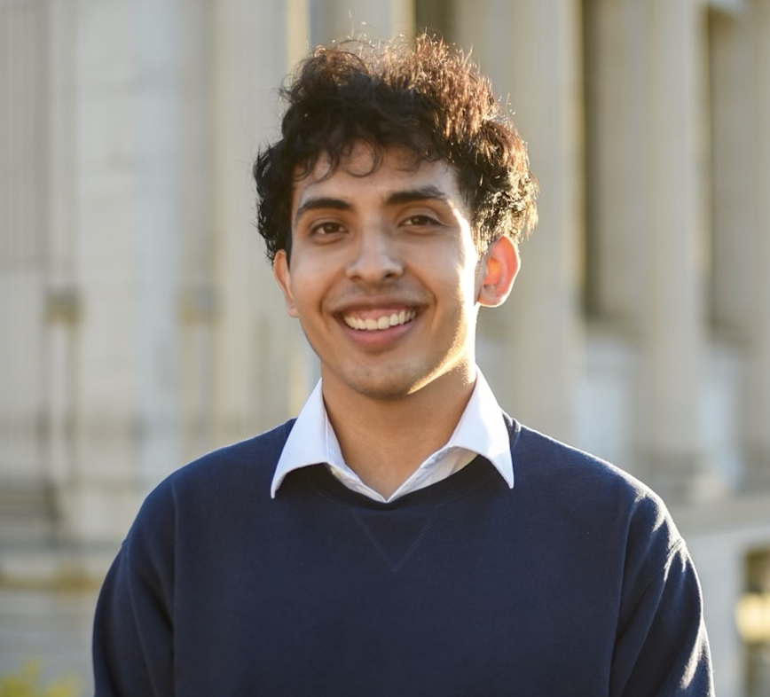
THANK YOU
Hector Ramos
hector.ramos@berkeley.edu

Slide 18
CREDITS
Presentation template by SlidesCarnival
Photographs & Icons by Unsplash
Weather data by Meteostat
Landsat Images data by USGS

