Slide 1
Evolution of Music
EPS 109
Andrew Zhang

Slide 2
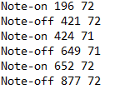
Extracting Pitch and Duration
Found data from a public music analysis project from Carnegie Mellon University
Each text file from the database detailed one piece by a composer
Two ways in which the data was formatted
One note on each line, its beginning and end timing, and pitch (Figure 1)
Two lines for each note, with “note-on” and “note-off” showing time and pitch at activation/release (Figure 2)
Figure 1. First type of data formatting
Figure 2. Second type of data formatting

Slide 3
Average Pitch of Composers
Chose 4 composers with the most works aggregated
The data is not unexpected
Bach, Beethoven, and Chopin emphasized both hands
Bach especially embraced polyphony, featuring two-handed melodic conversations
Mozart placed more emphasis on right hand melodies
Central pitches of all four composers were a little over 60, showing emphasis on higher pitched notes within melodies
Figure 3. Central Pitch of Each Composer

Slide 4
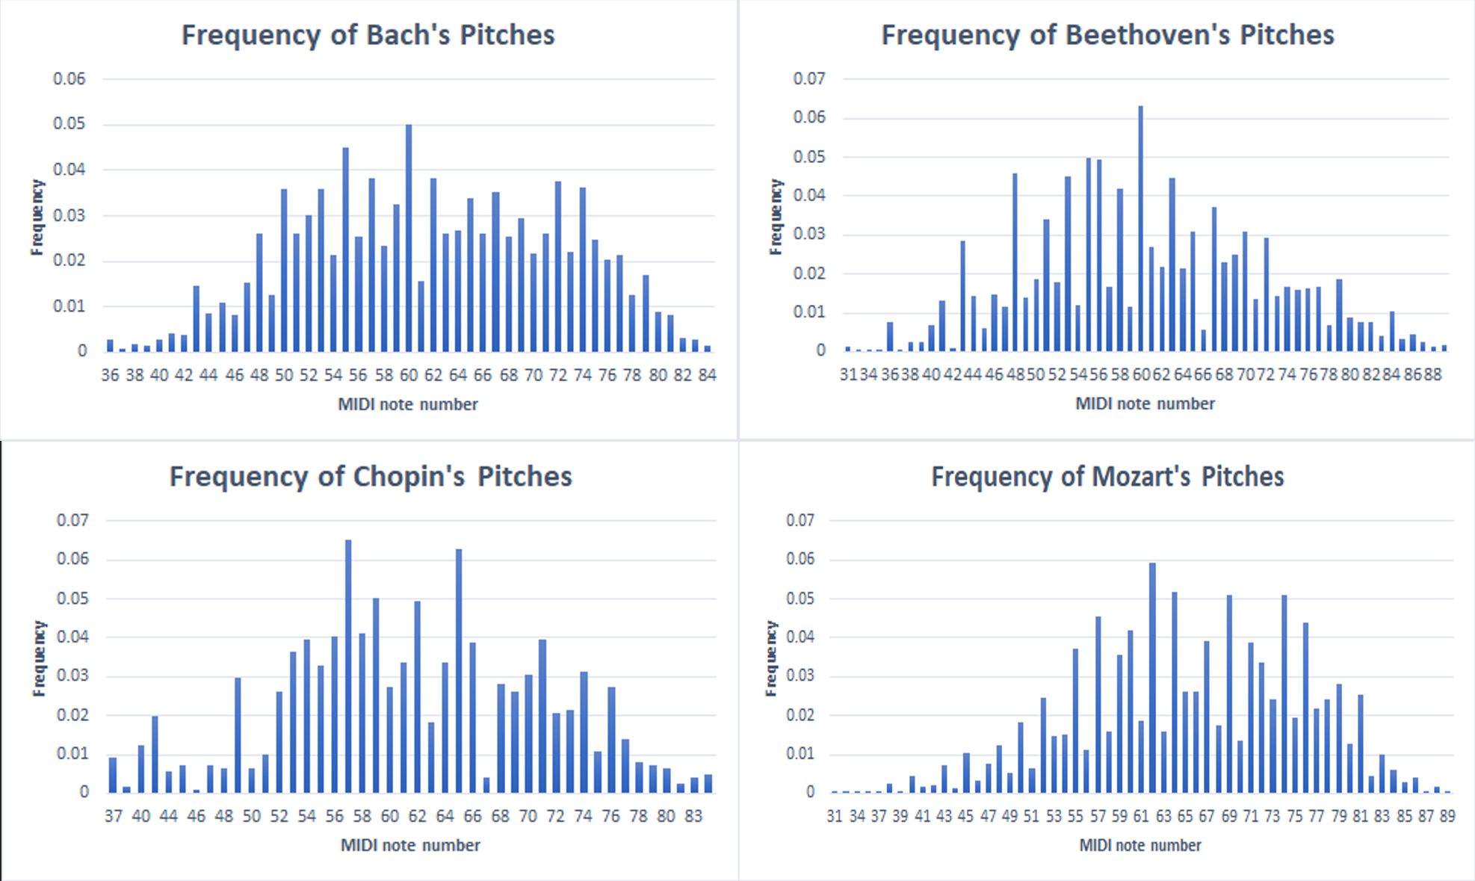
Figure 4. Frequency of Pitches in Works of Each Composer

Slide 5
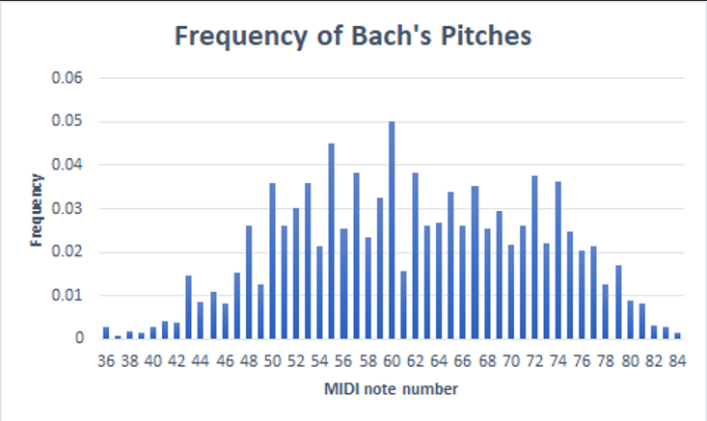
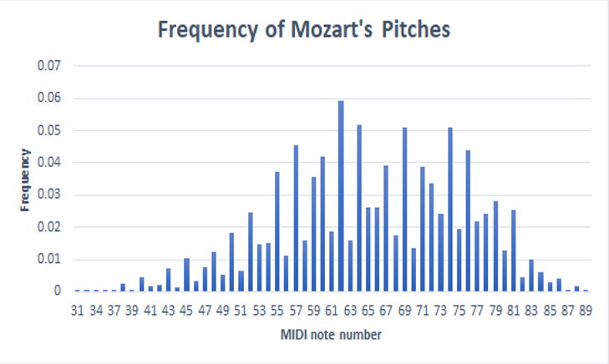
Pitch Frequency of Composers
Graphs accurately hint at the style of composition of composers
Bach and Mozart’s graphs look close to a bell shape
Especially noticeable in Bach, who composed many pieces in all keys, such as his Preludes and Fugues
Intensive use of counterpoint and polyphony

Slide 6
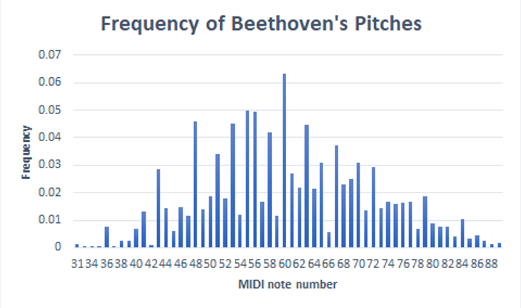
Pitch Frequency of Composers
Beethoven’s graph has massive differences in frequencies between notes
Shows his technique of developing a musical idea during a piece
Sticking to a common melody in a piece increased the frequencies of notes in the melody
“Pathetique” Sonata revolves around simple melody in the opening bar

Slide 7
Figure 5. Bach Note Frequency Totals over Time

