Slide 1
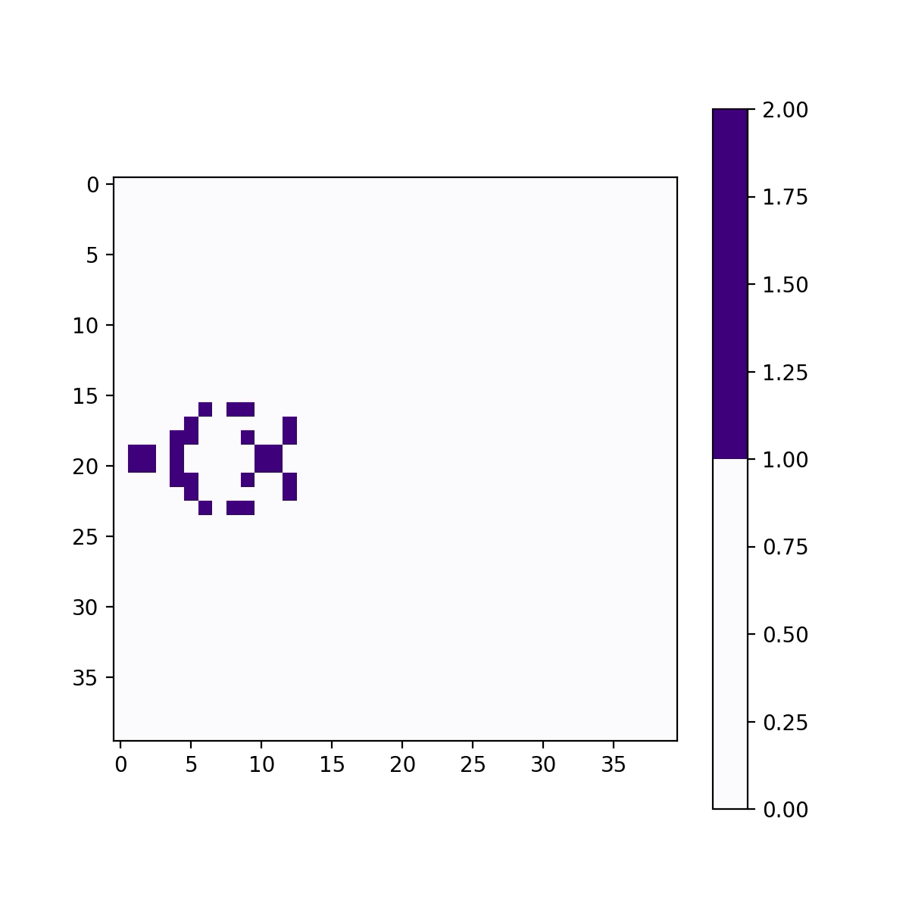
Conway’s Game of Conflict
Kushal Khangaonkar
Figure 1: Original Conway’s game of life
Website where you can experiment on original game
https://playgameoflife.com/

Slide 2
Topic/Methods
Original Ruleset: Given a grid where all cells are either 1 or 0, the next timestep is...
  For a cell that was previously populated: If it has 2 or 3 neighbors, it survives, otherwise it dies For a cell that was previously empty: if it has exactly 3 neighbors, it becomes populated
Goal: Modify Original Conway’s game to have multiple populations
  Need a way to visualize this game
  Need to brainstorm rules for population interaction
Visualizing:
  Order the N populations arbitrarily. The i^{th} population is plotted as (2^i) instead of just 1.
  Can look at a cell and tell which populations exist in that cell
    E.g., if a cell contains populations 0, and 2, it will have value 5 because it is represented by 0101 = 2^0 + 2^2
Possible population rules in addition to original ruleset:
  If multiple populations enter the same cell, uniformly choose a single survivor
  A specific population in a cell will die if it has more neighbors from other populations than its own.
    + All cells randomly populated with a population with probability = (e *log(timestep)) where e < 0.01
    + If a currently empty cell has a neighborhood with a majority population, fill the cell with that population
  (BEST VISUALS) A population in a cell will die with probability (# other population neighbors / all neighbors)

Slide 3
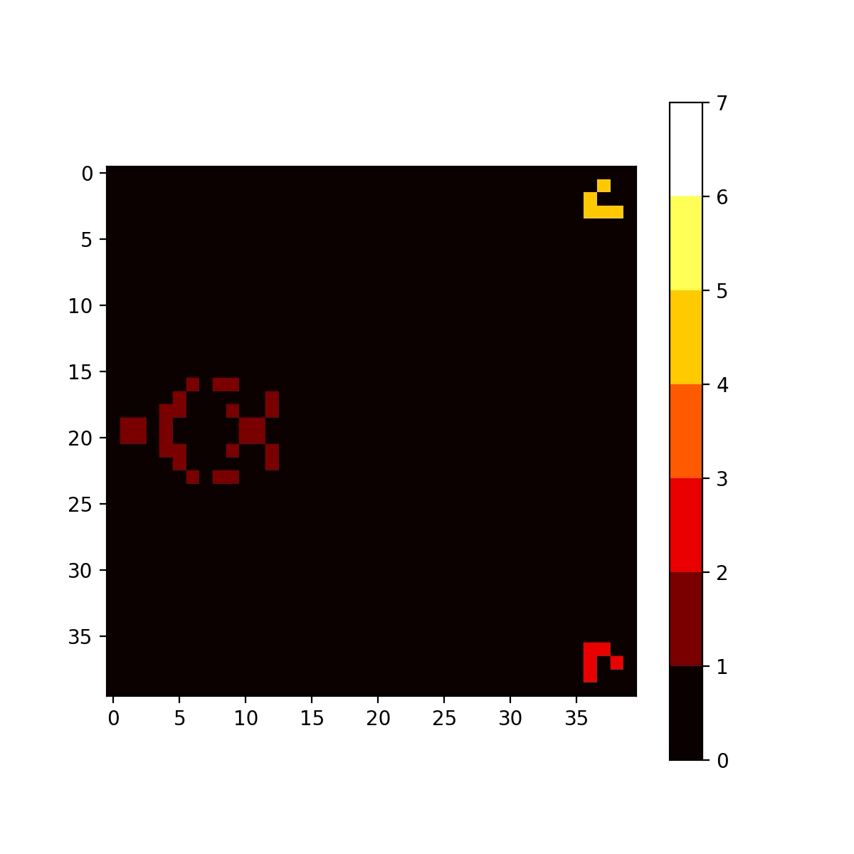
Figure 2: Trying new rules on 3 populations on collision course

Slide 4
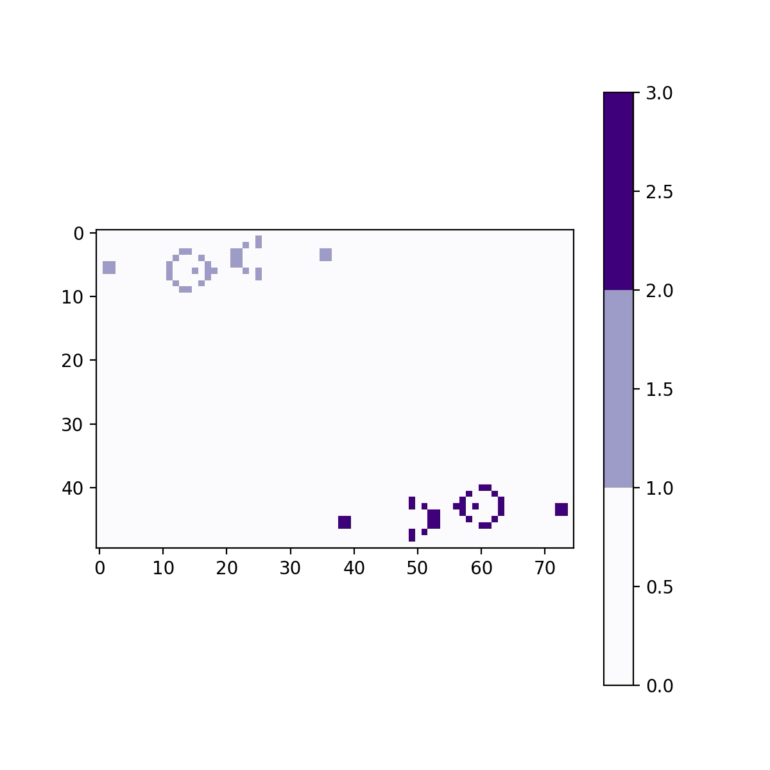
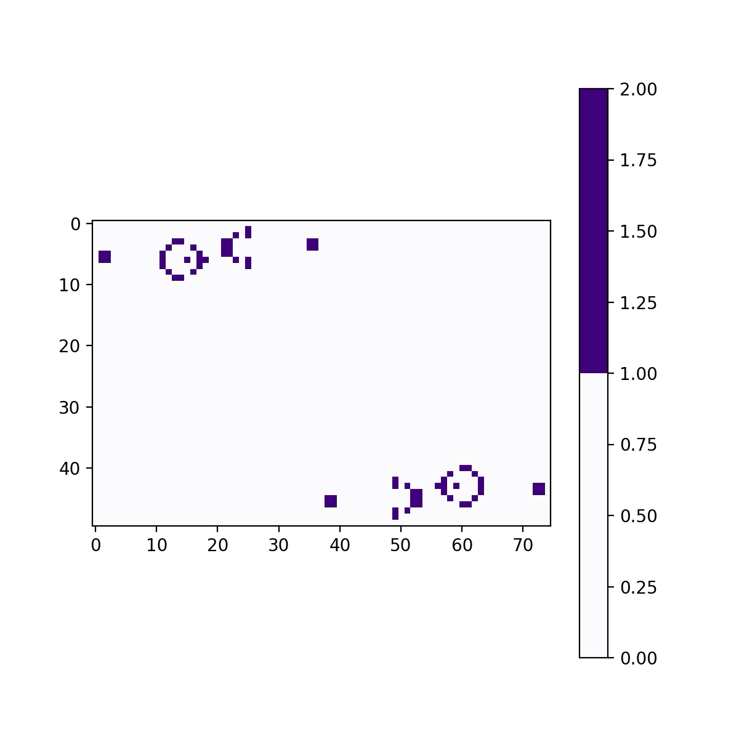
Using the Gosper Glider Gun as Competing Populations
https://conwaylife.com/wiki/Gosper_glider_gun
Figure 2: Simulating “Glider guns” under original rules
Projectiles snuff each other out on contact
Figure 3: Competing guns under new rules

