Slide 1
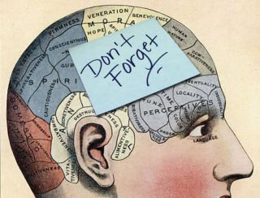
HopField Networks: A model of memory
Eric Jung

Slide 2
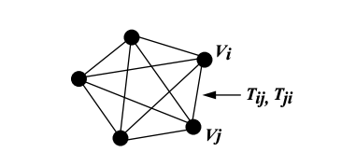
Hopfield Networks
Models memory
Attractor network – Converges to specific states it “Remembers”
Generally will be a fully connected graph
Neurons are represented as nodes on the graph
Synapses are represented as directed edges
Sources: https://redwood.berkeley.edu/wp-content/uploads/2018/08/handout-attractor-nets.pdf https://github.com/takyamamoto/Hopfield-Network
Notes:
Sources:
https://redwood.berkeley.edu/wp-content/uploads/2018/08/handout-attractor-nets.pdf
https://github.com/takyamamoto/Hopfield-Network

Slide 3
Animation

