Slide 1
Simulating the Intermediate Axis Theorem
Kieran Manning
EPS 109

Slide 2
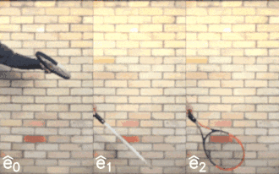
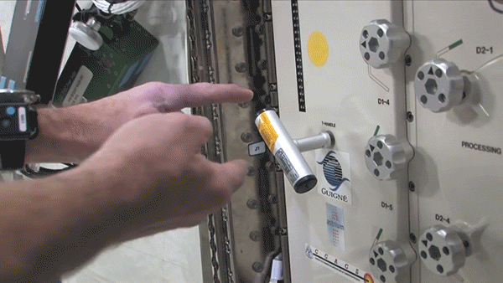
Theory
Objects rotating under 0 torque are governed by Euler’s Equations:
$$I_{1}{w′}_{1}=(I_{2}−I_{3})w_{2}w_{3}$$
$$I_{2}{w′}_{2}=(I_{3}−I_{1})w_{3}w_{1}$$
$$I_{3}{w′}_{3}=(I_{1}−I_{2})w_{1}w_{2}$$
Given $I_{1}$ < $I_{2}$ <$I_{3}$ and $w_{1}$,$w_{2}$, and $w_{3}$ all > 0, rotation about axis 1 and 3 is stable…
…however, rotation about axis 2 causes exponential growth in the perturbations of $w_{1}$ and $w_{3}$ until the
orientation of the object completely flips!

Slide 3
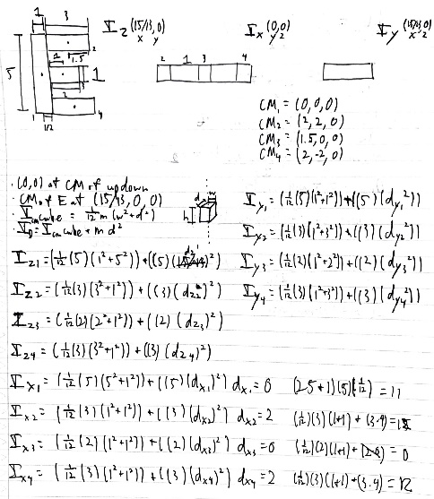
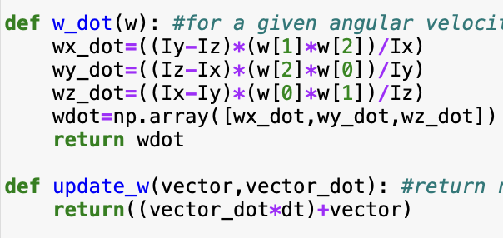
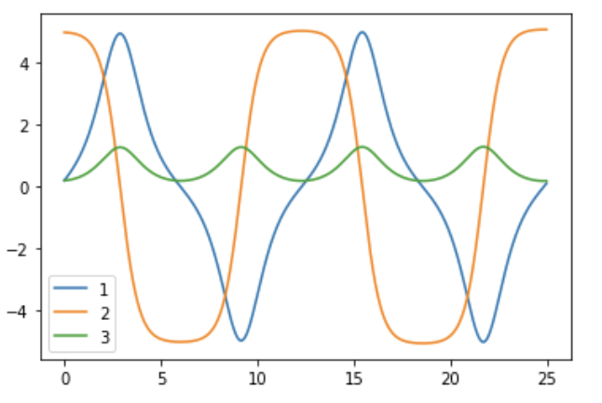
Modeling Method
First I determined the center of mass and rotational inertia of my letter E before creating a 3D model using vpython .
Given arbitrary initial angular velocities, I solved Euler’s equations for every dt = 1/50 seconds.
Plotting the angular velocities about each axis shows the perturbations increasing until a “flip” occurs and the object reverses its velocity on the second axis.

Slide 4
Un-Perturbed
If only one axis has a non-zero rotational velocity, it will continue to spin as such indefinitely. If perturbed, which spin will reverse?

Slide 5
Animation
Congrats if you guessed the unstable axis of rotation was…
the x-axis!

Slide 7
Sources
https://thatsmaths.com/2019/12/12/the-intermediate-axis-theorem/
https://www.glowscript.org/docs/VPythonDocs/text.html
https://en.wikipedia.org/wiki/List_of_moments_of_inertia
http://hyperphysics.phy-astr.gsu.edu/hbase/parax.html#:~:text=The%20expression%20added%20to%20the,at%20the%20center%20of%20mass.
https://www.youtube.com/watch?v=PY7fRozbrtk

