Slide 1
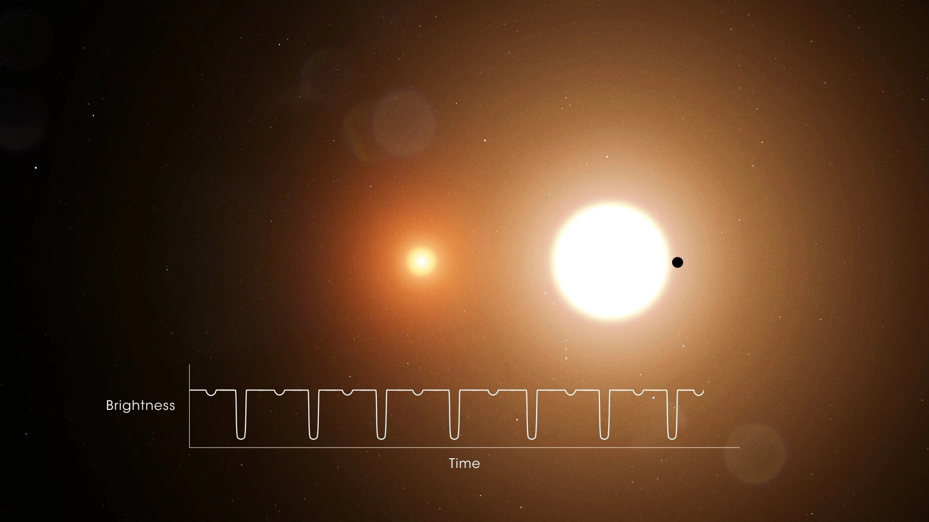
TOI 1338: Circumbinary Planetary System Transit
By: Fira Fatmasiefa

Slide 2
About TOI 1338 and Methods Used
What is TOI 1338?
A circumbinary planetary system: a Neptune-like planet orbits an F8 and red dwarf binary stars.
Can observe transit: where the brightness of the brighter star dips as the dimmer star and the exoplanet passes in front.
Modeling Orbits: Keplerian Orbits and ODE
Using known data on masses, distances, period, etc.
Calculate velocity and transit frequency.
Modeling Transit: Pixel Graphics
Using known radii data, approximate transit depth
Create pixel graphic to scale
Using velocity and period, animate how often transit occurs

Slide 3
TOI 1338 ORBIT

Slide 4
TOI 1338 TRANSITS

