Slide 1
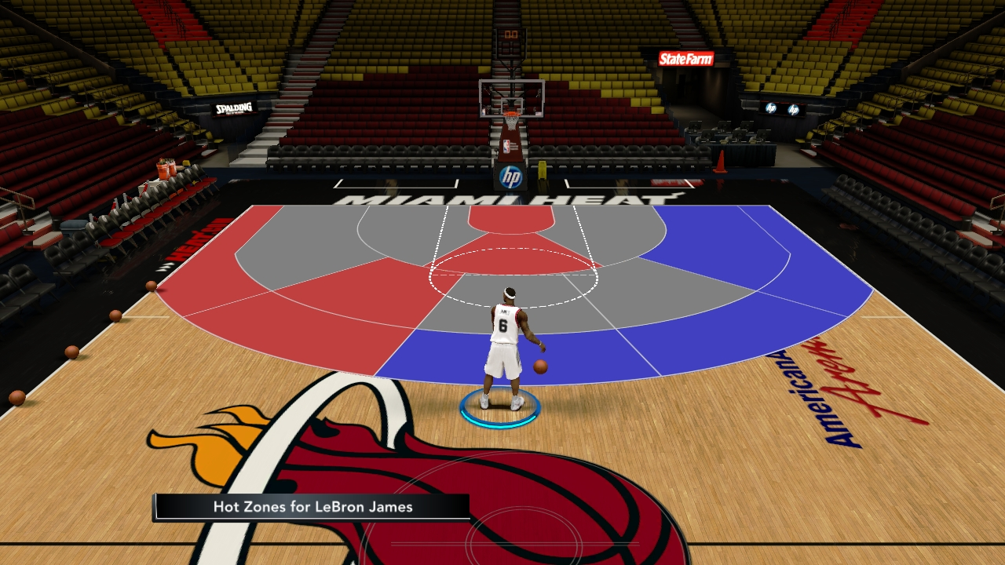
Shot O’Clock - Basketball Shot simulation
Jevon Jackson

Slide 2
Topic of Simulation and Methods That Were Used
The main point of the simulation is to see how the the spots in which players scored at the most has changed throughout the history of basketball. This demo shows a snippet of the Golden State Warriors, Los Angeles Lakers, and Boston Celtics.
To do this, I used the nba_api in order to generate individual players and teams, and to get information on the location of where points were scored at on court for every game in the season.
After putting the data into a table and parsing it, I was able to use matplotlib in order to graph the points onto the court
Sources: https://towardsdatascience.com/make-a-simple-nba-shot-chart-with-python-e5d70db45d0d

Slide 3
