Slide 1
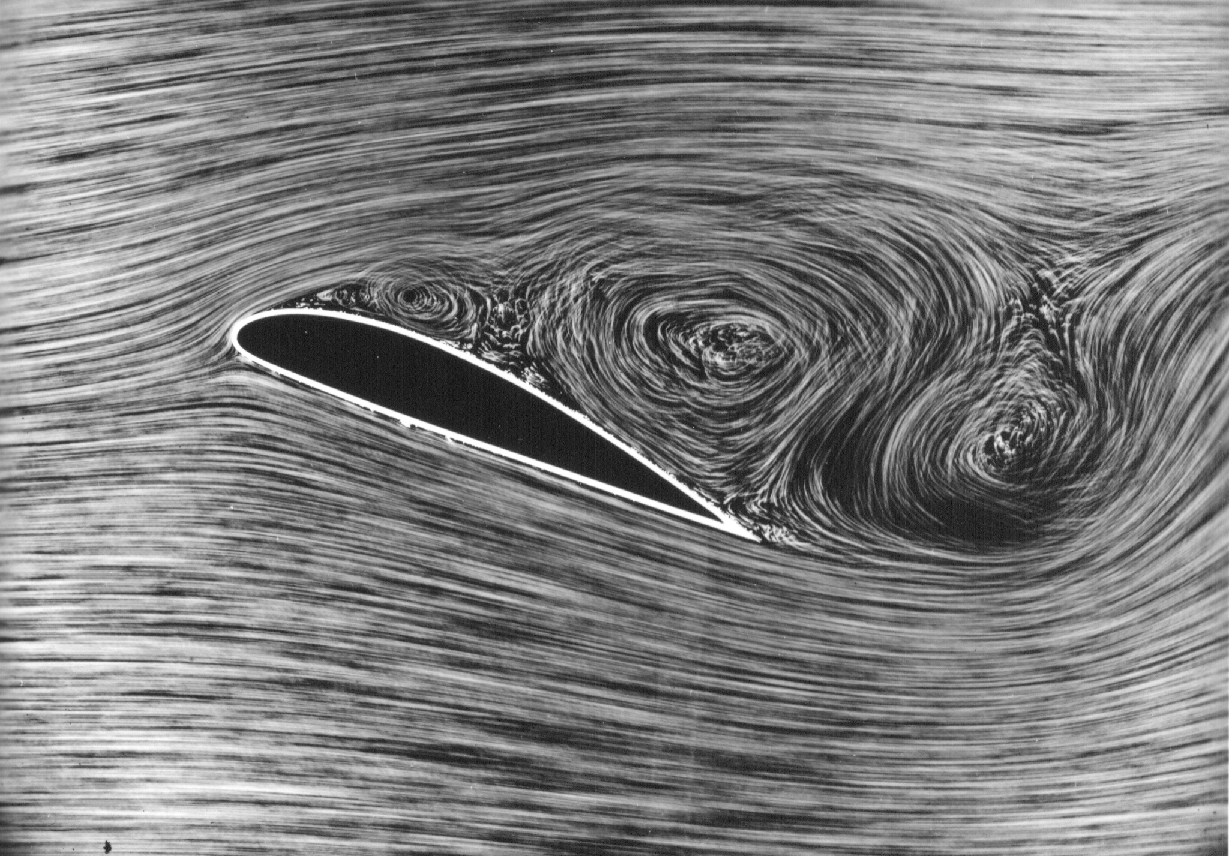
Airflow Around An Airfoil
Sam Paplanus
Image: https://en.wikipedia.org/wiki/Stall_%28fluid_dynamics%29

Slide 2
Topic & Methods
Airflow around an airfoil varies based on the airfoil’s angle of attack
A larger angle of attack typically produces vorticity at the trailing edge
This can lead to turbulence and unsteady airflow past the airfoil itself
This project utilised the Lattice Boltzmann method, which discretises the 2D plane into individual points which can move and interact with objects
Once the airfoil shape was placed in the plane, the particles were set to move to the right, collisions were detected, and the air particles’ momentum was varied based on collisions with the airfoil
From these reactions, the actual path of the airflow and the vorticity resulting from the collision with the airfoil were determined
The three rotations of the airfoil were run through the time/collision loop in which the airflow and vorticity were separately animated, leading to six total animations
These were all saved as .mp4 files as taught in class
Sources:
https://physics.weber.edu/schroeder/javacourse/LatticeBoltzmann.pdf
https://medium.com/swlh/create-your-own-lattice-boltzmann-simulation-with-python-8759e8b53b1c

Slide 3
Animations (Flat Airfoil)

Slide 4
Animations (Tilted Airfoil)

