Slide 1
Seismic Data Analysis: Visualizing the Gutenberg-Richter Law in Bay Area Earthquakes
By Yair Franco

Slide 2
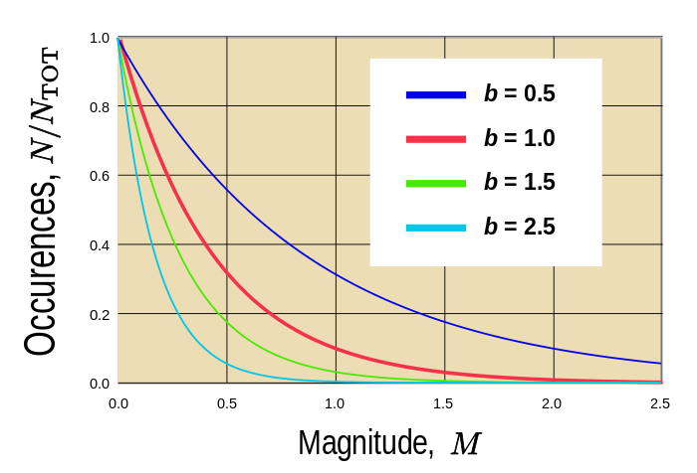
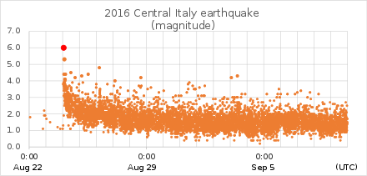
Gutenberg-Richter Law
Approximates the behavior of earthquake sequences
B-value is the rate of decrease in frequency as M increases.
Indicates seismic activity
Can change over time in a given area
With enough data, these changes can be tracked in short time scales

Slide 3
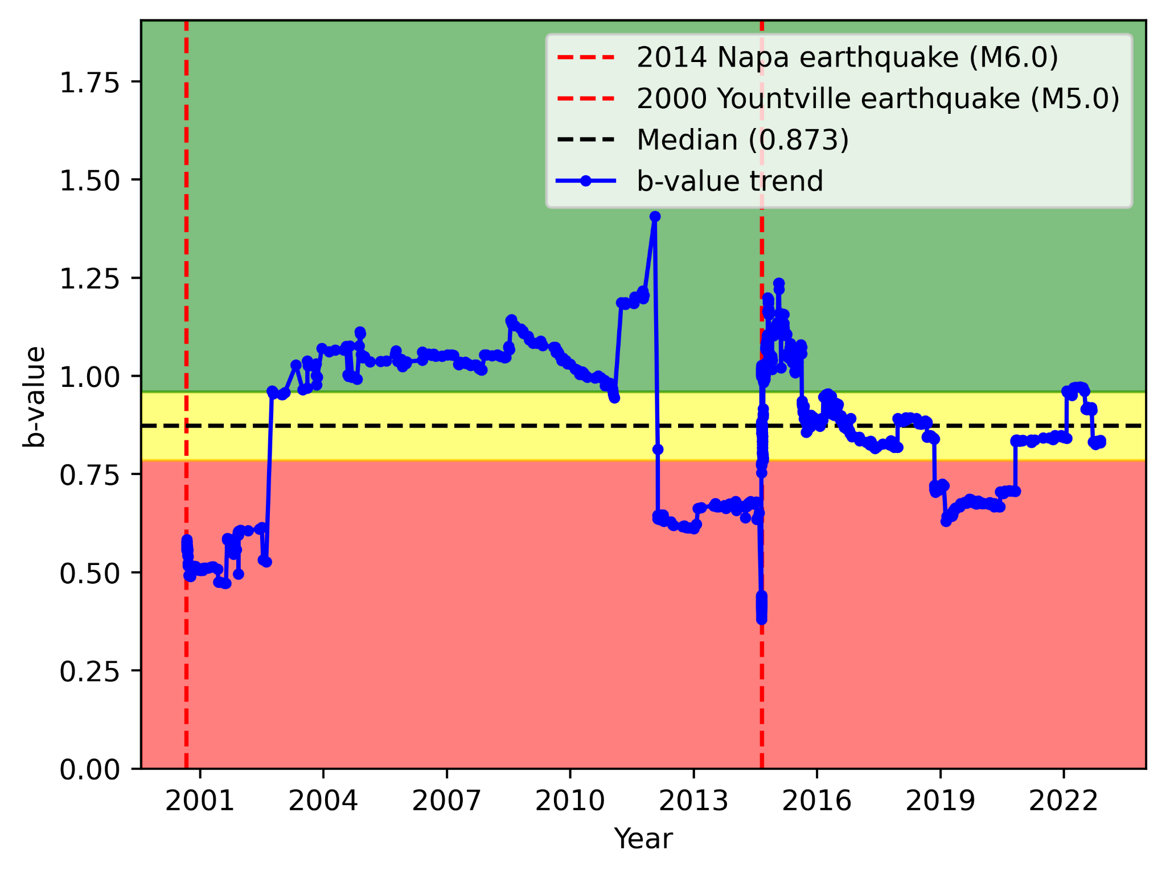
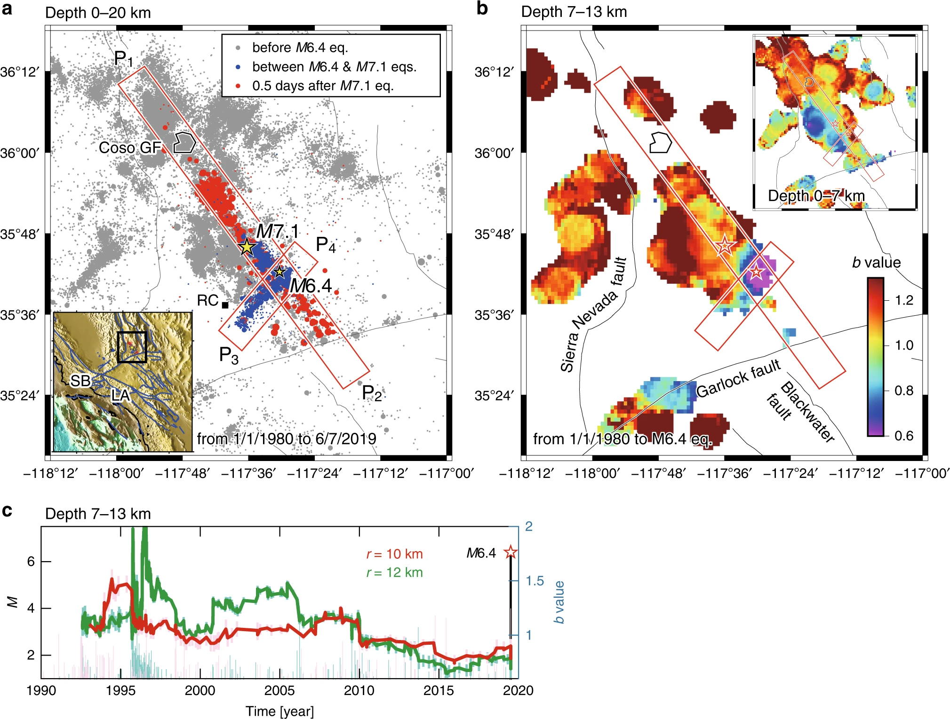
B-value changes and short-term seismic activity
Drops in b-value tend to indicate the start of an earthquake sequence
Observed to drop after a foreshock, rise after a mainshock

Slide 4
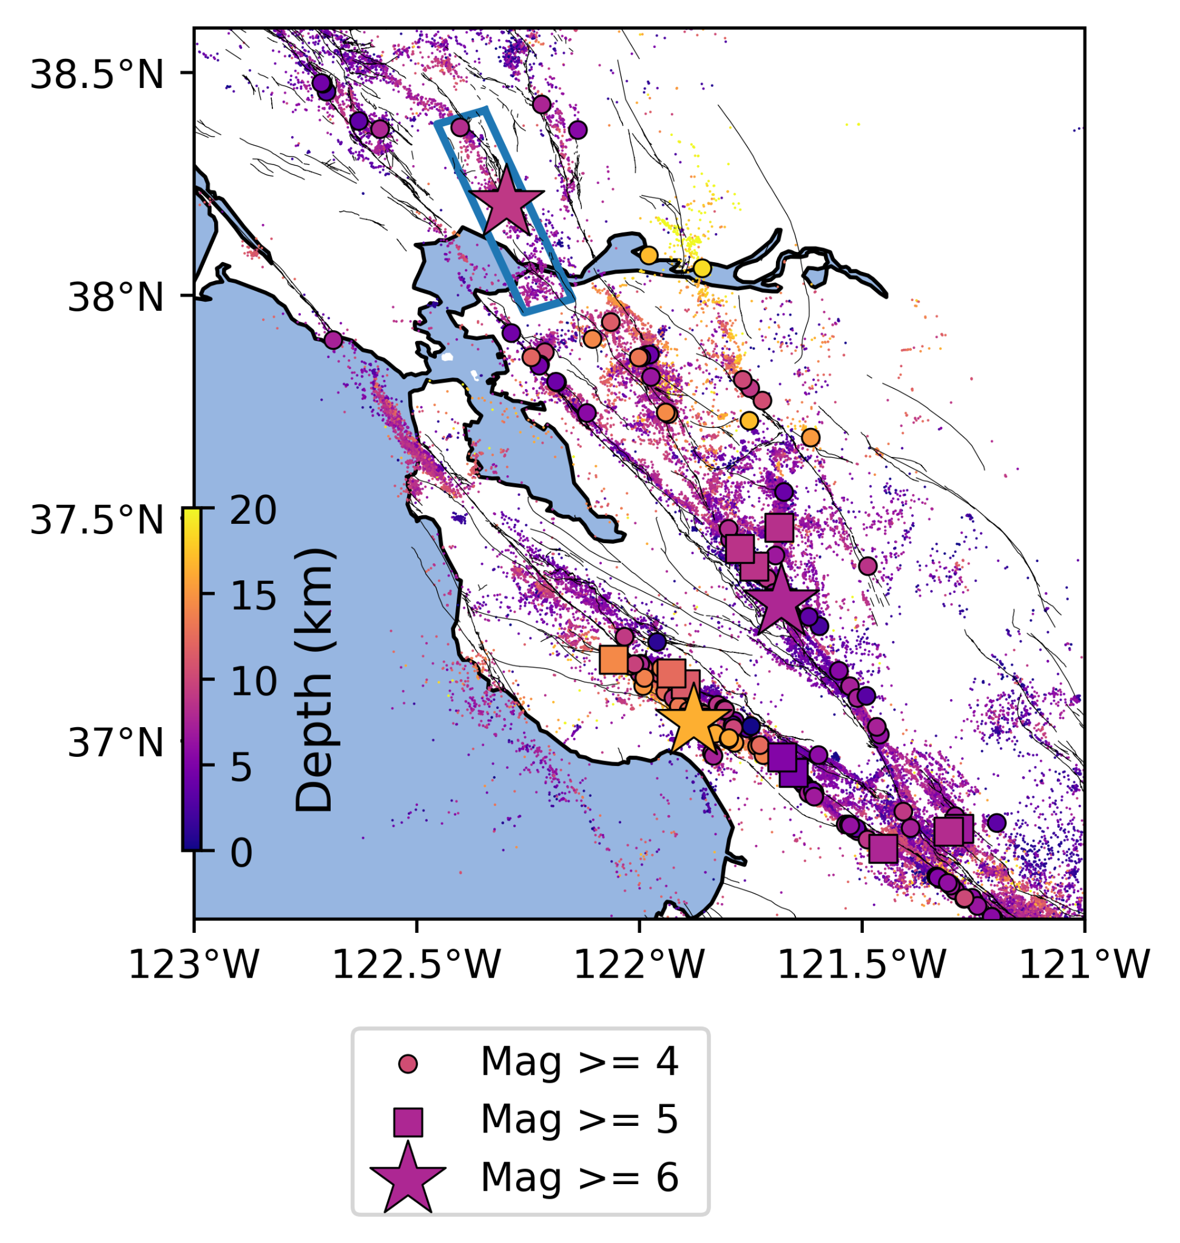
Coding methods
Packs: Numpy, Matplotlib, Obspy, Cartopy
Starter code for research provided by Yifang Cheng, PhD.
Fault data: USGS
Catalog: NCSN
Grid approach…

Slide 6
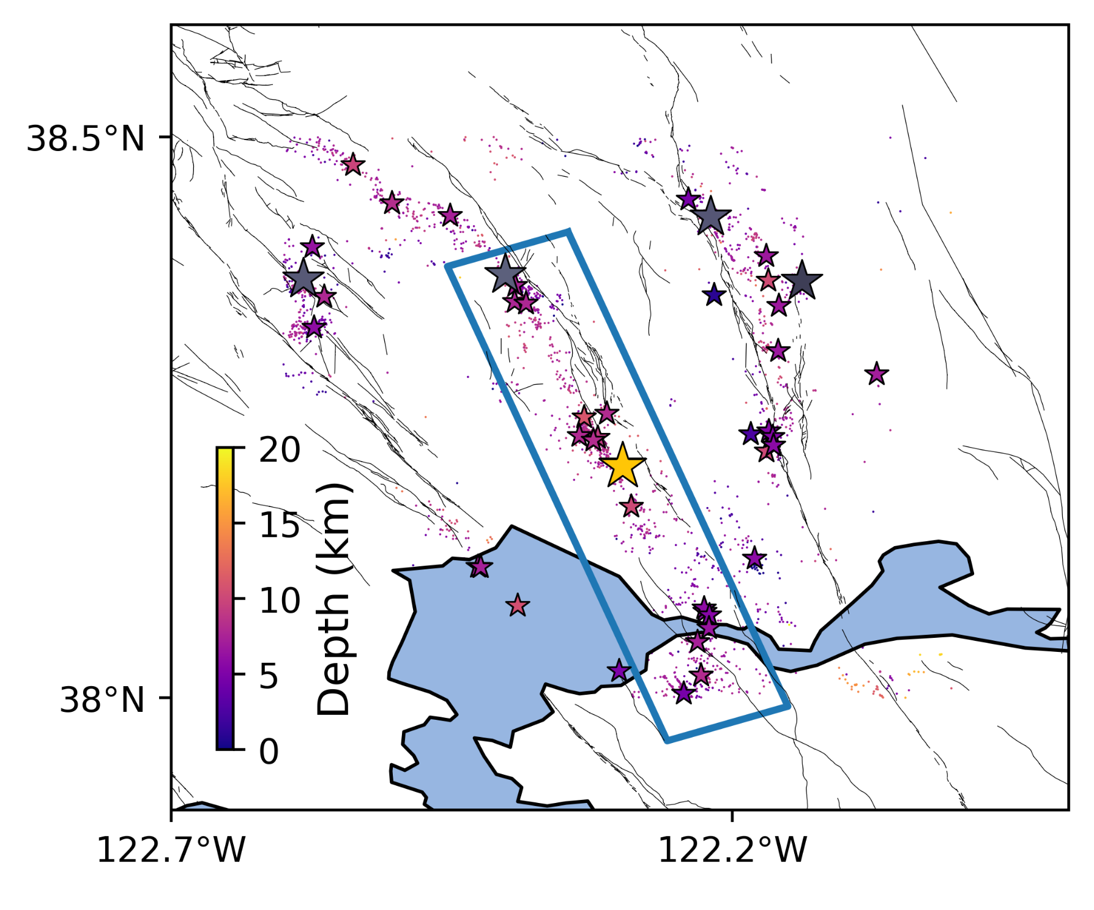
Challenges
While reliable, b-value does not predict earthquakes
Obtaining many b-values requires a very rich dataset

Slide 7
Sources
Nanjo, K.Z. Were changes in stress state responsible for the 2019 Ridgecrest, California, earthquakes?. Nat Commun 11, 3082 (2020). https://doi.org/10.1038/s41467-020-16867-5.
Gulia, L., Wiemer, S. Real-time discrimination of earthquake foreshocks and aftershocks. Nature 574, 193–199 (2019). https://doi.org/10.1038/s41586-019-1606-4.

