Slide 1
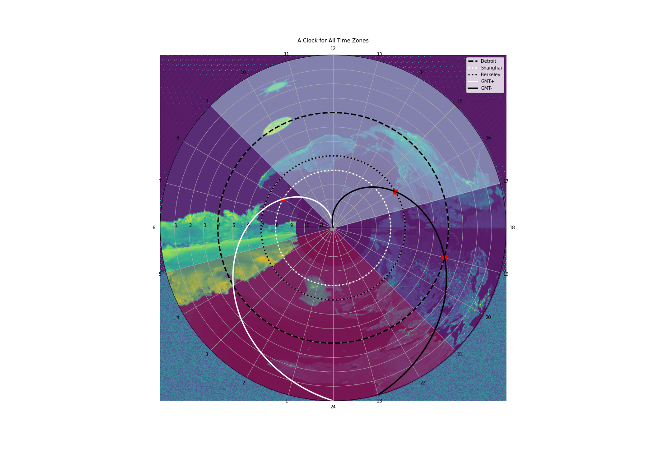
Universal Clock 1.0
Hanji Xu

Slide 2
different time zones

Slide 3
🧮 🤔 & 🧐 ⌚

Slide 4
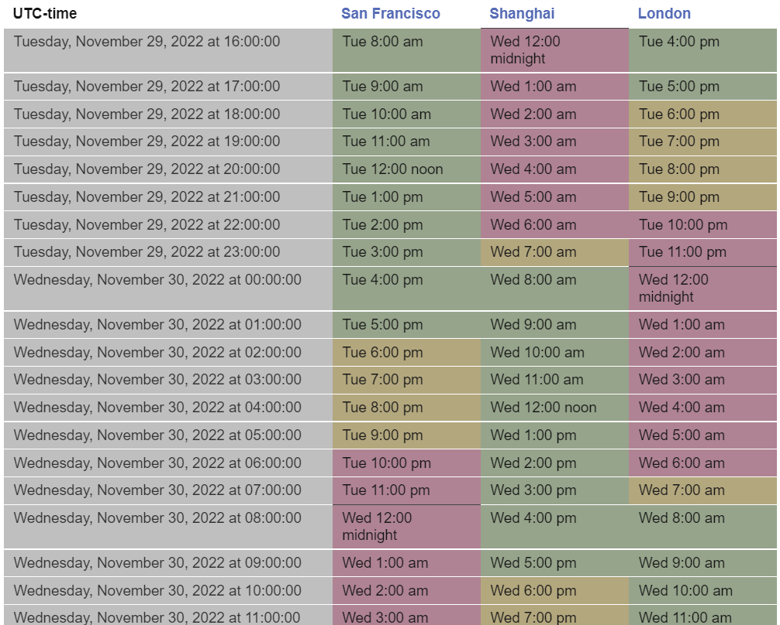
✔️ ❌

Slide 5
White GMT +
Black GMT –
24-hour
→ +/- by n

Slide 6
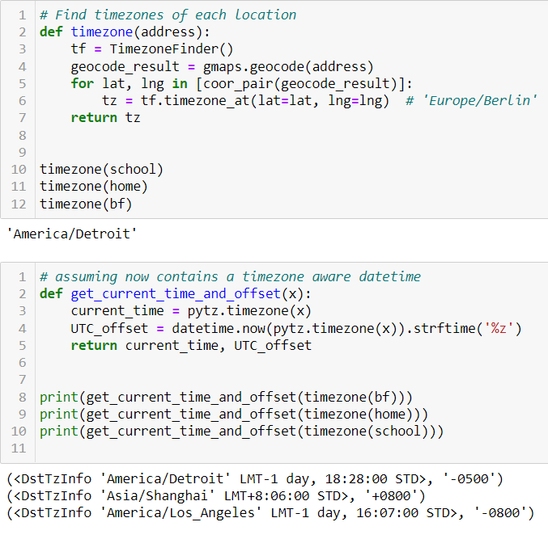
Use Address to find GMT/UTC Offsets
Googlemaps API
timezonefinder
pytz
datetime
* Daylight savings *

Slide 7
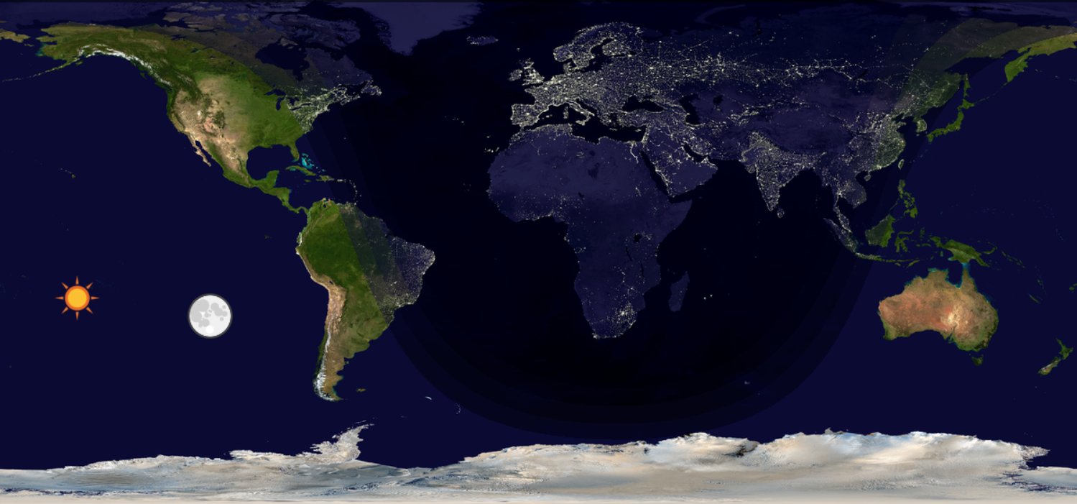
Image Warp *HW12
(Photoshop)
OpenCV
-11 -10 -9 -8 -7 -6 -5 -4 -3 -2 -1
0 +1 +2 +3 +4 +5 +6 +7 +8 +9 +10 +11 +12

Slide 8
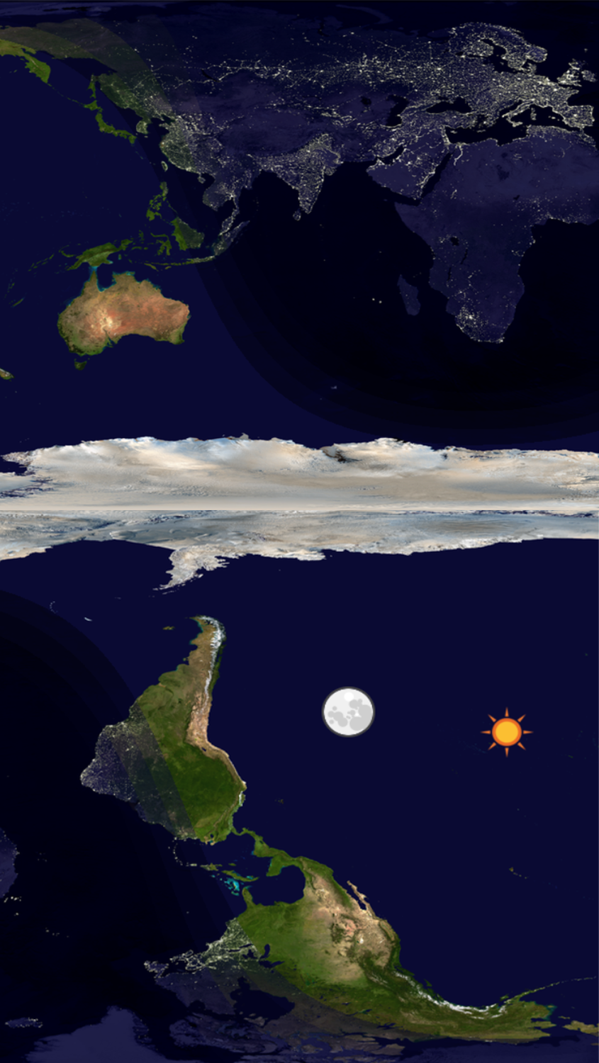
Image Warp
-12 -11 -10 -9 -8 -7 -6 -5 -4 -3 -2 -1
0 +1 +2 +3 +4 +5 +6 +7 +8 +9 +10 +11
(Photoshop)
OpenCV

Slide 9
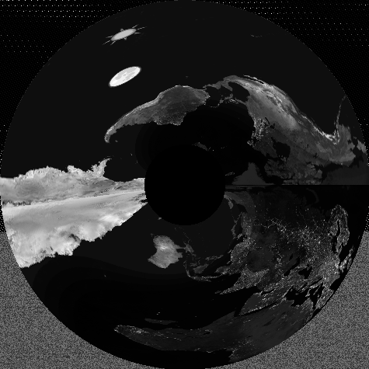
Image Warp *HW12
(Photoshop)
OpenCV
Cartesian -> Polar

Slide 10
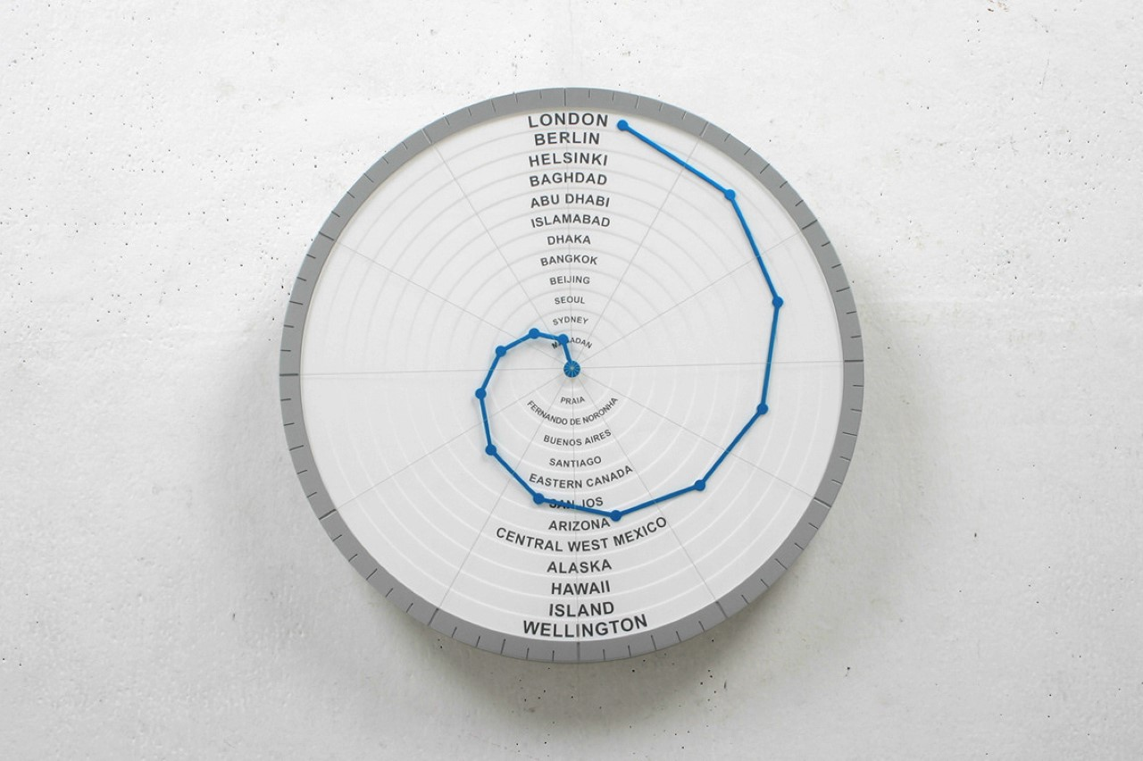
Spiral -> Cardioid design
numpy
matplotlib

Slide 11
Make a Clock Face

Slide 12
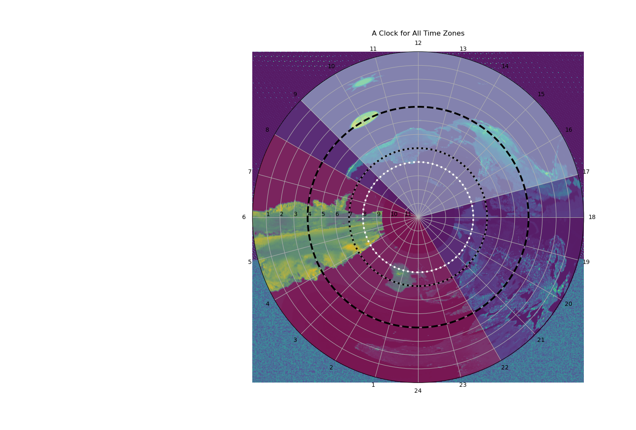
*HW4 floodfill
Work hour in lightblue
Sleep hour in red

Slide 13
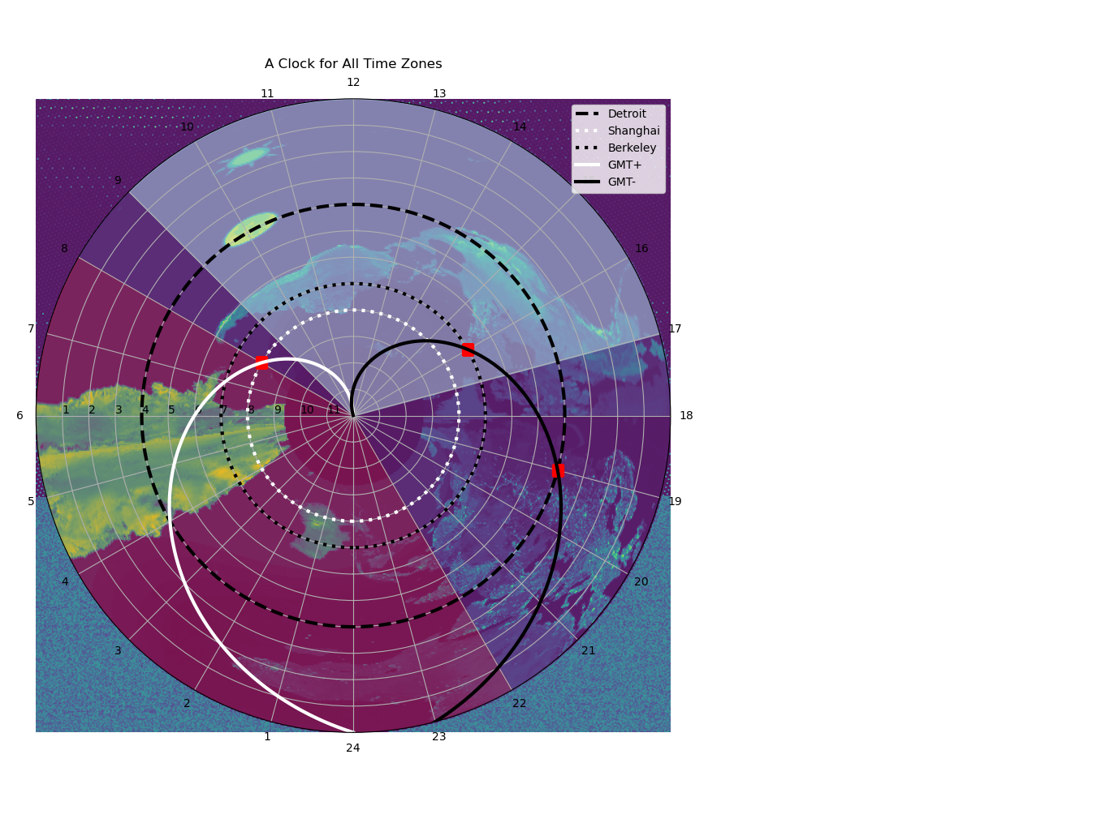
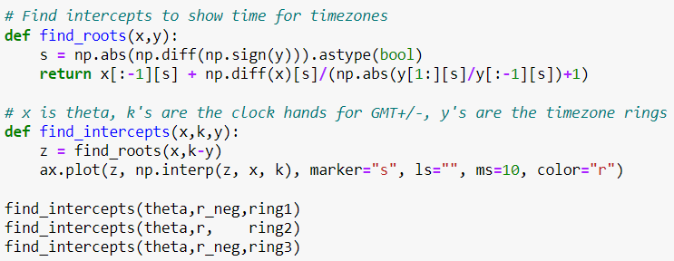
Cardioid Hands
Finding an equation for the opposite spiral
was like a riddle

Slide 14
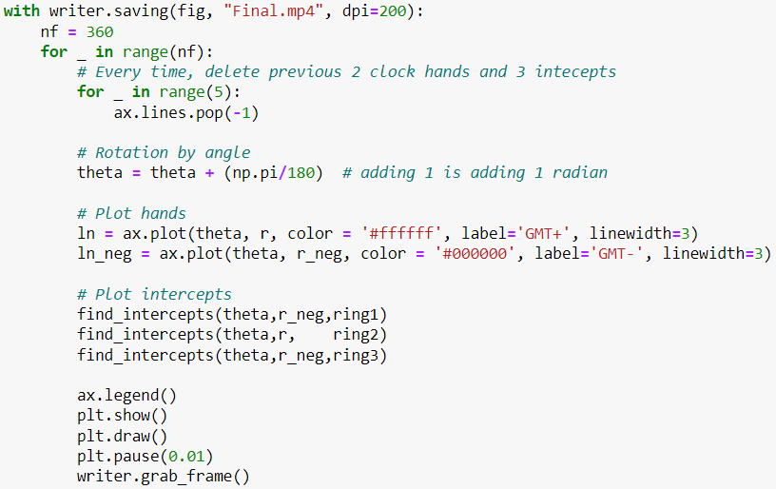
Clock animation *HW7

Slide 16
ERROR = not +=

Slide 17
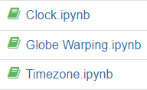
Bibliography
Run files in reverse order
https://github.com/jannikmi/timezonefinder
https://www.yankodesign.com/2022/04/22/genius-world-clock-uses-a-golden-spiral-to-show-the-time-in-every-single-time-zone-simultaneously/
https://docs.python.org/3/library/datetime.html#module-datetime
https://www.geeksforgeeks.org/get-current-time-in-different-timezone-using-python/
https://pypi.org/project/pytz/
https://stackoverflow.com/questions/59636600/removing-tool-bar-and-figure-title-when-using-jupyter-matplotlib
https://en.wikipedia.org/wiki/Cardioid
https://stackoverflow.com/questions/4981815/how-to-remove-lines-in-a-matplotlib-plot
https://stackoverflow.com/questions/16417496/matplotlib-fill-between-multiple-lines
https://stackoverflow.com/questions/23664646/fill-between-two-lines-in-polar-coordinates
https://stackoverflow.com/questions/62445303/how-to-fill-between-3-lines-in-a-polar-plot
https://stackoverflow.com/questions/43082637/reverse-radial-axes-of-matplotlib-polar-plot
https://stackoverflow.com/questions/46909373/how-to-find-the-exact-intersection-of-a-curve-as-np-array-with-y-0/46911822#46911822
https://stackoverflow.com/questions/68994736/opencv-inverse-warppolar-output-out-of-frame
https://stackoverflow.com/questions/50826119/matplotlib-version-1-5-3-vs-2-2-2-imshow-on-polar-axis
https://stackoverflow.com/questions/58367681/how-to-plot-polar-and-cartesian-subplot-in-one-plot-as-shown-in-picture

