Slide 1
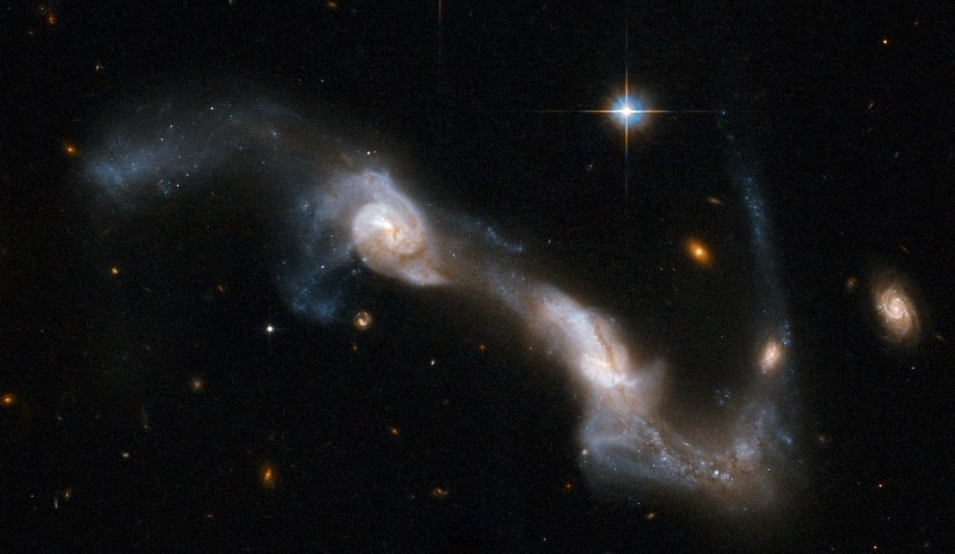
Galaxies Collide: Visualizing the Toomre-Toomre Model for Galactic Bridges and Tails
Cuong Bui
Image: http://mason.gmu.edu/~rpfeifle/research.html#

Slide 2
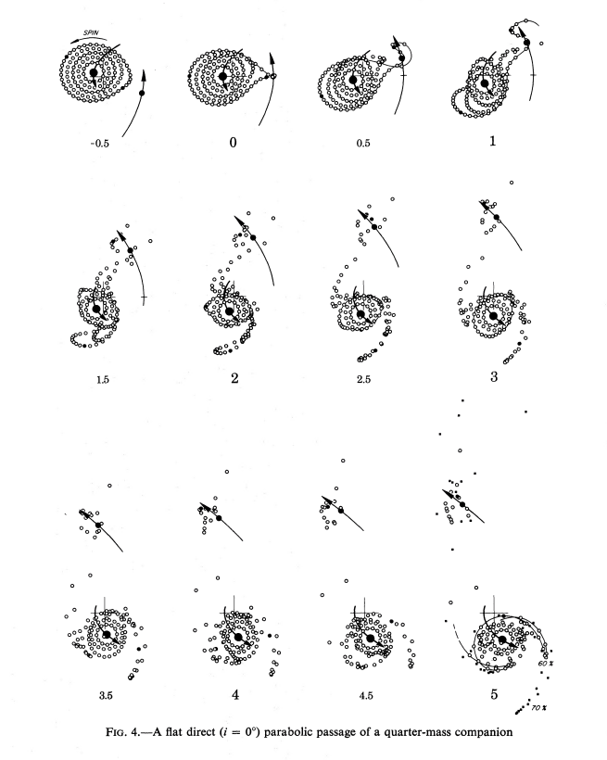
Toomre and Toomre Model
Tails and bridges formed through tidal forces during the close encounter of two galaxies.
Conditions:
The two galactic centers follow roughly parabolic trajectories counterclockwise of each other.
Orbiting stars spin counterclockwise.
Method of Simulating:
ODE
Fourth-Order Runge Kutta Method
N-body Orbit Simulation using Object Oriented Programming (star.py)
Toomre & Toomre, 1972

