Slide 1
Visualizing the orbits of all SpaceX Starlink Satellites
Will Minnis

Slide 2
What is Starlink?
SpaceX is an aerospace company owned by the world’s richest idiot
But the company has done some pretty cool stuff
They have launched a constellation of satellites (Starlink) to provide high speed, affordable internet service worldwide.
Currently have ~3,400 Sats in orbit

Slide 3
NORAD TLE Data
TLE Data is a standard format for specifying the orbital parameters and general information about satellites
http://celestrak.org/NORAD/elements/active.txt
STARLINK-1008
1 44714U 19074B 22331.81154500 -.00000201 00000+0 54127-5 0 9993
2 44714 53.0538 164.1038 0001579 77.9804 282.1361 15.06392890168209
STARLINK-1009
1 44715U 19074C 22331.80048404 -.00000428 00000+0 -98314-5 0 9996
2 44715 53.0538 164.1651 0001488 91.2388 268.8772 15.06394425168197

Slide 4
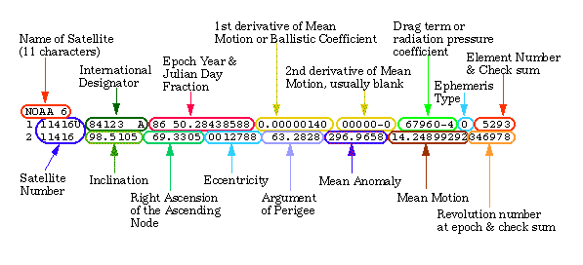
Decoding TLE Data

Slide 5
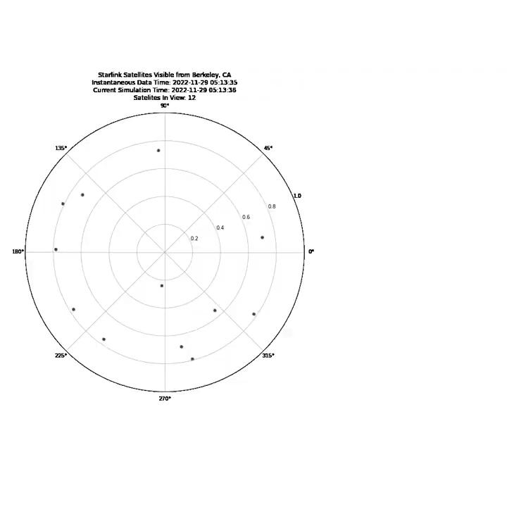
Satellites In Visible Range - Downtown Berkeley

Slide 6
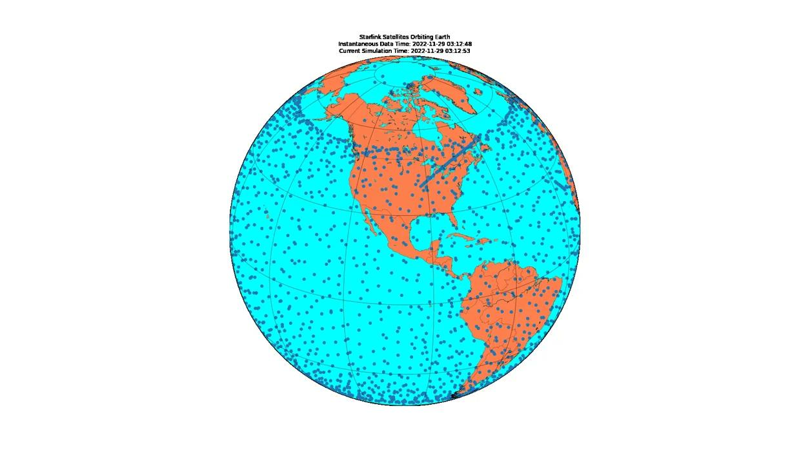
All Satellites in Constellation

