Slide 1
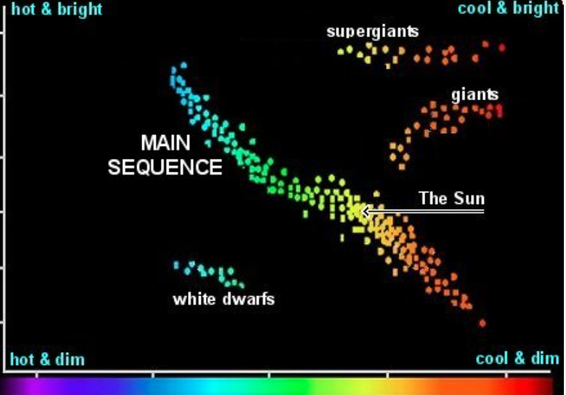
HR Diagram Simulations
Raphael Baer-Way

Slide 2
Methodology/Project
Investigating evolution of stars on HR diagram
Use MESA Stellar evolution tracks-roughly 200 mass tracks
Used MESA to read-in code
Iterate through 1000 ages from 50000 to 15 million years
Many masses-find closest time point in mass track for each iteration
Find associated R, T and L for index-np.searchsorted!-plot HR at every time
Varying metallicity-see effects-run each .ipynb file for each metallicity
Radius changes-red giants and blue WR stars-denoted by size of point
Most massive stars just become supernovae

Slide 3
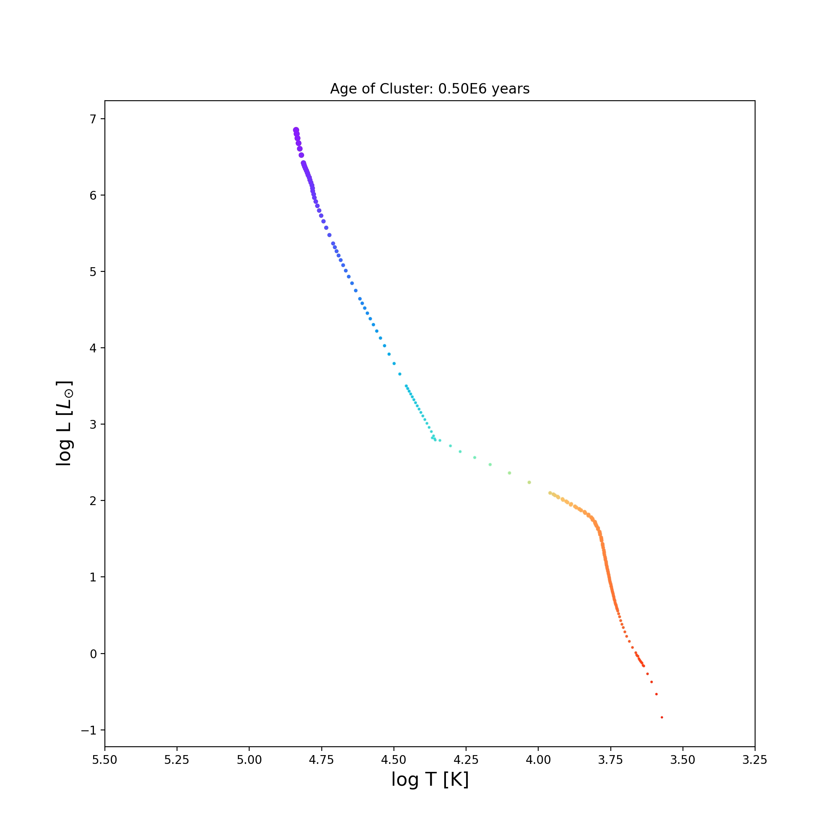
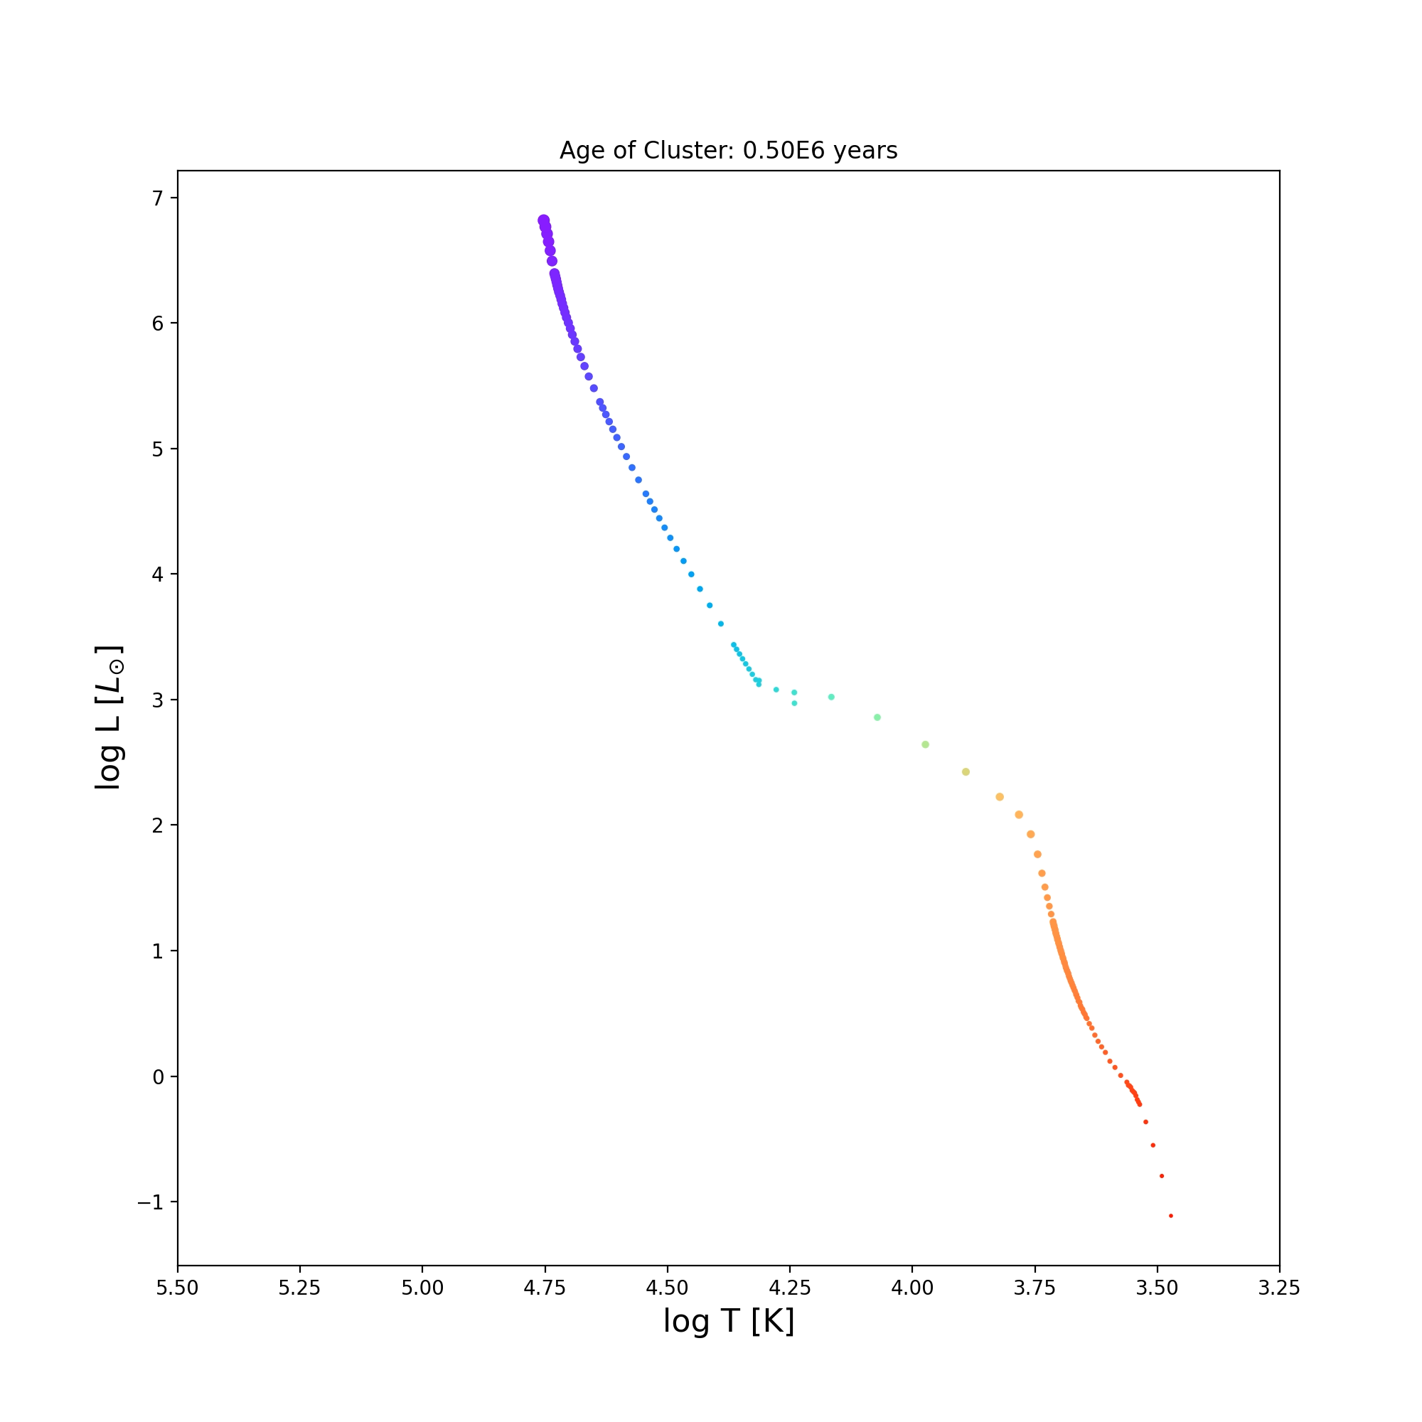
Animations
-4 Solar Metallicity
Solar Metallicity

