Slide 1
Space Debris Simulation
EPS 109
Bryce Casaje

Slide 2
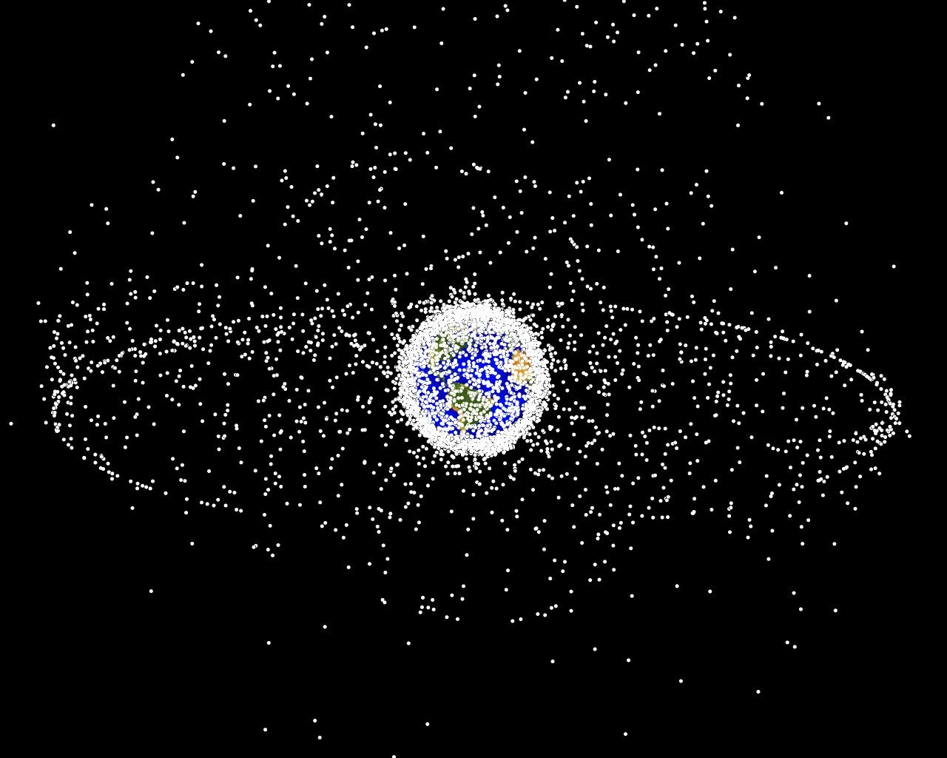
Space Debris Project
Goal: Show the level of space debris and satellites in Earth's orbit over the years
Why: I've heard scientists talk about space debris/space junk, and the dangers that it causes to all spaceflight. I’ve seen pictures, but I think it would also be cool to see how Earth’s astral environment has evolved over time.
Some space debris facts:
According to NASA, there are millions of pieces of space junk flying in low earth orbit, with some reaching speeds of 18,000 mph (7x faster than a bullet)!
There are approximately 23,000 pieces of debris larger than a softball orbiting the Earth
Low earth orbit is the "World's largest garbage dump"
Many of these orbital pieces can damage spacecrafts, even the small ones since they're at such high velocities

Slide 3
Methods (Graphical)
I wanted to model this in 3D, with a 3D model of the Earth and rings around it corresponding to orbits.
To do this, I used Panda3D, an open-source framework for 3D rendering & games, which has a Python implementation.

Slide 4
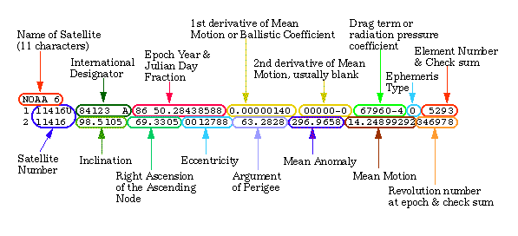
Data
One of the harder parts of this project was finding the data to use. I ended up using orbital data in a format called “TLE”: two-line element set.

Slide 5
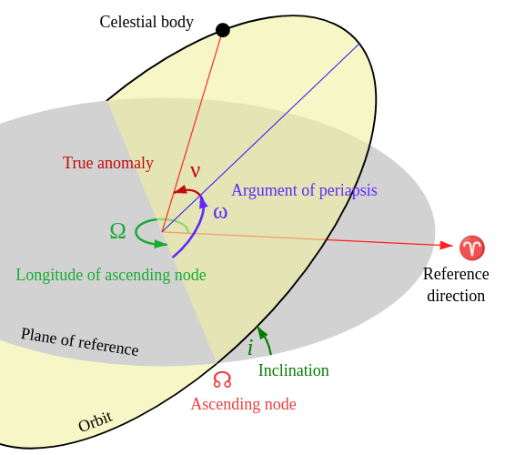
TLEs
TLEs are a data format used to encode details of orbital elements for a given point in time called the epoch (usually for Earth-orbiting objects). You can get these TLEs from places like the NORAD website, CelesTrak, Space-Track (DoD)...

Slide 6
Methods (Analytical)
When working with TLEs, you're supposed to use some specific set of mathematical models (the main one being SGP4), for which there are implementations in Python. However, I did not use this for three reasons:
I wanted to implement the math myself, not just use a library
To understand SGP4 you need to either read a 94 page research paper or understand the libraries that implement it (but they’re literally thousands of lines)
These models aren’t perfect anyway, having 1-3km of error per day
So instead, I did my best to convert the TLEs into the traditional Keplerian element set, fully knowing that this would increase the amount of error. Since the goal was not to accurately plot the orbits but to get a sense of how space debris has been increasing over time, I thought this was a worthwhile trade-off.

Slide 7
Animations

Slide 8
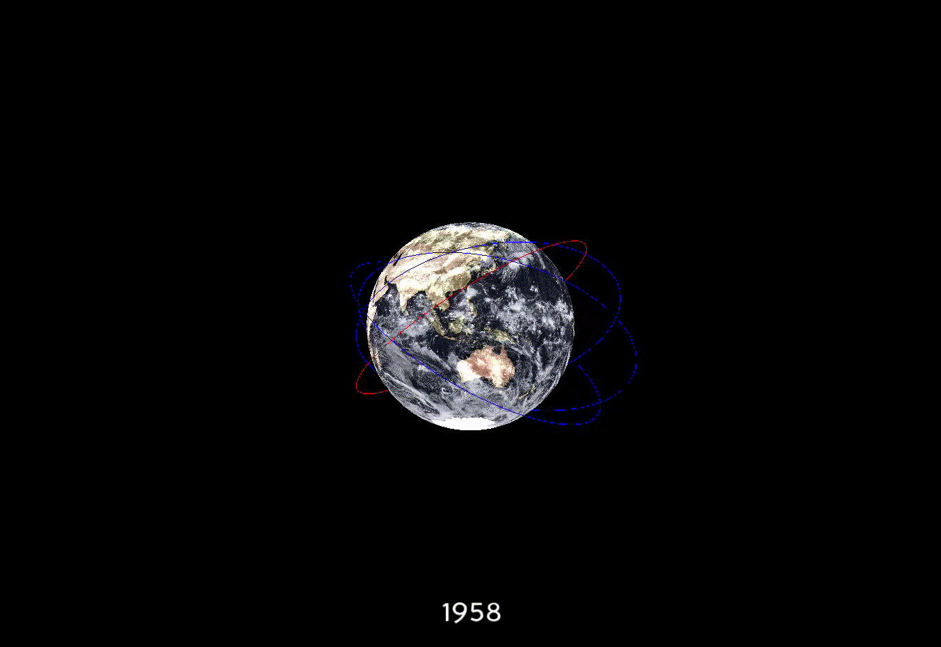

Slide 9
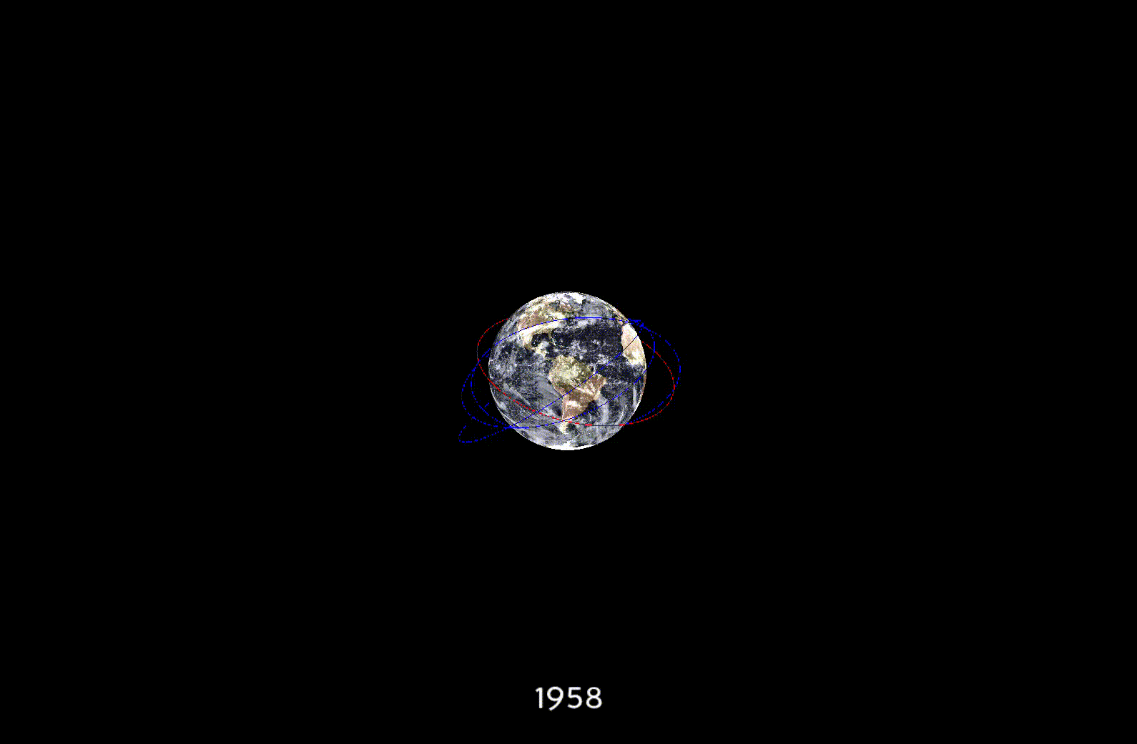

Slide 10
Live Demo?

Slide 11
Future Work / Limitations
Implement the SGP4 perturbation model to hopefully reduce the amount of error
Get a better source of TLE data (my simulation only shows debris/satellites that are still active today, so historically it would have been much more than my simulation)
Try other root-finding methods besides Newton-Rhapson

Slide 12
Thank you!

Slide 13
Sources
https://www.nasa.gov/centers/hq/library/find/bibliographies/space_debris
https://www.nasa.gov/mission_pages/station/news/orbital_debris.html
https://miro.medium.com/max/1194/1*dYa0T_eg6DZa03Hv9OHaCw.png
https://blog.hardinglabs.com/tle-to-kep.html
https://www.panda3d.org/
https://github.com/pytroll/pyorbital/
https://github.com/Elucidation/OrbitalElements
https://github.com/RazerM/orbital

