Slide 1
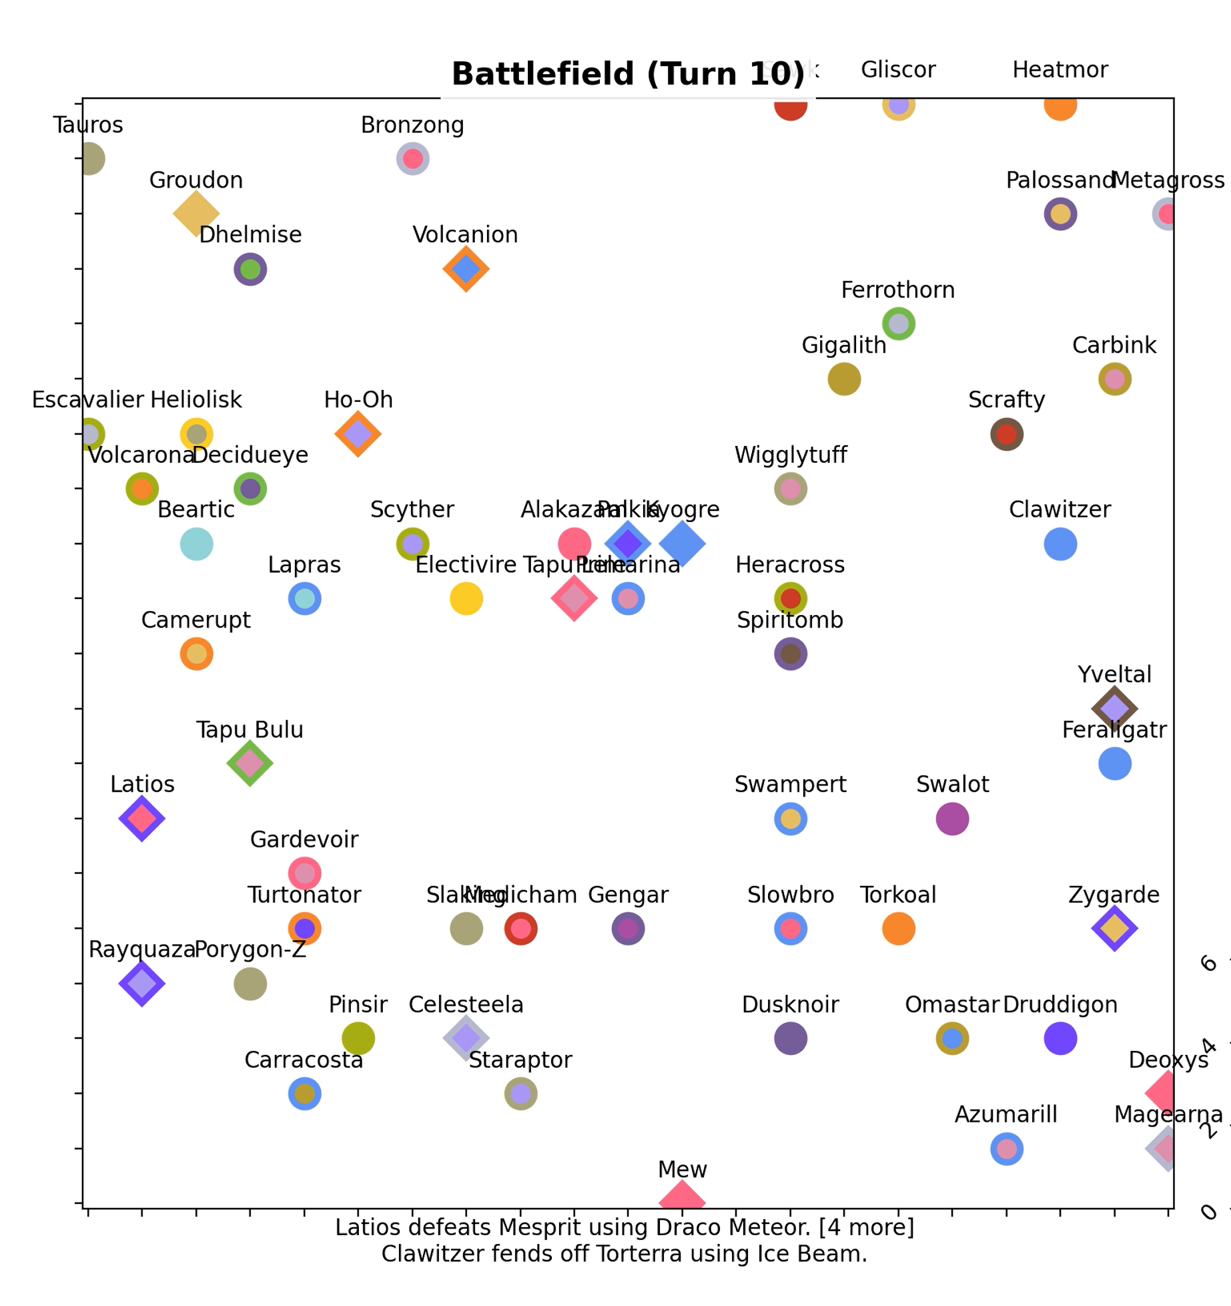
The Strongest Pokemon
George Liu
EPS 109
30 November 2022

Slide 2
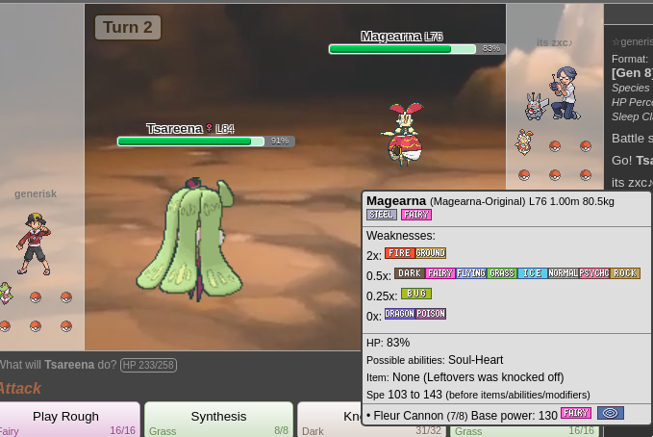
Pokemon
friendly competition between creatures
turn-based combat
can have slightly mind-bending complications
Type matchups, abilities, attack side effects, status moves, stats, IVs, EVs, natures, status conditions, switching/entry hazards, held items, etc. [insert more professional strategy stuff here]
Question: What kind of Pokemon wins in a free-for-all brawl?
A hypothetical contest of pure raw damage output – who’s the best?
Suppose we put a bunch of Pokemon on a big battlefield and find out

Slide 3
Random Walk + Simplified Battle Logic
For each Pokemon on the field, in order from fastest to slowest (one move per “turn”):
1. A ambushes D: The attack is so strong the defender cannot survive. A wins and takes the position; D is removed from the field.
A
D
A
D
2. A defeats D: The defender survives and uses a move back, but deals less damage in return. A wins and takes the position; D is removed from the field.
A
D
If chosen move goes to an occupied square, decide a one-turn battle between the attacker and defender.
Attacker A first uses a move.
Choose randomly to
move one step in any of four directions
(or possibly stay put, if Pokemon has speed below average)
A
D
3. D fends off A: The defender survives and uses a move back, doing more damage in return. A loses and is removed from the field; D keeps its position.

Slide 4
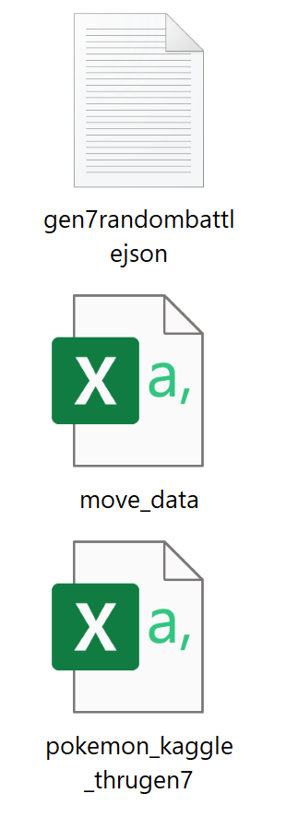
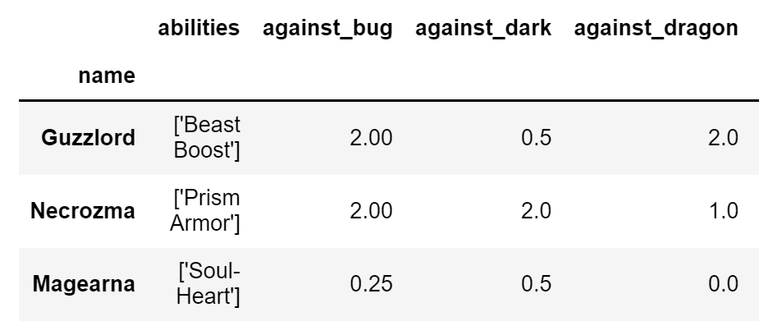
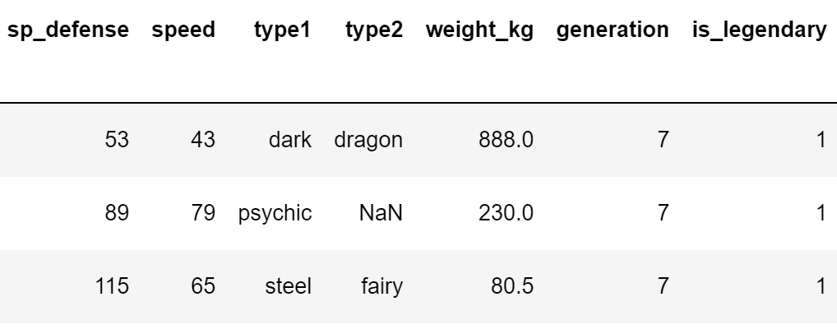
Extra Resources
400+ relatively strong Pokemon and the moves they typically use
From Pokemon Showdown https://github.com/pkmn/randbats/tree/main/data
Move data including type and power
From https://bulbapedia.bulbagarden.net/wiki/List_of_moves
Obtained with help from https://www.datacamp.com/tutorial/web-scraping-using-python
Pokemon data including base stats, typing, and type weaknesses/resistances
From https://www.kaggle.com/datasets/rounakbanik/pokemon
Color palette from https://gist.github.com/apaleslimghost/0d25ec801ca4fc43317bcff298af43c3
pandas library to read files and clean/manage data
…
…

Slide 5
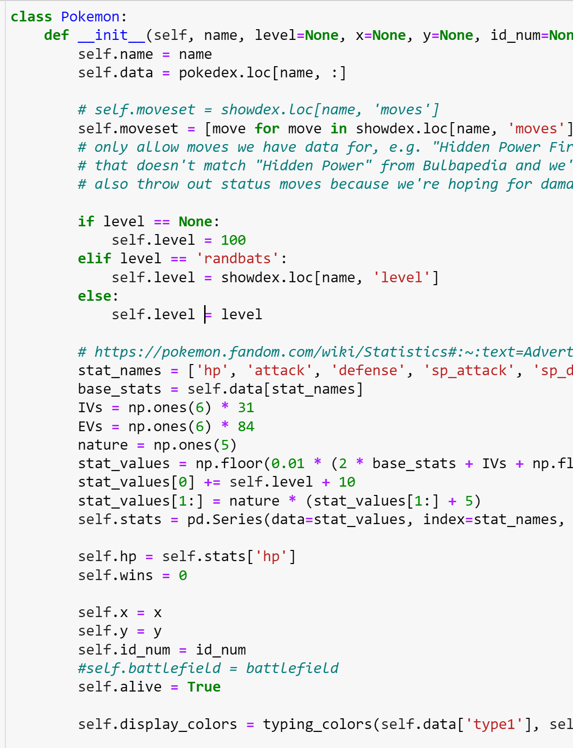
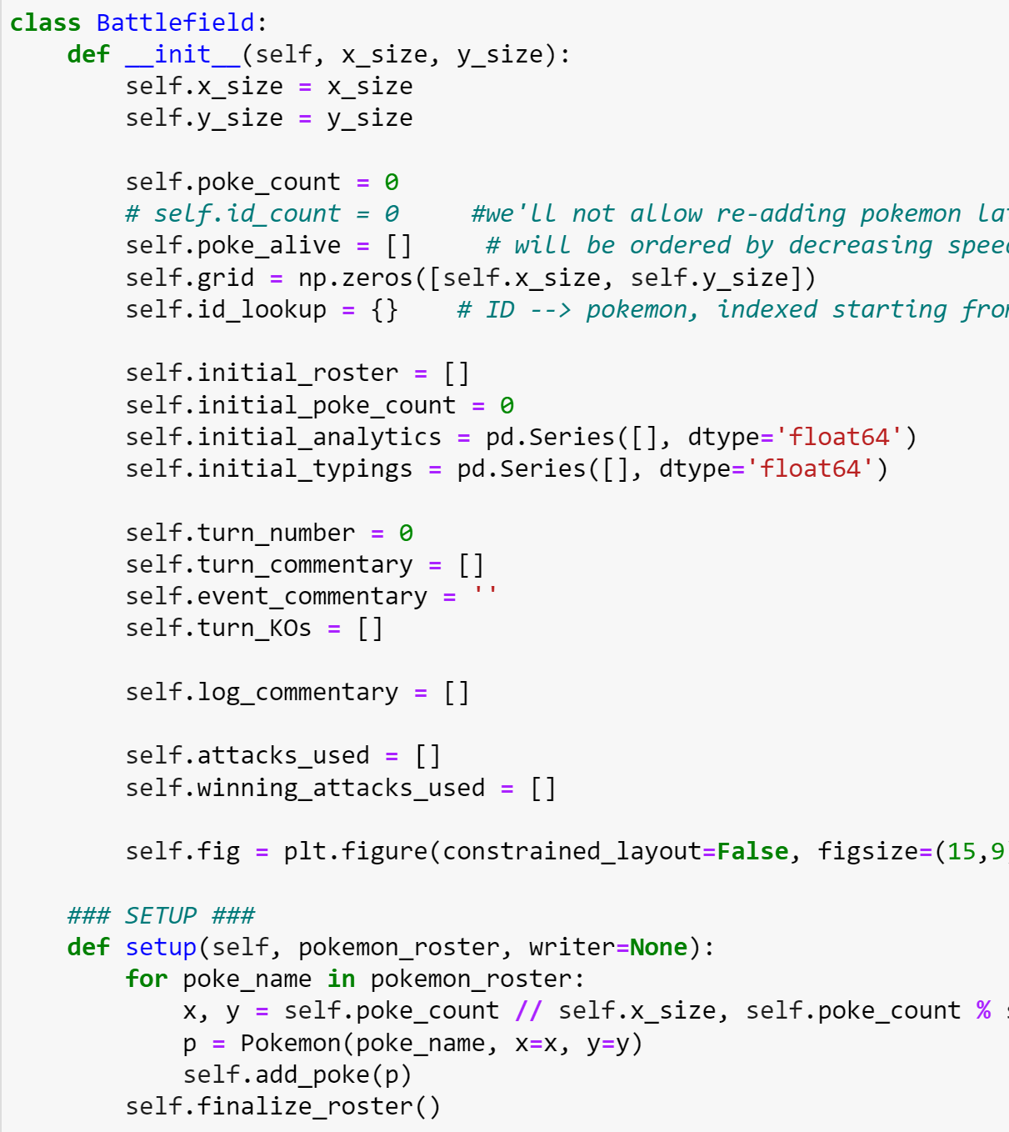
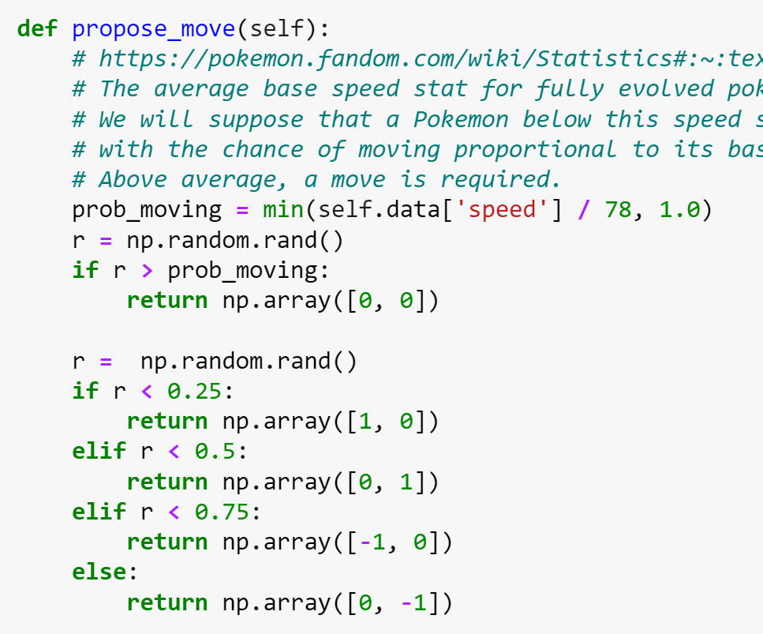
Implementation
Pokemon class Battlefield class Random walks
… …

