Slide 1
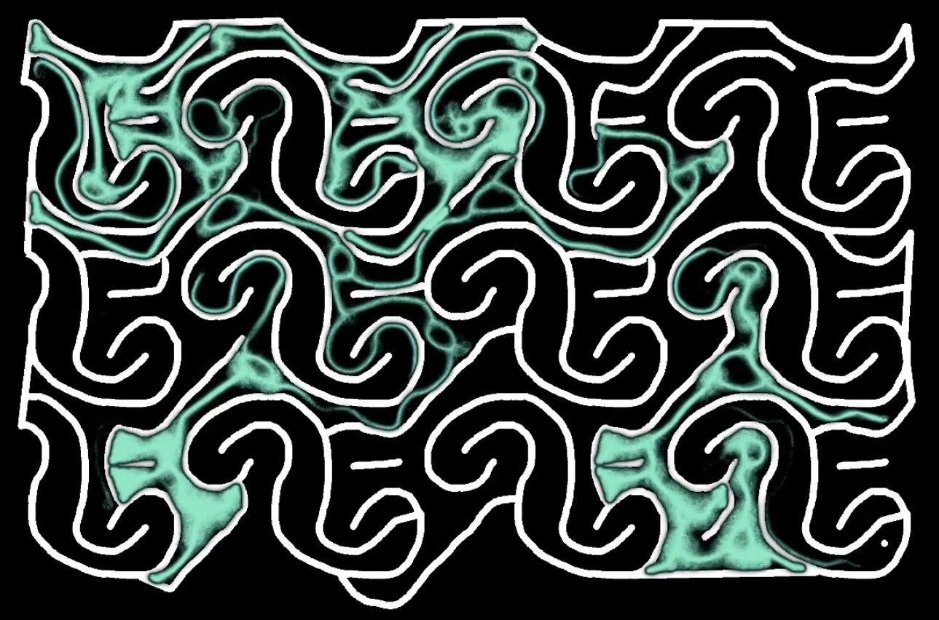
Physarum Slime Mold: Nature’s Living Computers
By Anish Shanbhag

Slide 2
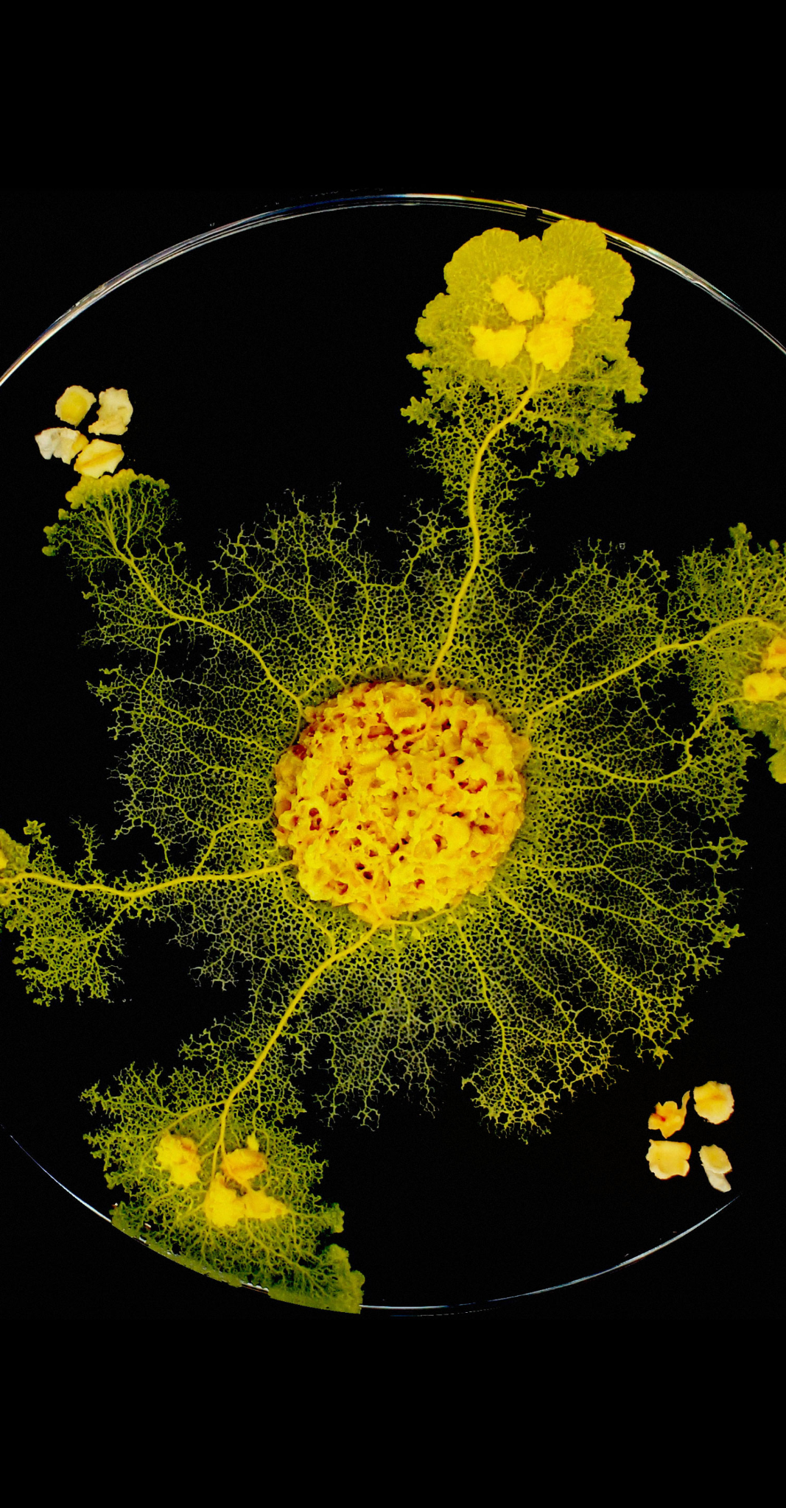
Physarum and Its Properties
Single-celled organism which feed on decaying material
Can be simulated by very simple rules:
Represent the mold with thousands (or millions) of tiny “particles”
At each step each particle senses which direction around it has a higher concentration of other particles, and turns to move that way
If there’s a tie, then it just picks randomly

Slide 3
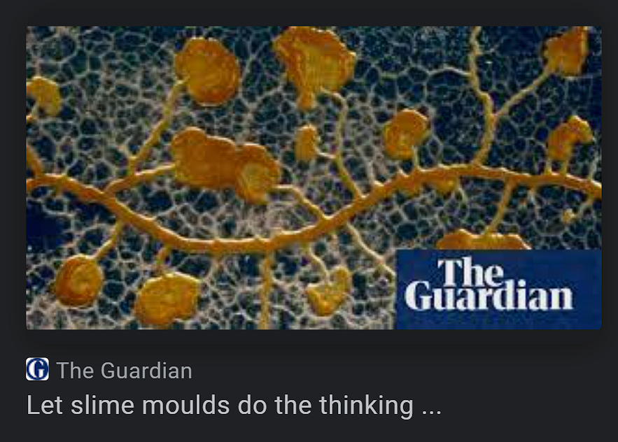
This behavior is pretty intuitive but it leads to highly complex behavior
Ability to pathfind around obstacles
Web-like structure that expands and morphs as the Physarum “explores” new areas
Can be considered a biological “computer” due to these unique behaviors
Valuable organism for study

Slide 4
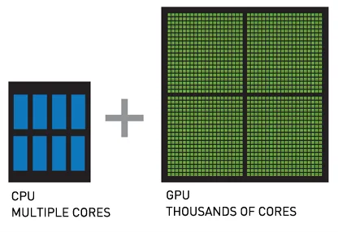
Simulation Methods
Utilizing the concept of random walks and pixel graphics from class
Need to simulate 100s of thousands or even millions of particles - infeasible with regular Python programming
Used GPU programming with CUDA + Numba Python library
Also used VisPy instead of Matplotlib for performance
Custom mazes/environments created from image files
Run with “python simulate.py” (Jupyter notebooks don’t work super well with VisPy)

