Slide 1
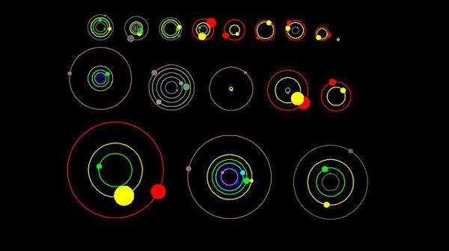
Exoplanet Orbit Simulation
NASA
Nadia Laswi

Slide 2
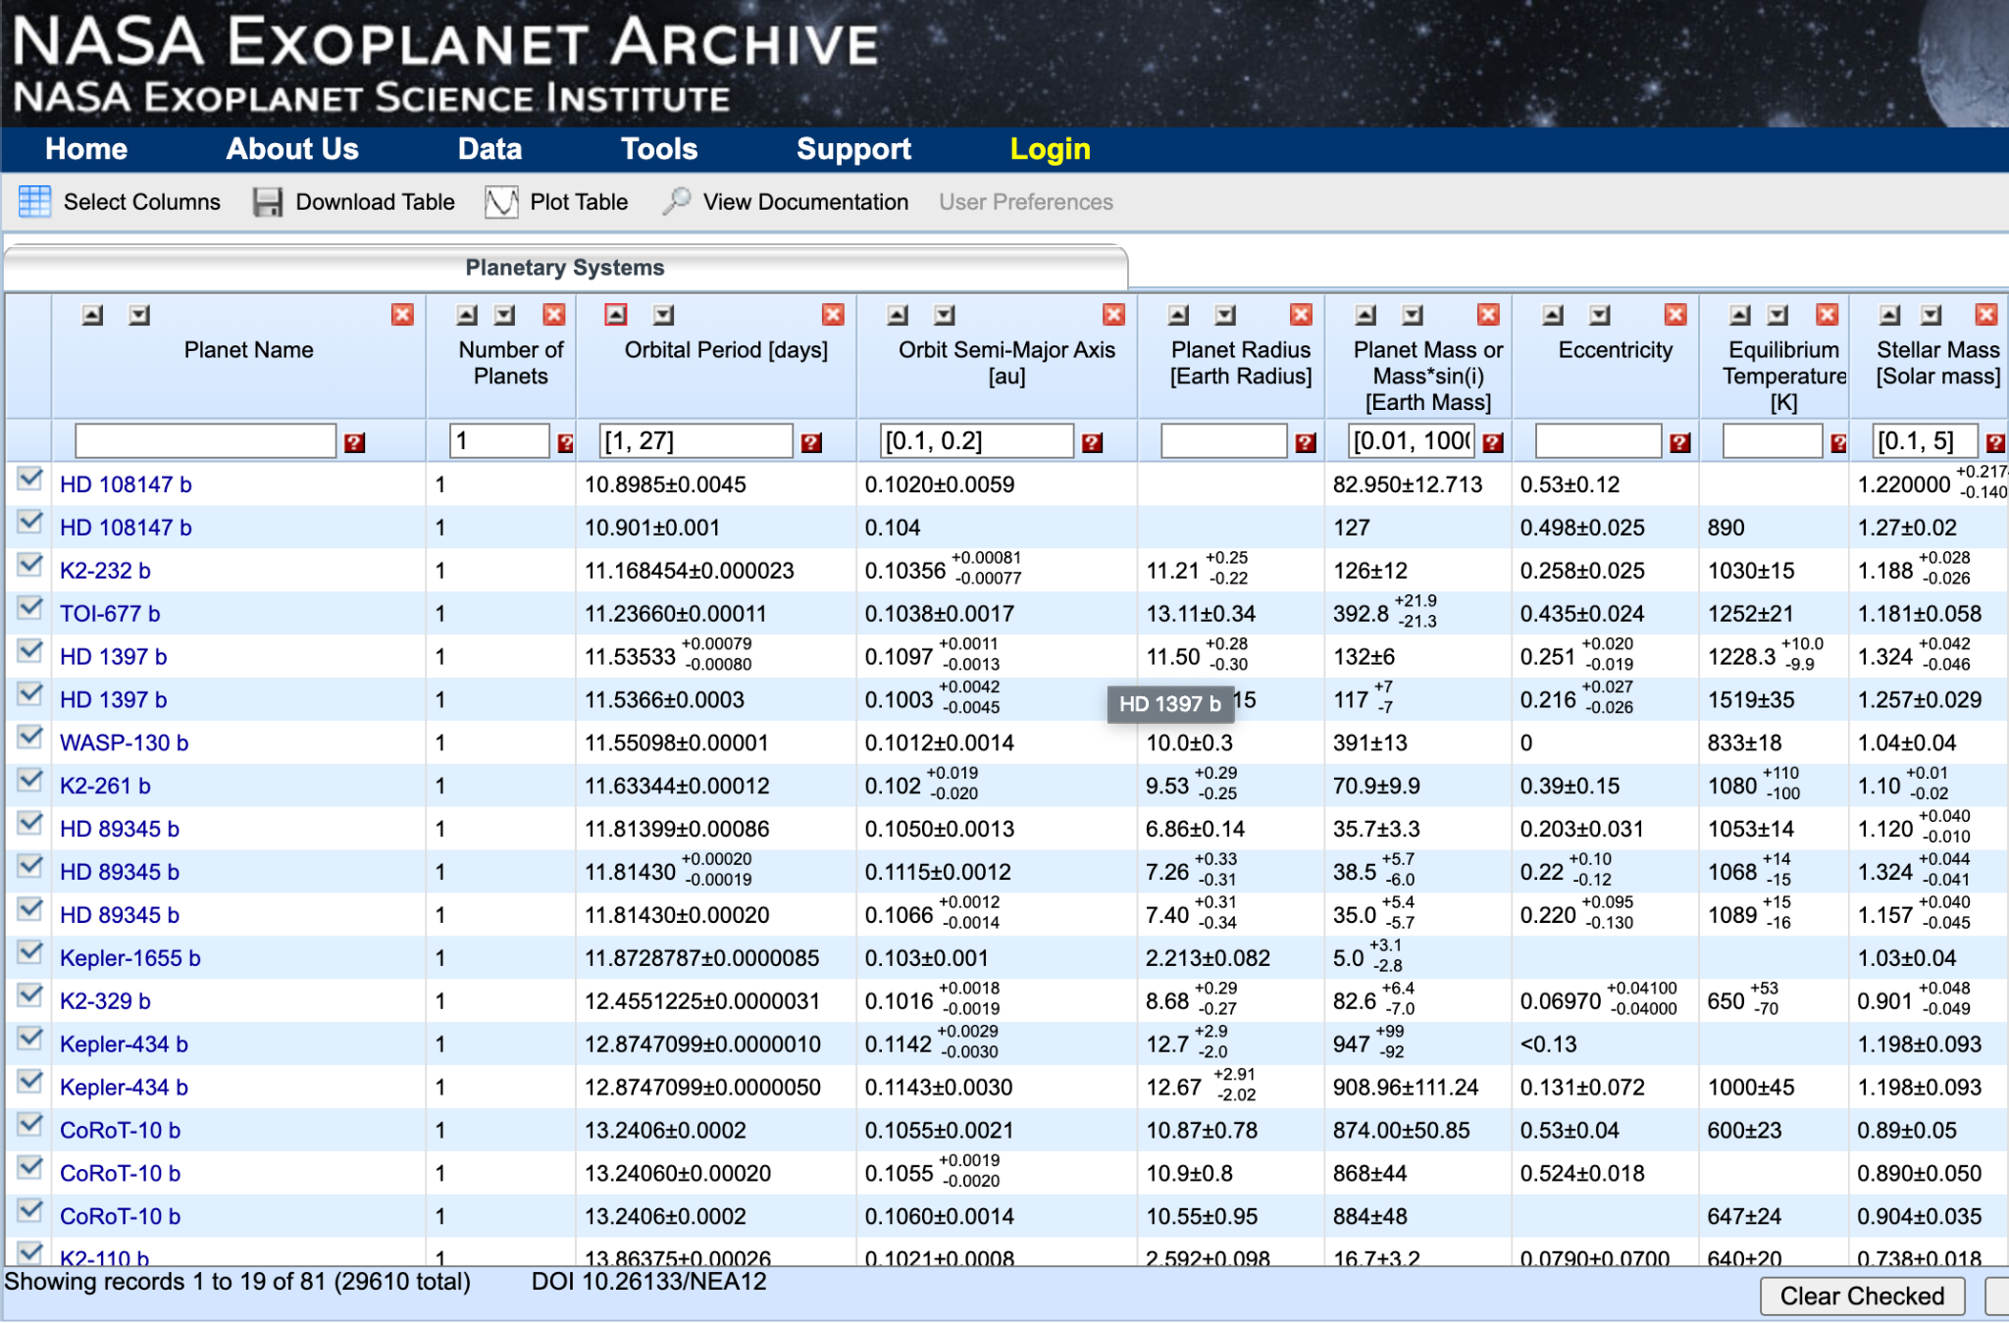
Method
Data from NASA’s Exoplanet Archive
Filtered through data
Forces simulated through KeplerODE function
https://exoplanetarchive.ipac.caltech.edu/cgi-bin/TblView/nph-tblView?app=ExoTbls&config=PS&constraint=default_flag=1

Slide 3
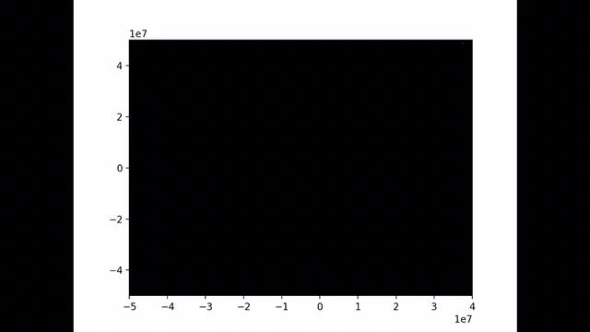
Result

