Slide 1
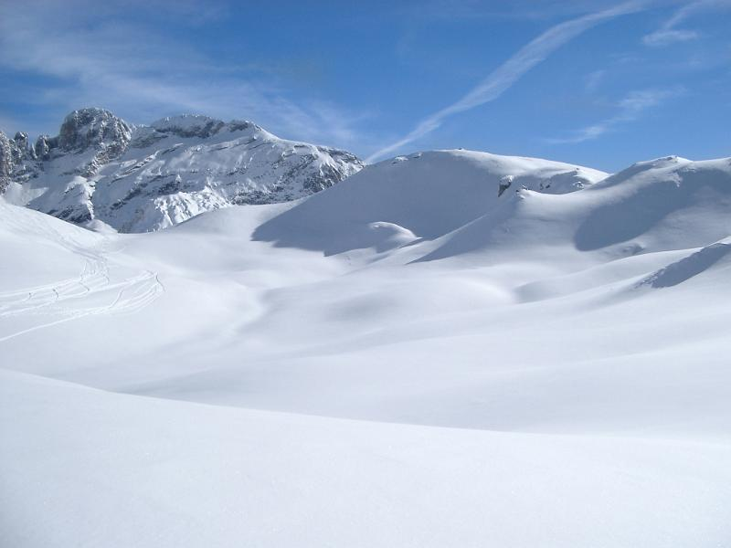
Random SnowFall
By Alan
This Photo by Unknown Author is licensed under CC BY

Slide 2
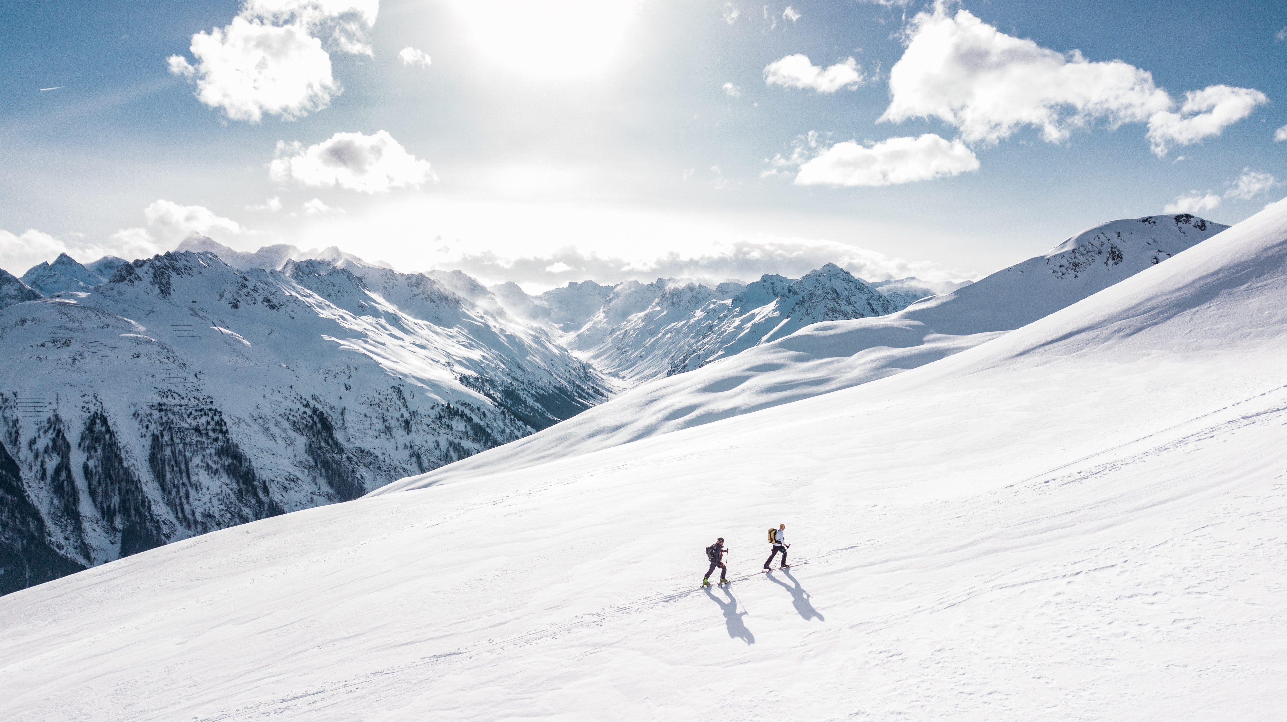
Methods
I incorporated DLA and random walk to have these “snowflakes” start and end up in random positions
I created functions that I implemented to check boundary conditions, incorporate randomness, and allow them to stack on top of each other
The first video shows what it looks like for five pieces of snow to fall
The second video will be the accumulation of snow building up

