Slide 1
The Erosion of Mt. Whitney
(Highest Peak in Contiguous U.S.)

Slide 2
In 40,000yrs…
Which Will Be Higher?
Currently:
Currently:

Slide 3
Simulation Methods

Slide 4
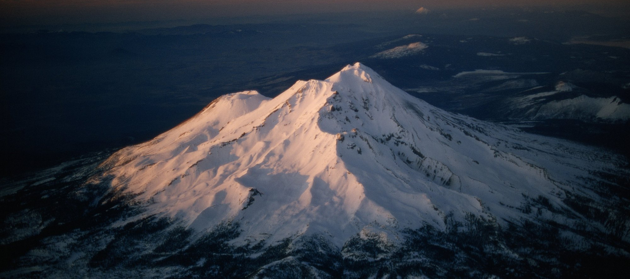
…Mt. Shasta Could be Higher!

Slide 5
Mt.Whitney:

Slide 6
Works Cited
U.S. Department of the Interior. (n.d.). Geologic activity. National Parks Service. Retrieved November 28, 2021, from https://www.nps.gov/moru/learn/nature/geologicactivity.htm.
How to read a topo map. How to Read a Topographic Map. (n.d.). Retrieved November 28, 2021, from https://www.rei.com/learn/expert-advice/topo-maps-how-to-use.html.
Images. Shutterstock. (n.d.). Retrieved November 28, 2021, from https://www.shutterstock.com/search.
P. Blair.National Geographic.Getty images; Mt. Shasta

