Slide 1
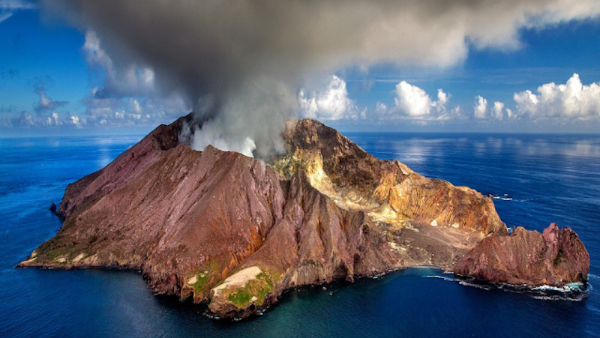
Erosion of Volcano Arcs
By Nelly Perez

Slide 2
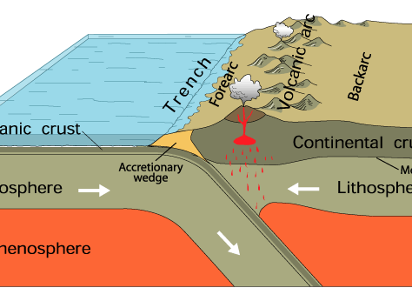
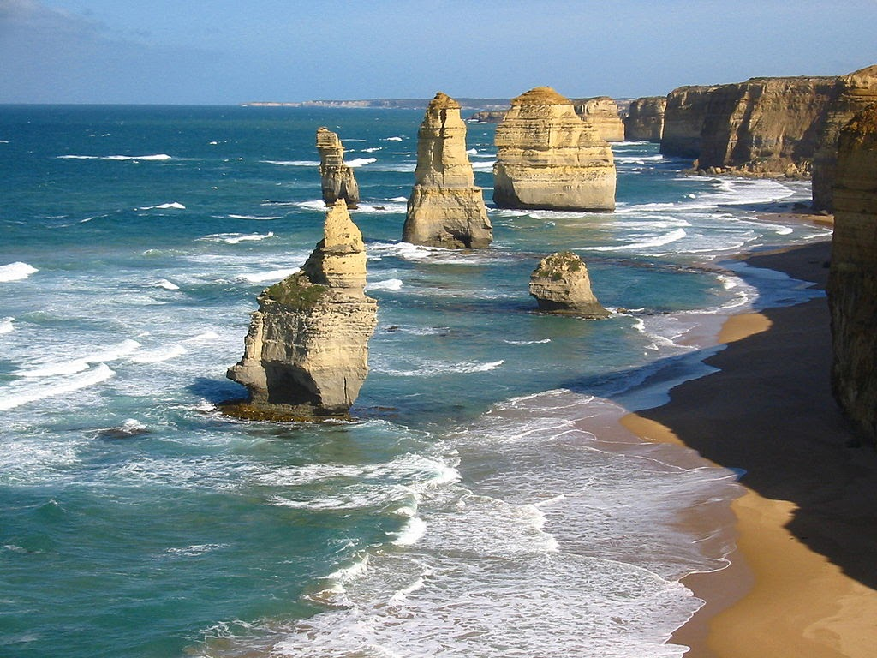
Volcano Arcs
Chain volcanoes formed from subducting plates
Many are found near the ocean along oceanic plates
Simulation has volcanoes near the ocean and will represent Hydraulic erosion
Number of iterations: 2000
Parameters: K = 3.0e-6
D = 0.005 # m^2/yr

Slide 3
Simulation

