Slide 1
Binary Star system
Yelinqing Shan

Slide 2
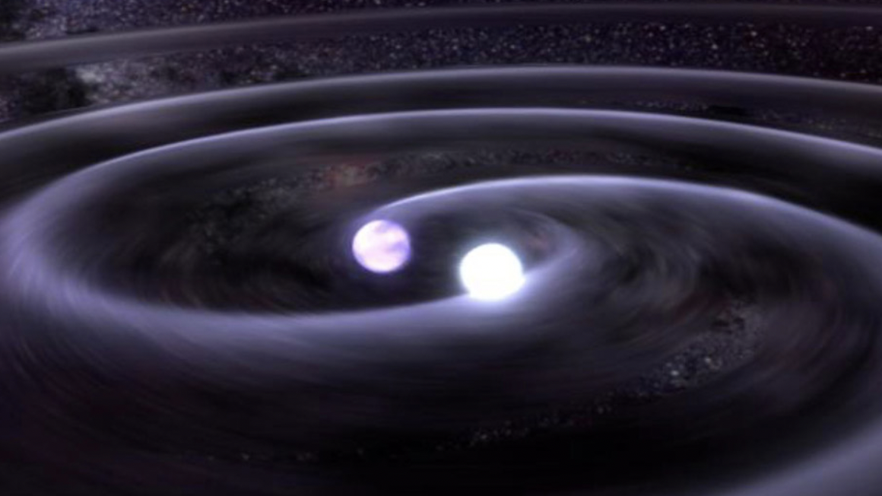
Introduction:
Two stars rotate about their center of mass
Most stars are in binary star system
Same period of orbiting
Image from: https://www.space.com/22509-binary-stars.html

Slide 3
Formulas

Slide 4
My simulation - Original

Slide 5
Second Simulation

Slide 6
Deorbiting

Slide 7
References
https://www.space.com/22509-binary-stars.html
https://www.youtube.com/watch?v=gph39sMrlM4

