Slide 1
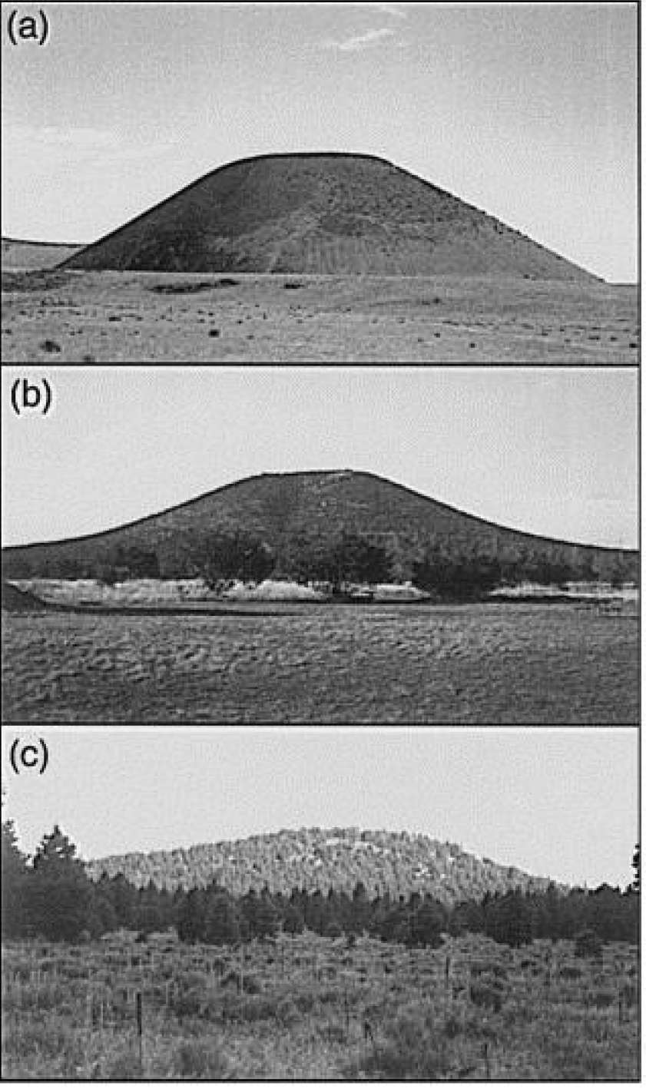
Computer-simulation models of scoria cone degradation
Peng Wang
EPS 109
(Hooper, Sheridan)

Slide 2
Reference Hooper, Donald M., and Michael F. Sheridan. "Computer-simulation models of scoria cone degradation." Journal of Volcanology and Geothermal Research 83.3-4 (1998): 241-267. Homework and lab 9 Perron et al., 2008
Uplift: 0 mm / year
Timescale: 0 to 80,000 years
Diffusion coefficient = 0.0214 m^2/yr
Cone Ratio (height/width)

Slide 3
Low ratio

Slide 4
High ratio

